Slide 1
Who are We?

Slide 2
Don’t worry though because Multiverse of Health will put your mind at ease

Slide 3

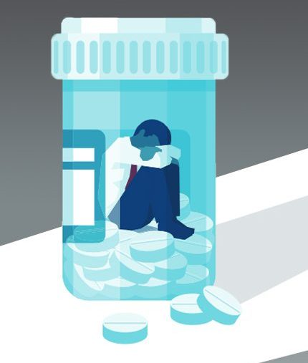
UN SDG goals
Good health and well-being for all at all ages. UN indicator alignment: 3.5.1, 3.4.2, and 3.8.1
Mission:
To offer affordable, automated and remote mental health counseling services to Generation Z of Vietnamese.
3.5.1
3.4.2
25%
Vision:
To establish as the top psychiatry counseling application for Generation Z.
Meditech
4.1%
SUD
Decrease suicide rate among 10.000 gen Z

Slide 4
Inadequacy in mental health healthcare
41
psychiatric hospitals in 63 provinces
satisfying the needs of only 20%
This has challenged psychiatrists who want to maintain high-quality support for patients. This is corresponding to 3.8.1 UN goal

Slide 5
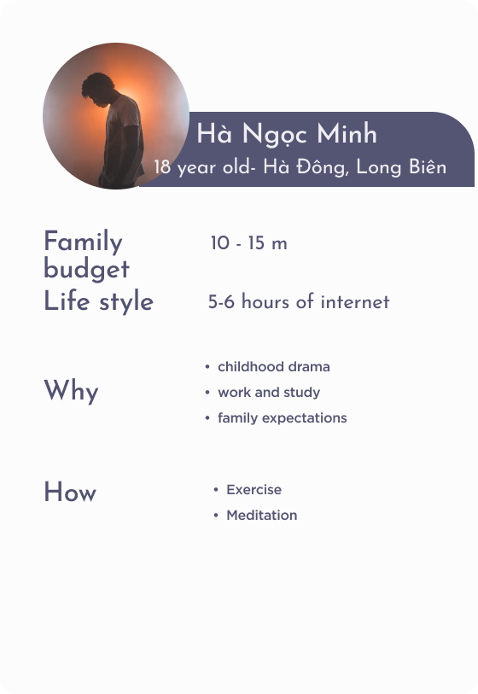
Target social issue
B2C
725-850 USD/month
1. Generation Z
(From 15 to 24 years old)
B2B
2. Psychologists

Slide 6



Target social issue
UNICEF, 2018:
3M
04 main root causes of targeted social issue:
Personal
Family
School
Community
Vietnamese teenagers
8% - 29%
For children and adolescents
20% +
Receiving proper treatment

Slide 7
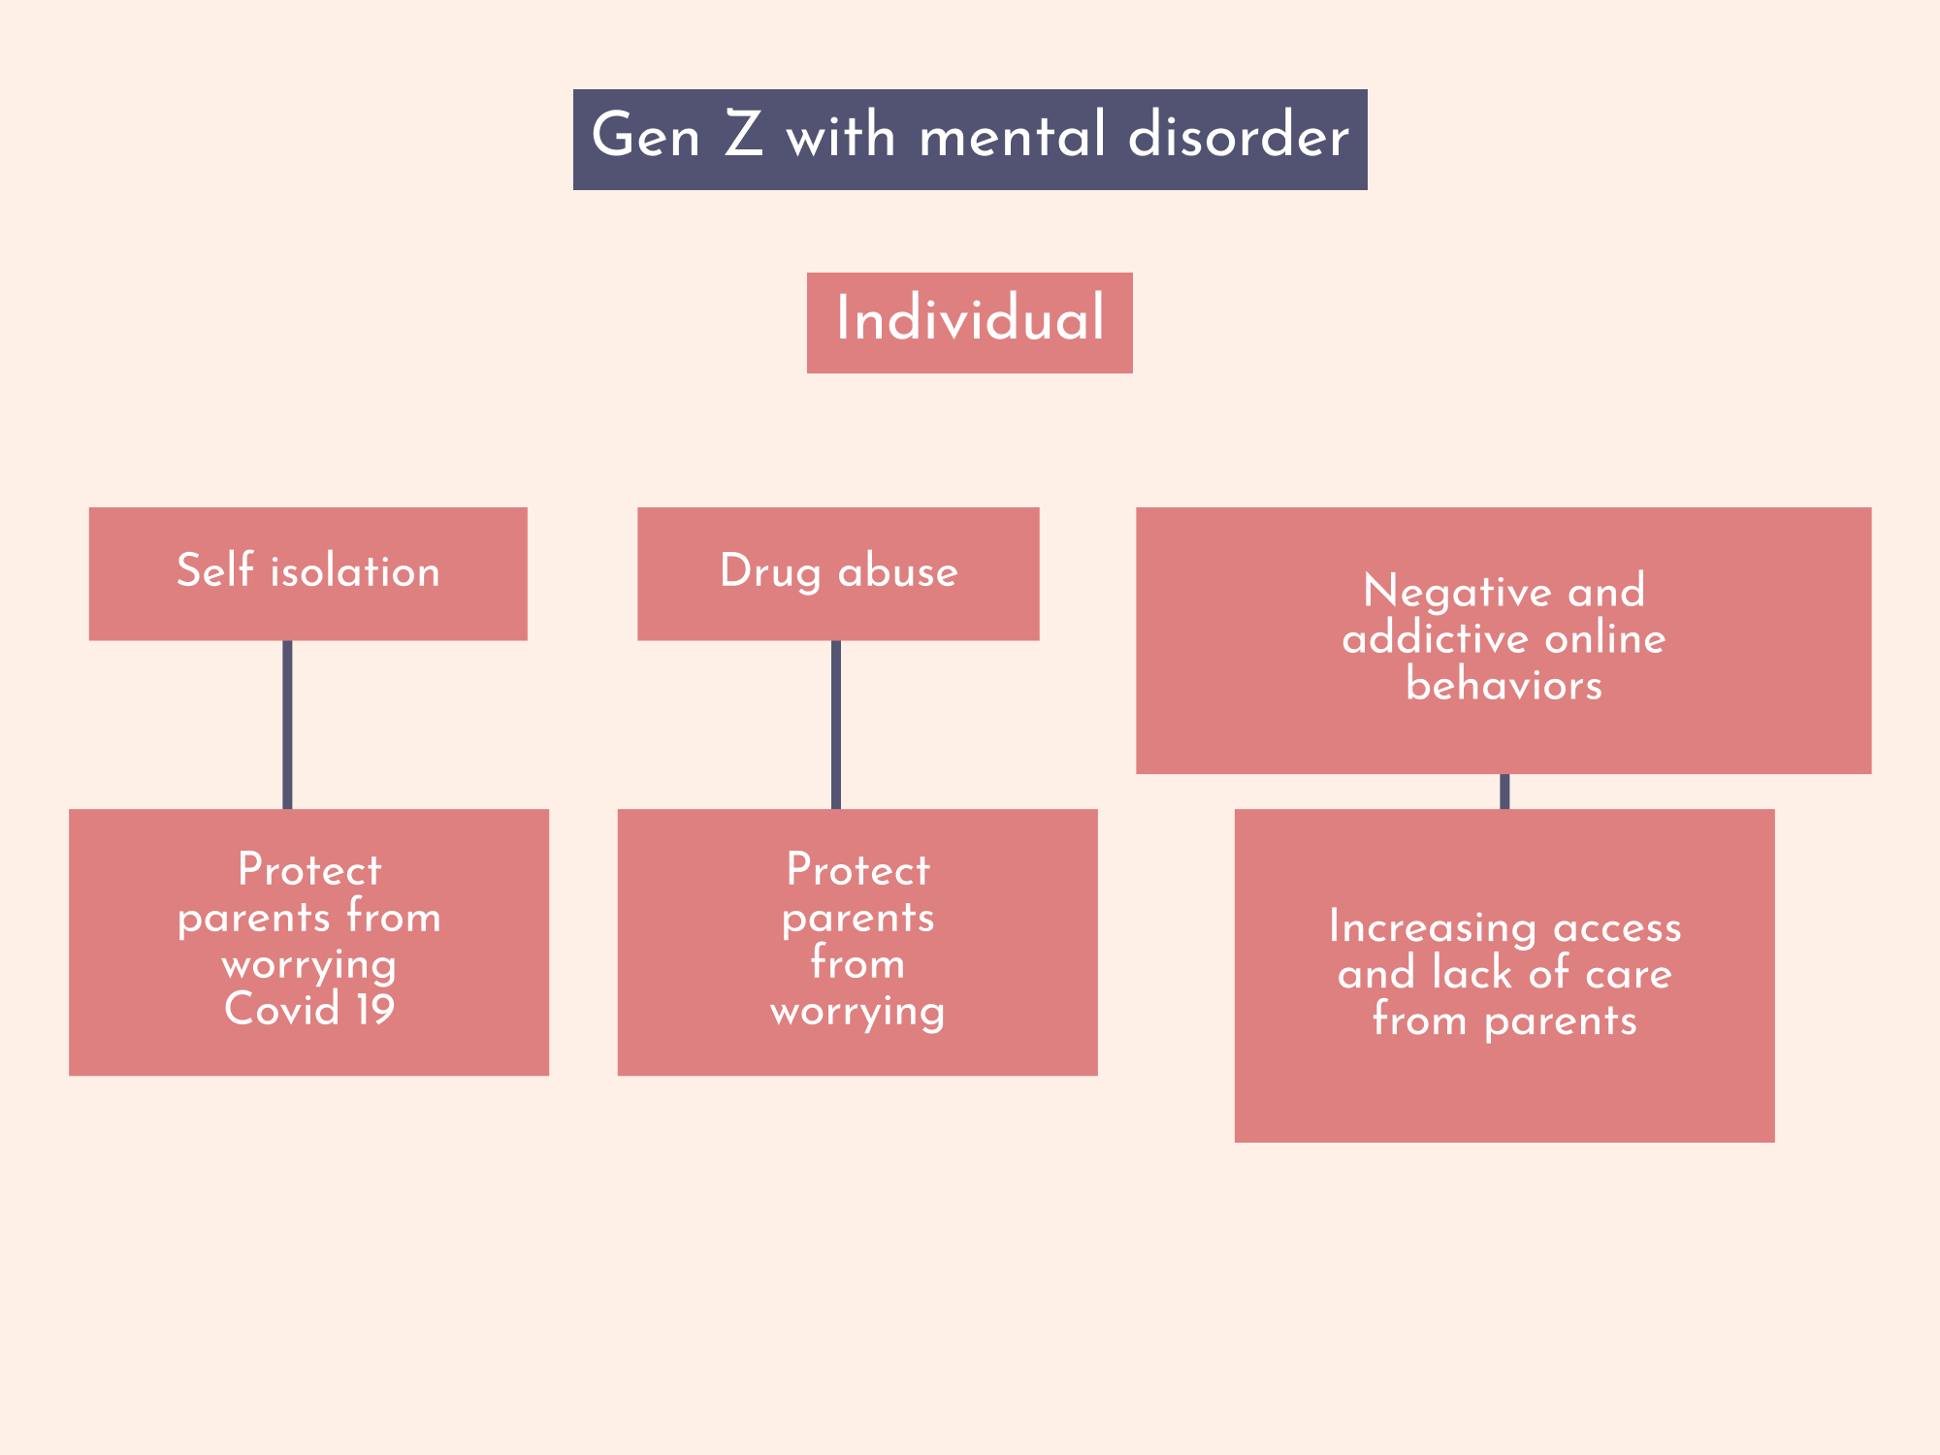
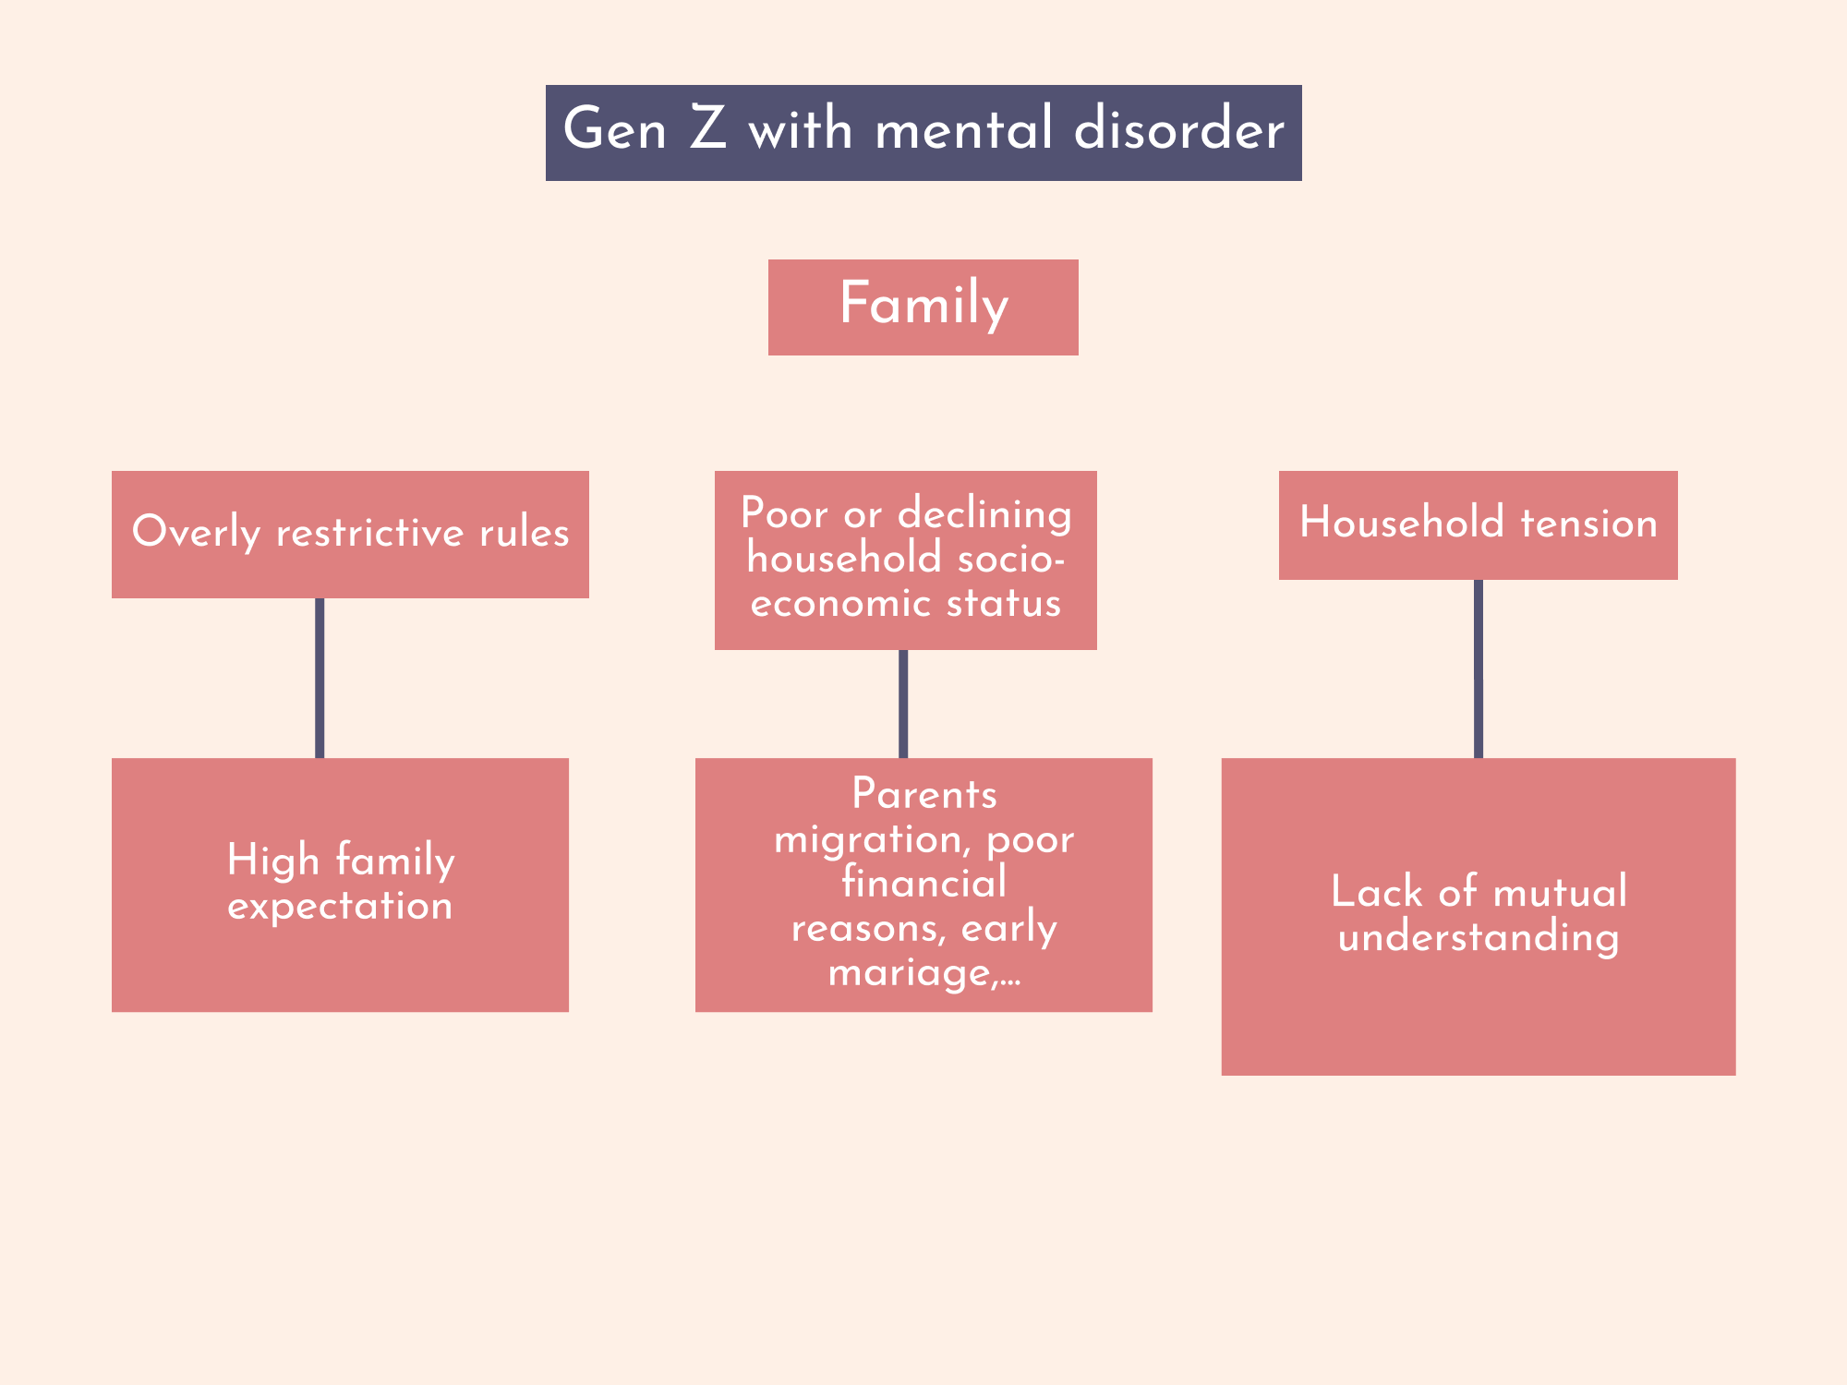

Slide 8
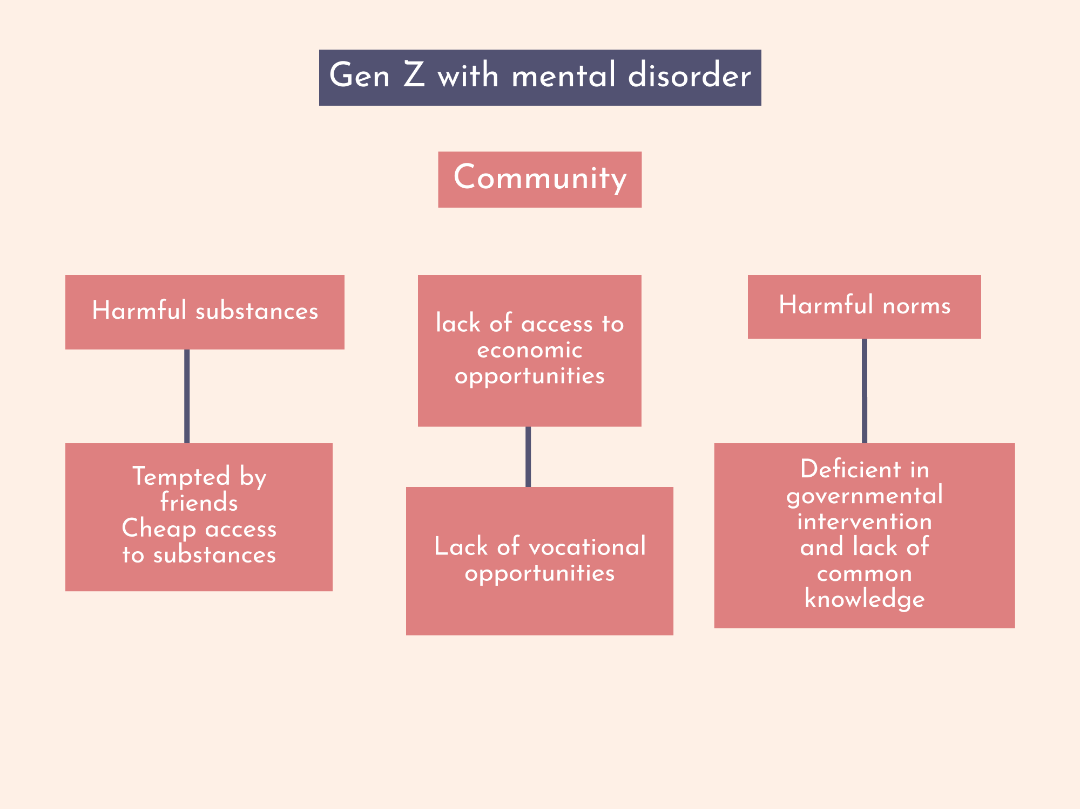
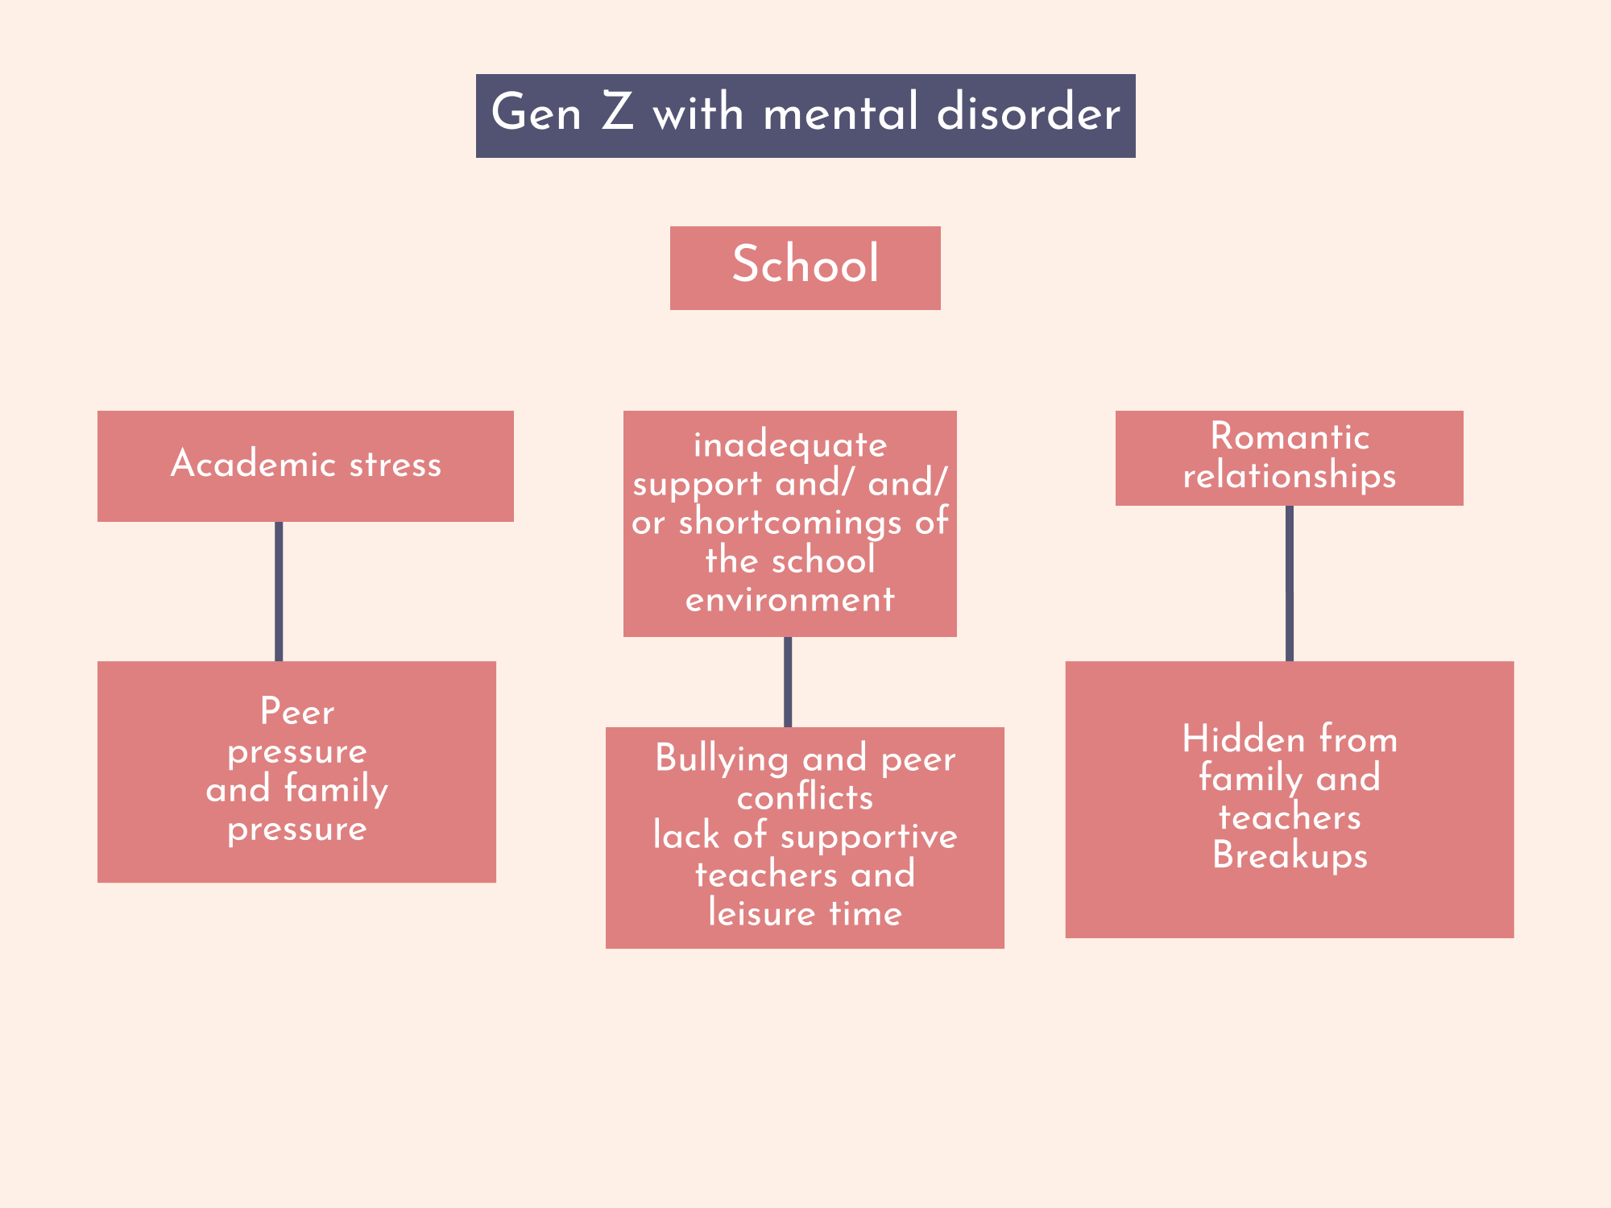

Slide 9


Solutions-How
Treating mental health in
Small province
Big cities
Can not access healthcare service as just big cities
Time
Expense
Remote mental support.

Slide 10


Direct competitors’ solutions | MoH’s solutions
 | Focusing on mental health interfaces friendly clear pricing.
SENME
Not aiming specifically to treat mental illness
VMOOD
Unclear pricing system and creates an unpleasant user experience

Slide 11

Indirect competitors
support hotlines
BetterHelp
Headspace
Youper
psychiatry hospitals
unavailable 24/7
unavailable for Vietnamese
geographically unavailable
MoH will offer:
support 24/7
affordable price
qualified therapists with the whole experience in Vietnamese

Slide 12



Online therapy counseling sessions
Safe space
to talk with a licensed therapist with support, guidance and tools
Involving using social and behavioral sciences
social engineering required
Providing additional avenues
For self-care, stress management, and self-reflection
To identify patterns and develop interventions

Slide 13




Invention design
MoH - a social engineer creating a newer system for treating mental illness.
Reduce time and save money
Exclusive app features
Certified services
Using social engineer to identify patterns

Slide 14
Positive impact | Negative impact
Promoting mental health awareness Reducing stigma Improving access to mental health services | Lack of cultural sensitivity and diversity

Slide 15




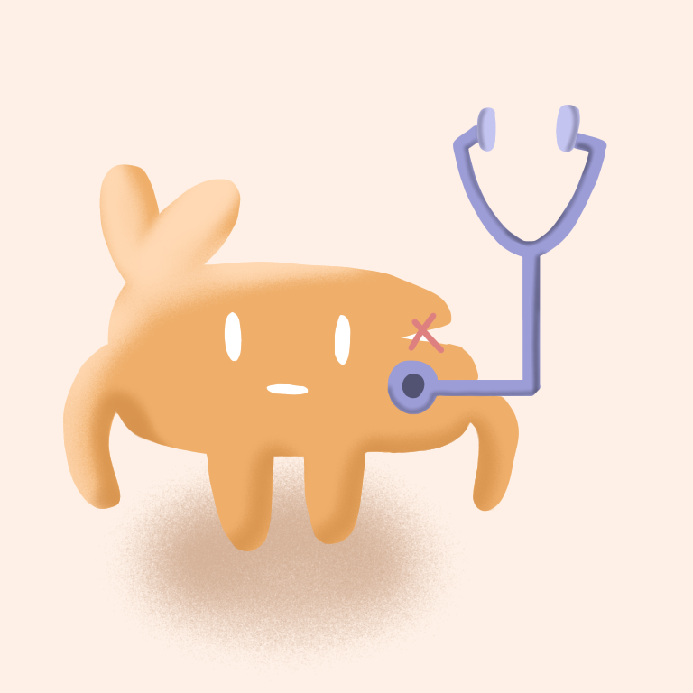

Newness
Multiverse of Health
Psychology Industry

Slide 16



Slide 17
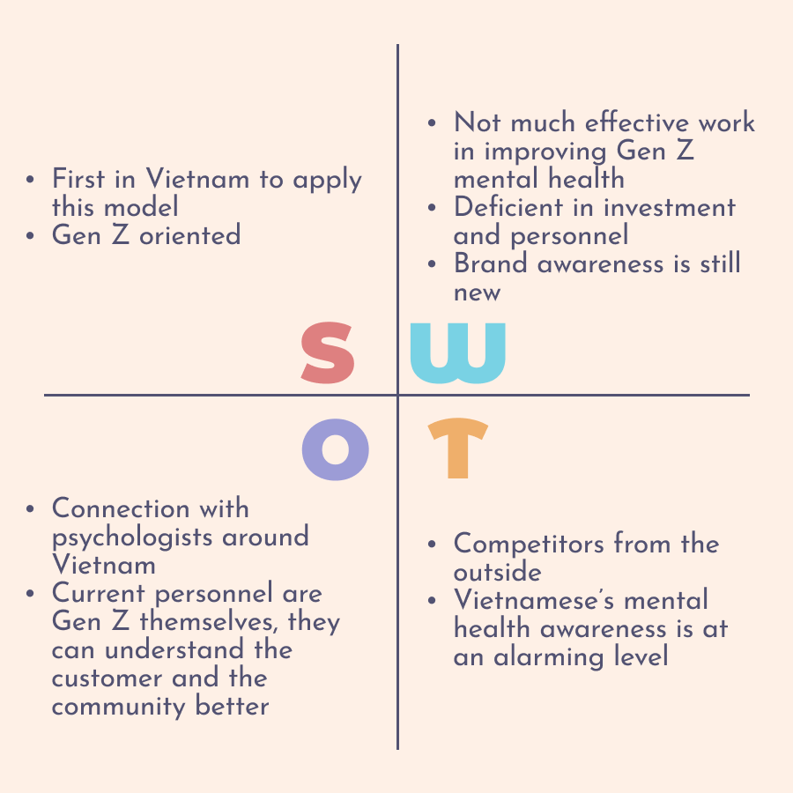


Personnel is not efficient
Vietnamese’s lack of mental health awareness

Slide 18

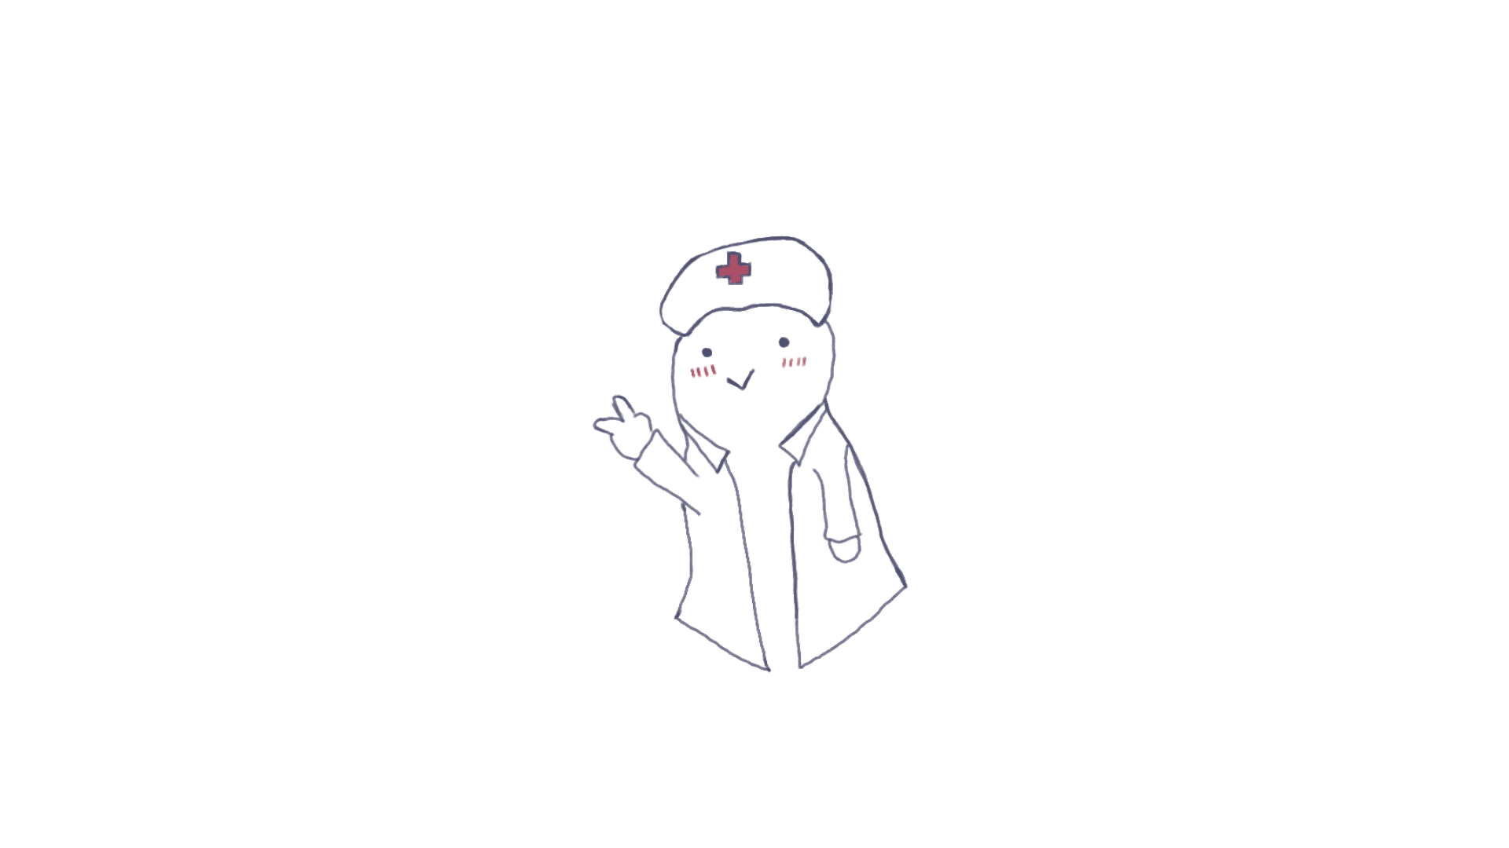


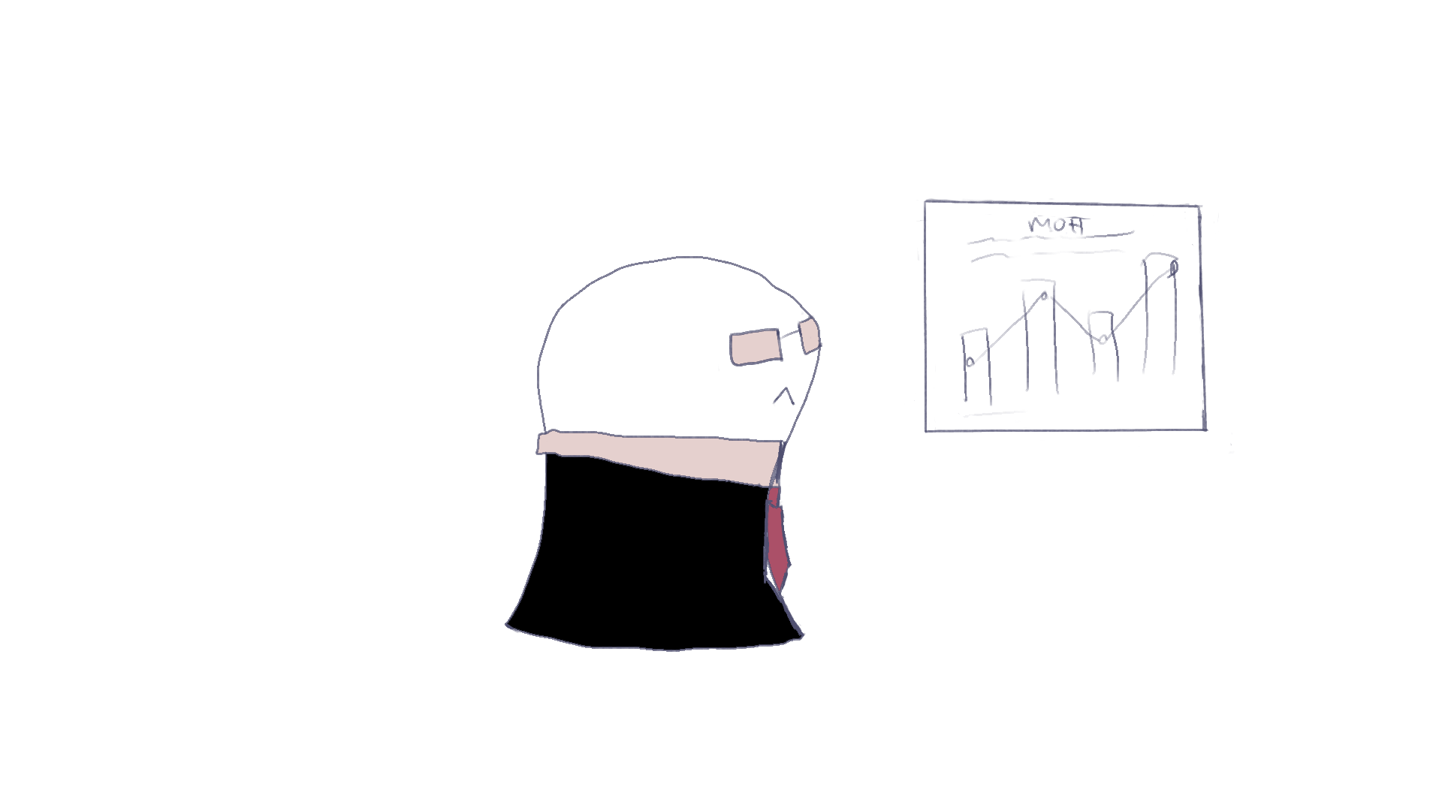


Three Stakeholder Groups
CUSTOMER
THERAPISTS
INVESTORS
1
2
3

Slide 19
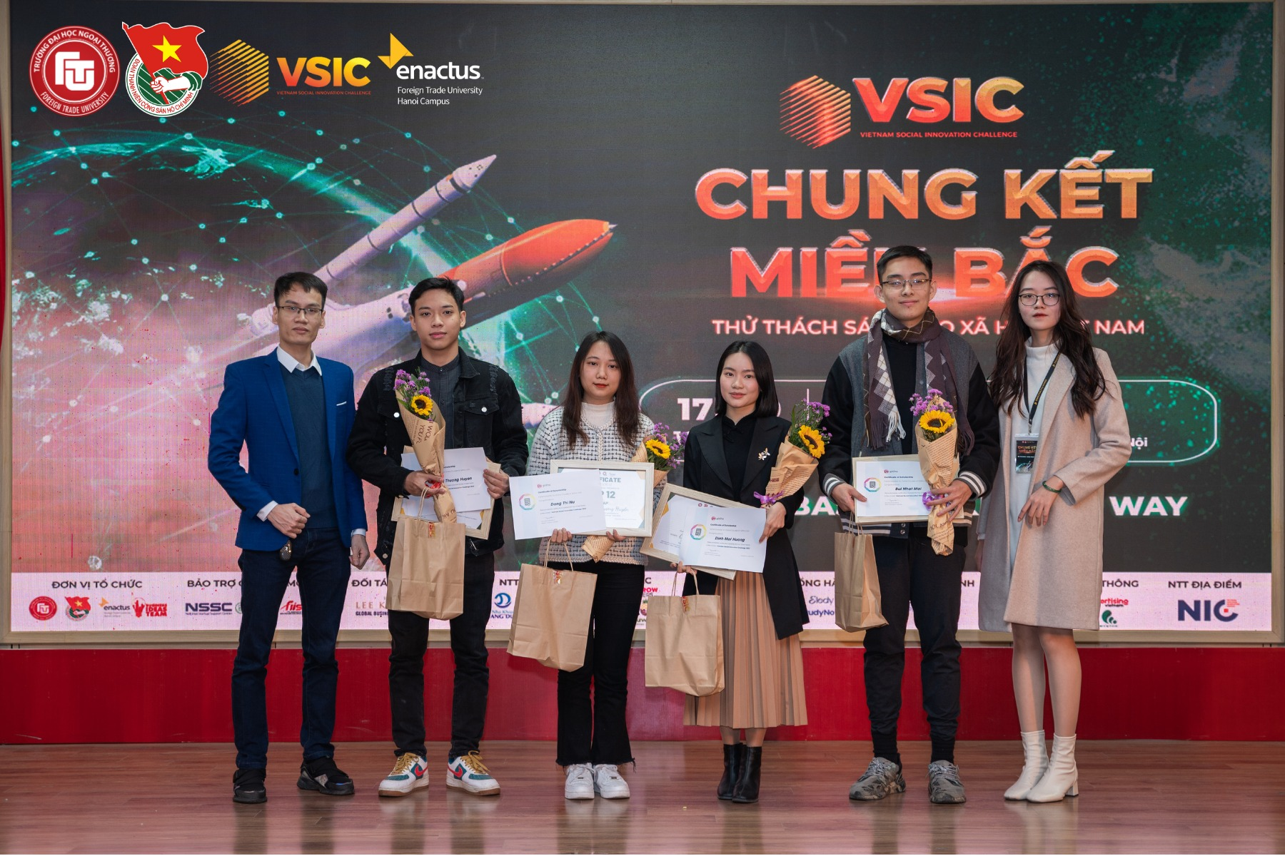
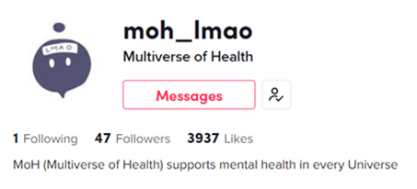

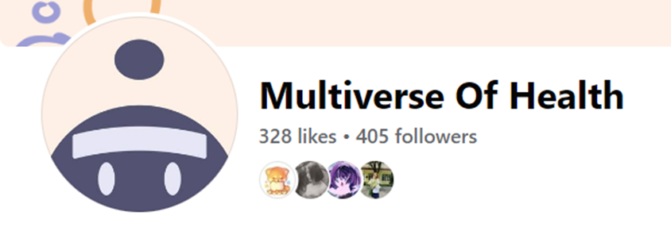
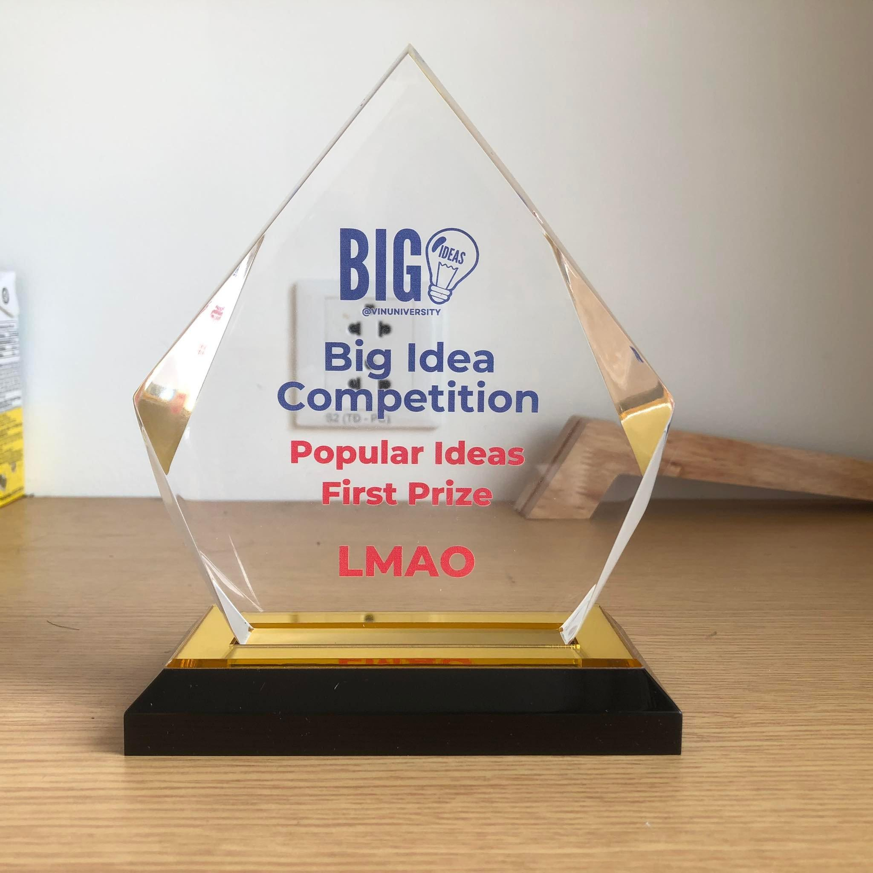
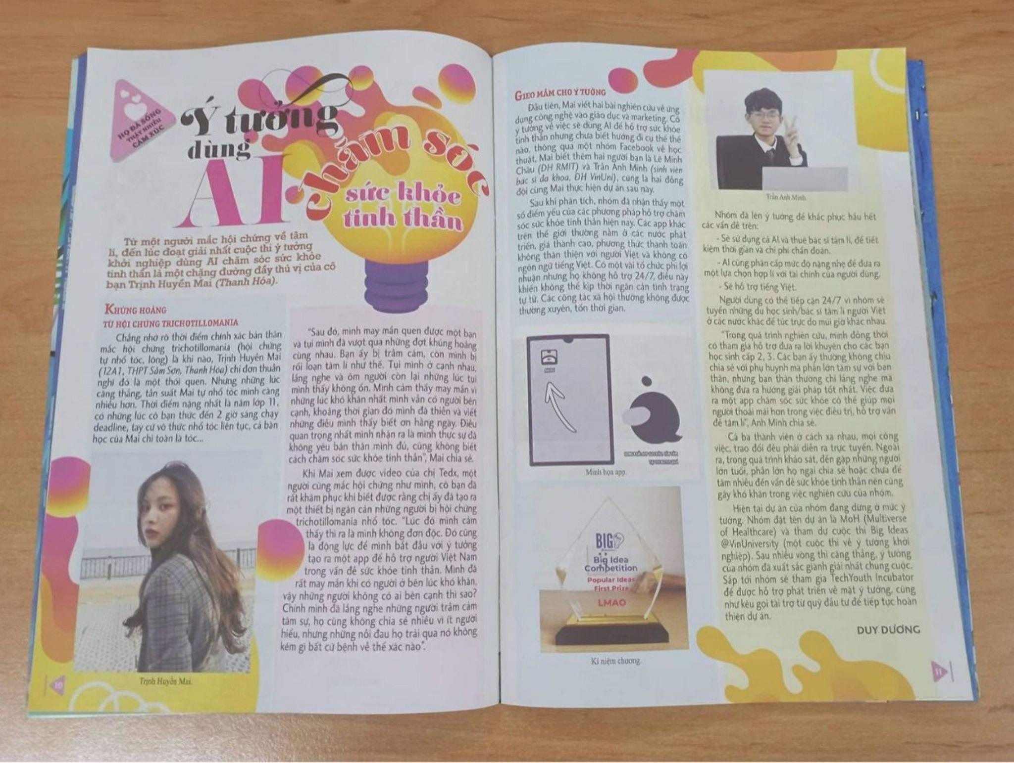



Social media and support
12th place at VSIC
Champion - VinUni Idea Big Competition
Appeared in “MucTim” newspapers

Slide 20
Our improvement strategy
We learn from
Mentors
Competitions
Research & Analysis
Project development | Competition | Specialists/ psychology consults
Research Talent management Time management Teamwork | Problems regarding legal issues, transactions How to attract psychologist Pitching | GenZ mental illness issue and common problems Pricing Which services to offer

Slide 21
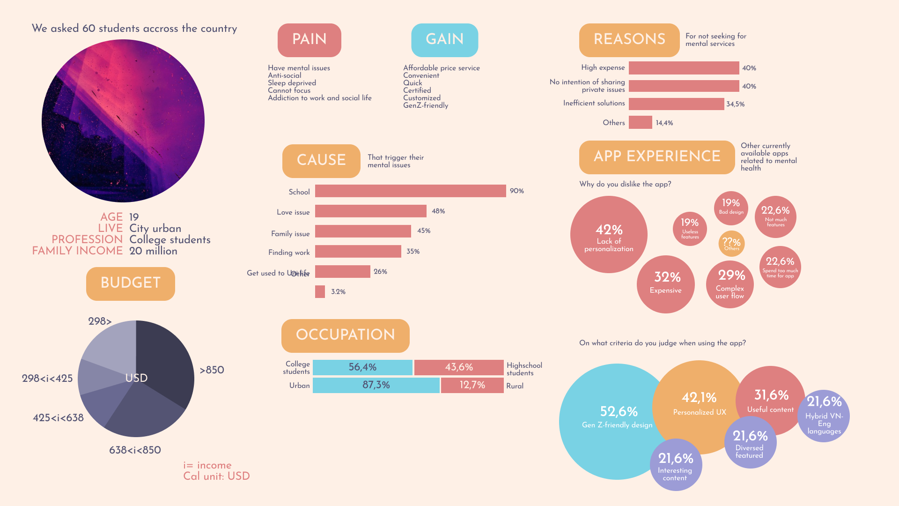

Slide 22
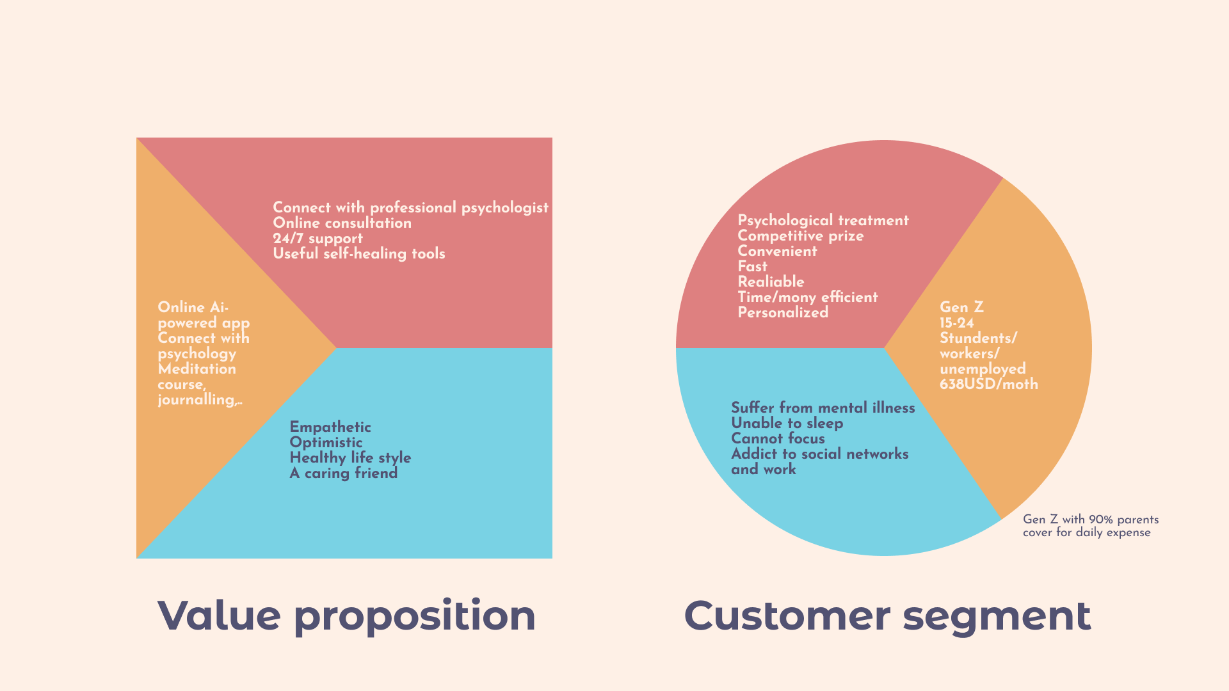

Slide 23
Thanks!
Any questions?
Notes:
Cảm ơn BGK và tất cả quý vị trong hội trường A901 đã lắng nghe ạ. Kính mời BGK đặt câu hỏi về dự án ạ

