Slide 1
Tlaloc´s Power
Alvaro Lopez Zepeda – SBC Pitch presentation

Slide 2
Our Mantra
Everyone should have access to water, no mater the source.

Slide 3
Our Vision
UNSDGs

Slide 4
The SDGs we will impact
SDG 6° Clean water & sanitation
SDG 11° Sustainable cities & communities
SDG 13° Climate action
Our product will provide clean water to the user by collecting this resource via rain collection, giving people an alternative to water consumption during the rainy season.
We seek to help low-income communities with problems with the local water supply system or who do not have access to one.
We promote the consumption of water through renewable sources.

Slide 5
Target social issue

Slide 6
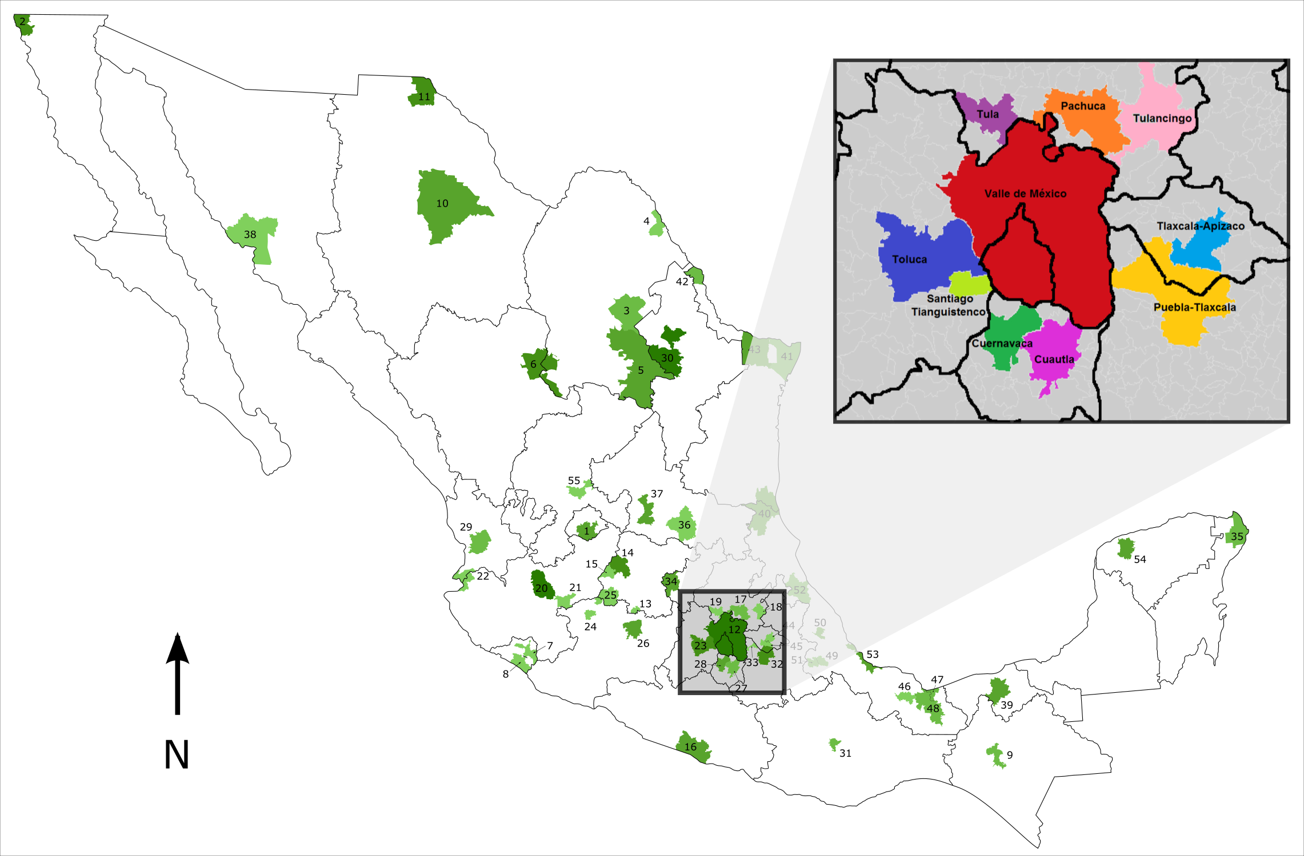
The root cause of the social issue
Mexico City’s entire megalopolis, with a population of 32 million habitants.
The geographical distribution of water does not coincide with the population.
The difference in water distribution between the east and west of the city is the most remarkable.
Hydrometeorological events cause constant damage to the infrastructure of the water supply system.

Slide 7
68% of the water is only destined for 23% (7,360,000) of the population, creating an apparent inequity in distributing essential resources and services.
40% of the water in the city is being wasted due to leakages in the systems creating a higher demand than the existing reservoirs.
22.7% of the water is polluted or highly polluted, making it unusable for human use.
58,647 cytidines (people living in the megalopolis’s deep center) had no access to water, according to official reports.

Slide 8
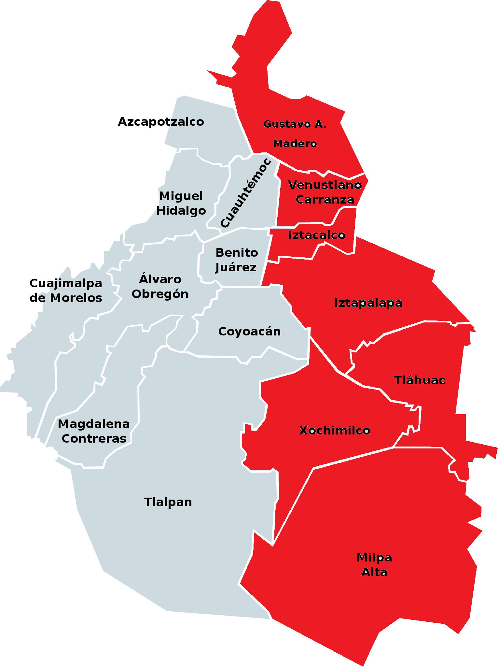
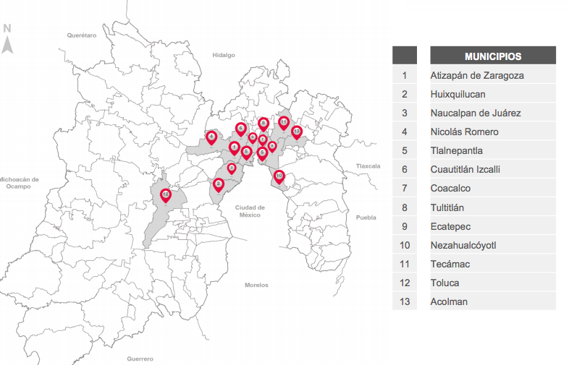
Geographical points without water
Mexico City (State)
Delegations and municipalities with out water
State of Mexico

Slide 9
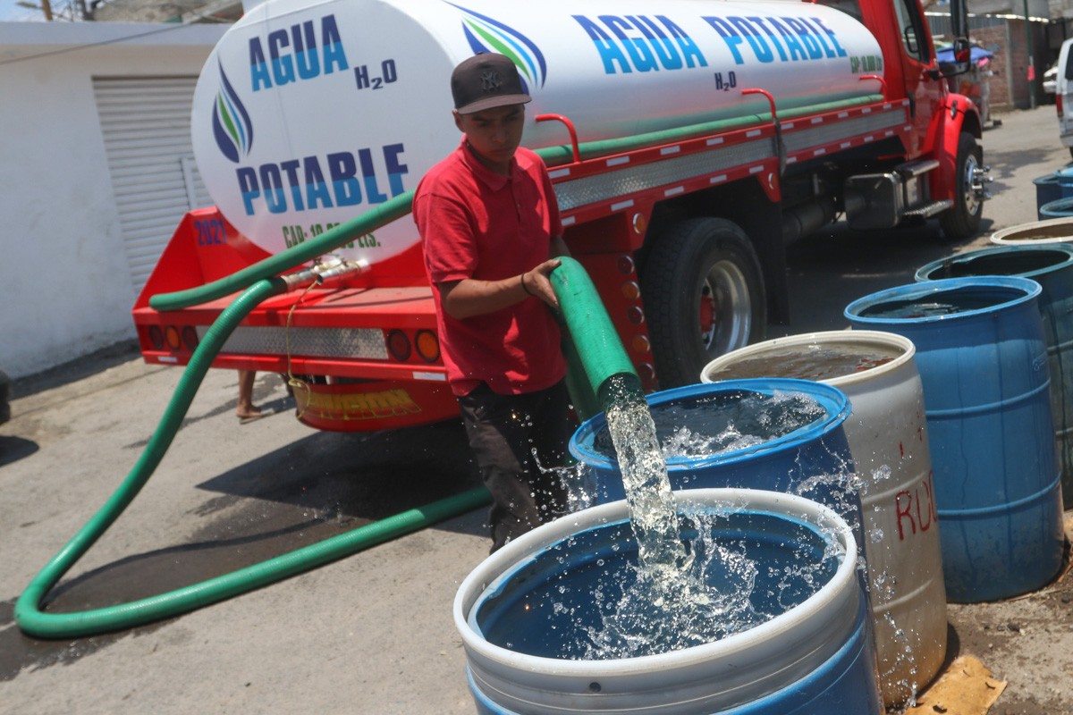
Current landscape
Pipes and jugs in Mexico city
The primary solution that the government offers to the affected population is to bring water pipes to the communities every three days, but for most, this is not enough, and they contract water bottlers like Ciel, Bonafont, or Epura to bring water jugs to their home daily, making much expensive than having a normal access to the water supply system

Slide 10
Sources
Gaceta UNAM. (2021, March 18). México experimenta escasez de agua y falta de equidad en su distribución - Gaceta UNAM. https://www.gaceta.unam.mx/mexico-experimenta-escasez-de-agua-y-falta-de-equidad-en-su-distribucion/
Díaz, O. (2023, March 22). ¿Por qué hay sequía y falta de agua en la CDMX? El Universal. https://www.eluniversal.com.mx/metropoli/por-que-hay-sequia-y-falta-de-agua-en-la-cdmx/
Gaceta UNAM. (2021, March 18). México experimenta escasez de agua y falta de equidad en su distribución - Gaceta UNAM. https://www.gaceta.unam.mx/mexico-experimenta-escasez-de-agua-y-falta-de-equidad-en-su-distribucion/
López, S., & López, S. (2023, March 25). ¿Se seca el Valle de México? - IMCO. ¿Se seca el Valle de México? https://imco.org.mx/se-seca-el-valle-de-mexico/
Colín, J. L. R. (2023, March 15). Agudiza desabasto de agua y crisis hídrica, miles de personas ya viven el día cero en CDMX. Publimetro México. https://www.publimetro.com.mx/noticias/2023/03/15/cdmx-agudiza-desabasto-de-agua-y-crisis-hidrica-miles-de-capitalinos-ya-viven-dia-cero/

Slide 11
Social solution

Slide 12
How do we solve this problem?
To provide low-cost and easy installation of intelligent pluvial-water supply systems for low-income communities.
Detects humidity in the zone and whether it's raining or not
Collects rainwater when it's raining
Covers itself up when it's not raining to protect from acid rain
Protects itself from sunrays when covered up to increase its lifespan
Connected to user's water tanks for immediate use
Water filter will be incorporated in the pipe section to ensure human consumption safety.

Slide 13
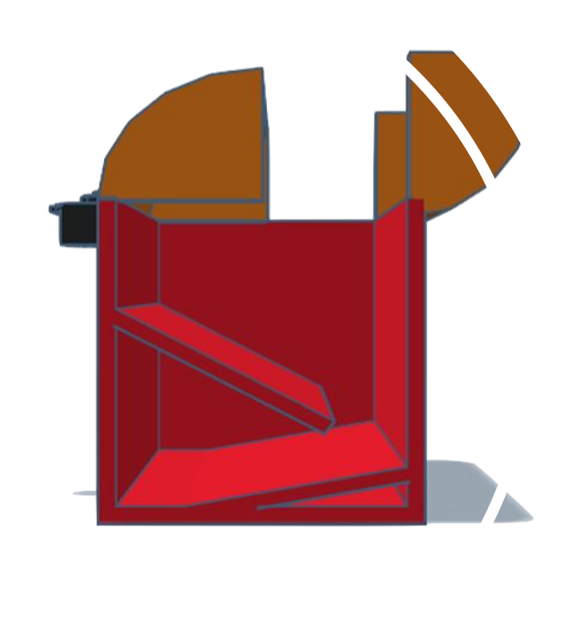
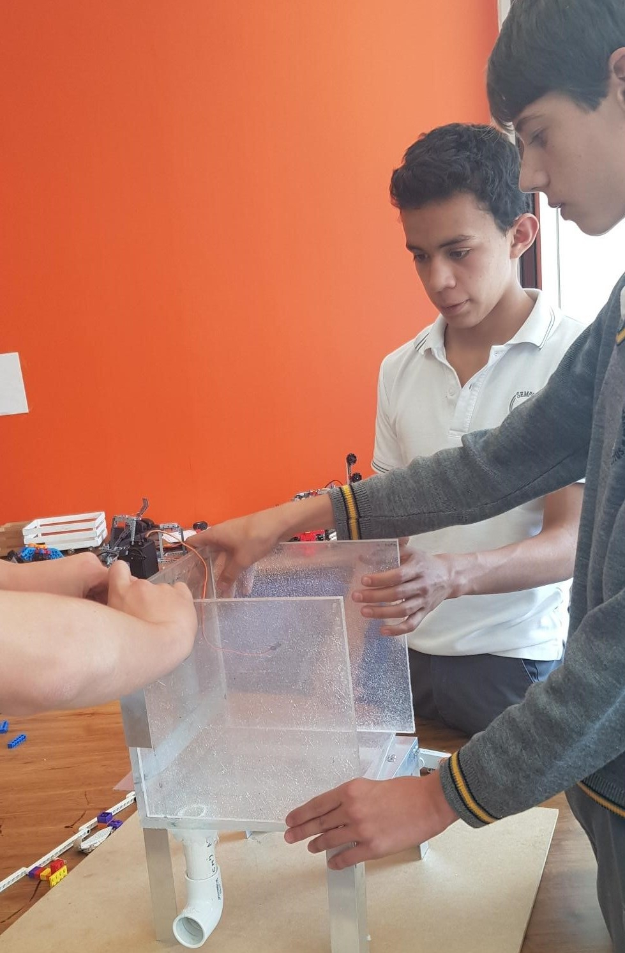
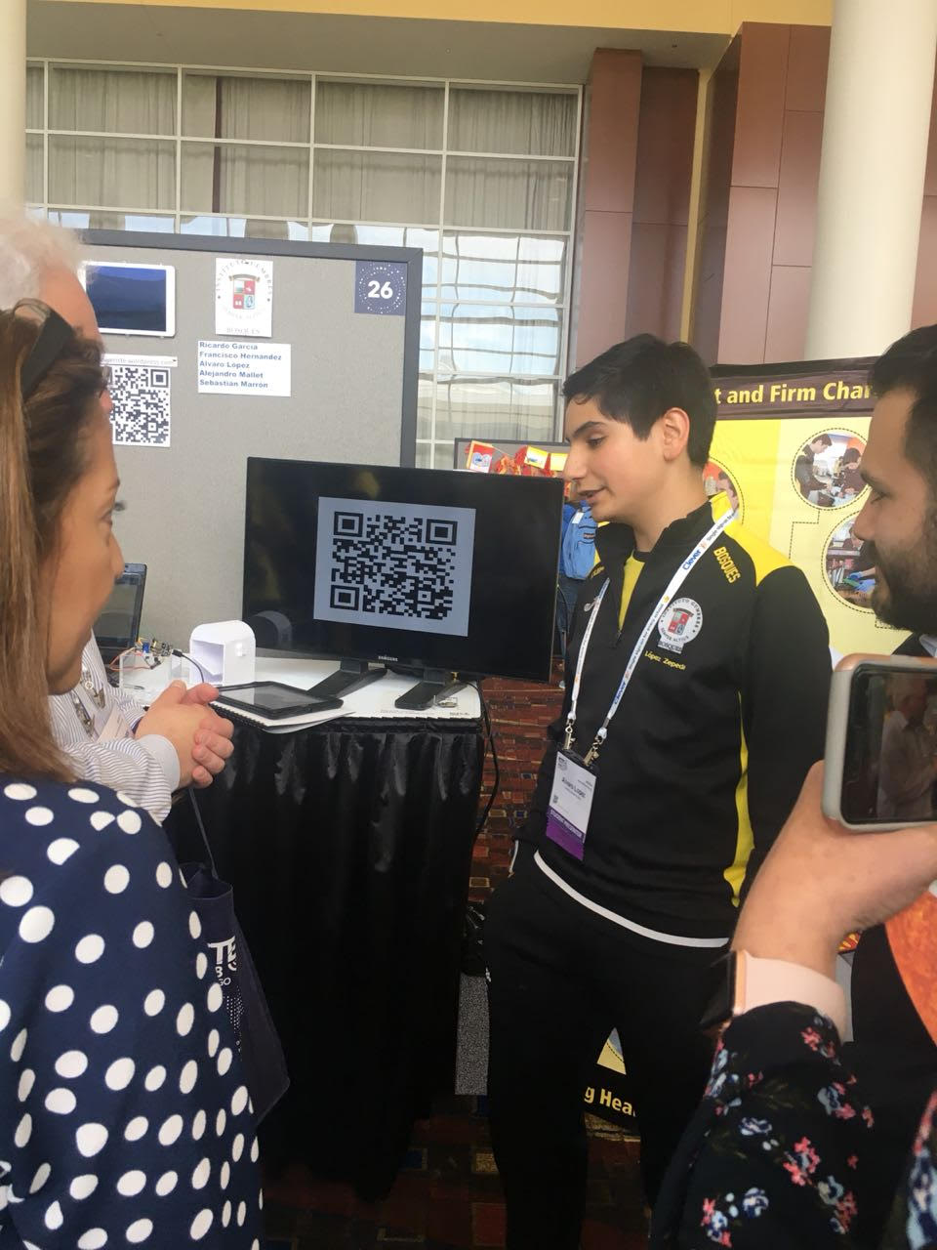
The first prototype

Slide 14
Social target
For people who live in highly active pluvial zones
For low-income people who don’t have access to or have problems with the local water distribution system and seek to increase their collection of this resource in a simple way to help reduce the scarcity created by the issues of the distribution system.
For people looking to reduce their water bill cost by using water consumption alternatives.
Social programs and NGOs

Slide 15
Thank you
Alvaro Lopez Zepeda
alvarolopez1333@outlook.com
+52(55)66107720

