Slide 1
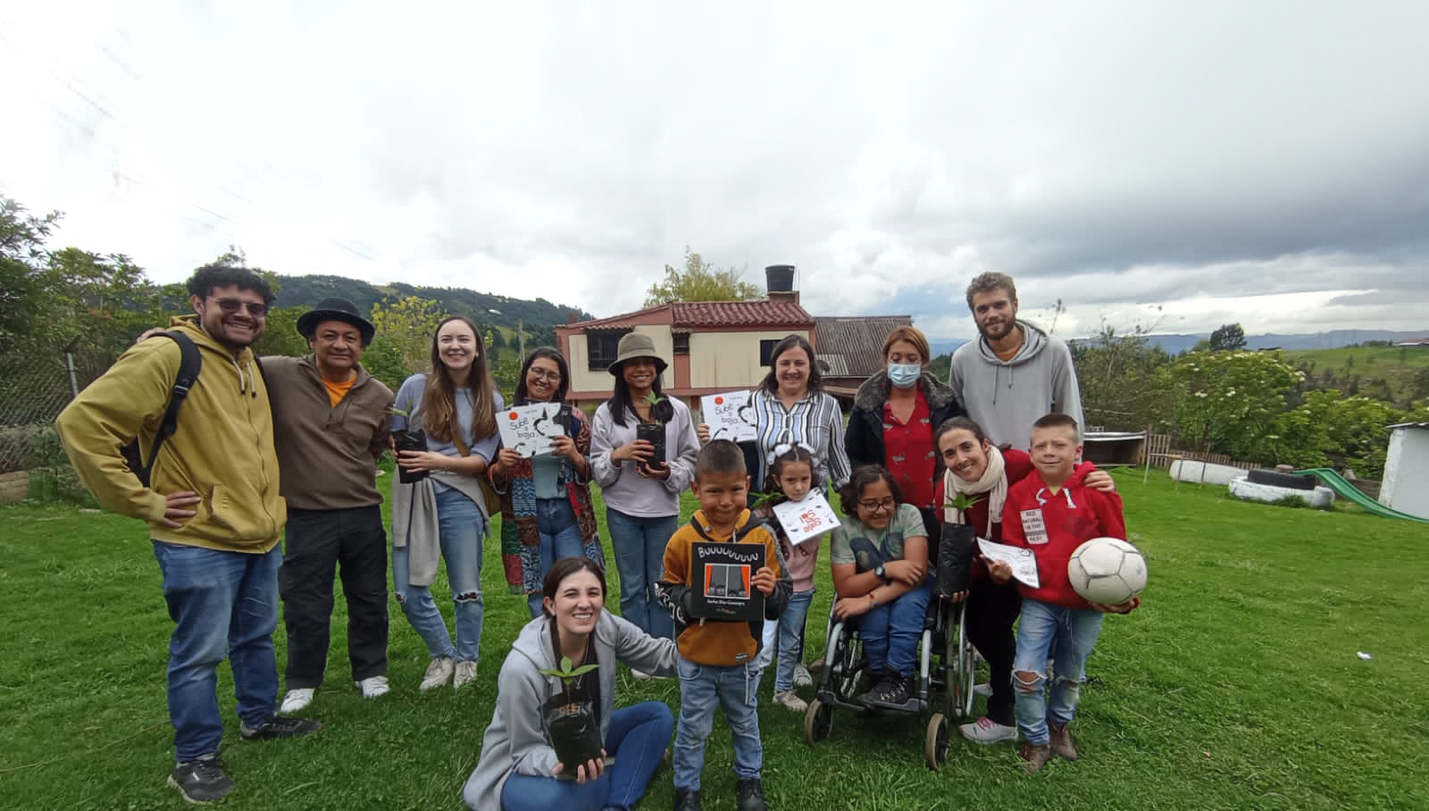
INTERACTIVE CHILDREN’S BOOKS AS A TOOL TO CONNECT RURAL COMMUNITIES AROUND NEW AND EXISTING STORYTELLING

Slide 2
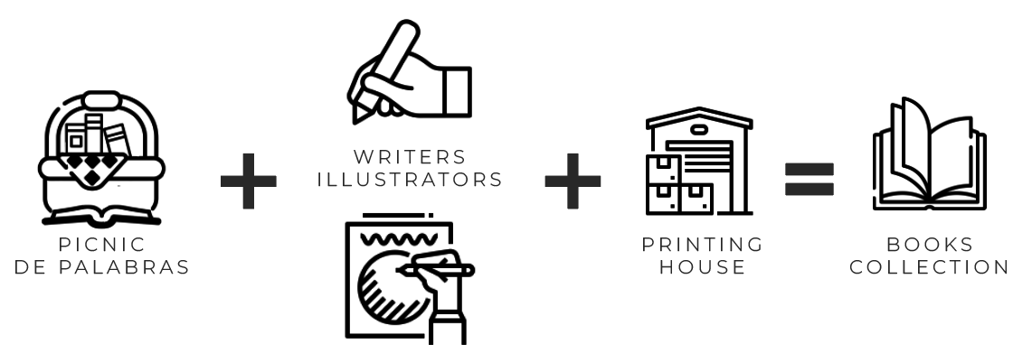
Mission: Creating a social enterprise that facilitates access to quality reading experiences and children's literature to close the gap in children´s cognitive develop in Colombian rural areas.
SDG 4. Education:
*4.2 By 2030, ensure that all girls and boys have access to quality early childhood development, care and pre-primary education so that they are ready for primary education.
Vision: For 2030, we will reach at least one rural area of each of the 32 Colombian states, by articulating, inspiring and faciliting access to meaningful reading experiences with high-quality children's books to Colombian rural families so they will engage with the habit of reading for the long run that will support early childhood development.

Slide 3
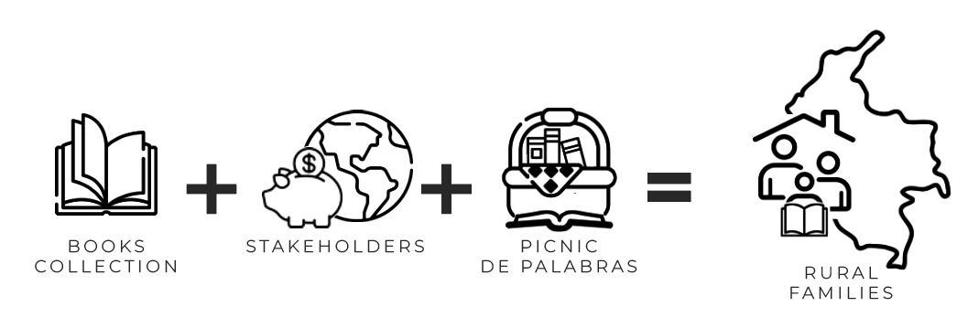
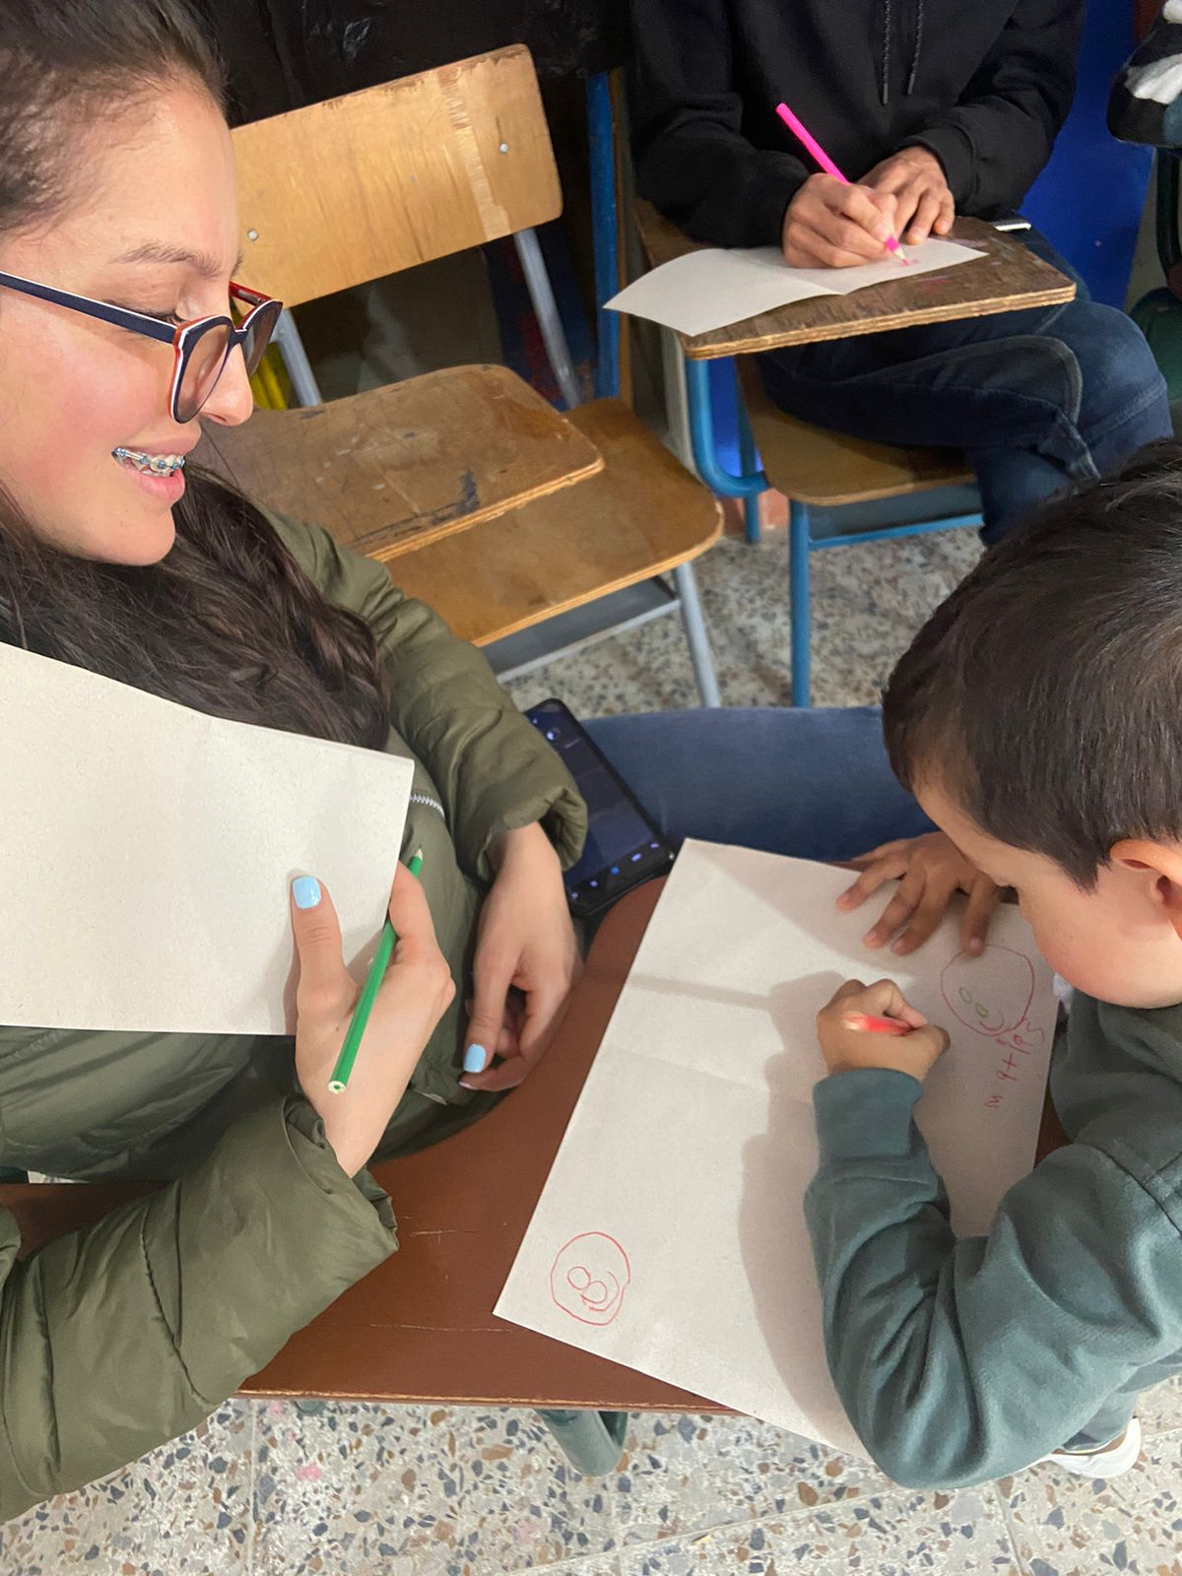
How do we achieve these?
Picnic de Palabras methodology and community
Team of experts and volunteers
Arribabajo Collection (4 books)
Local community NGOs to maximaze impact and resources
Planning and implementation MPV
- Virtual meetings to prepare our visit with local leaders
- Visits in rural areas where we active the collection through a workshop with rural families
Social Impact: measure the impact through quantitative and qualitative data
- Interviews, comments, surveys, and follow up on the participants their needs in order to update our own data and processes to continues improvement
Community benefits: giving access to reading children's books that enables stimulating cognitive development and social and emotional skills in early childhood.

Slide 4
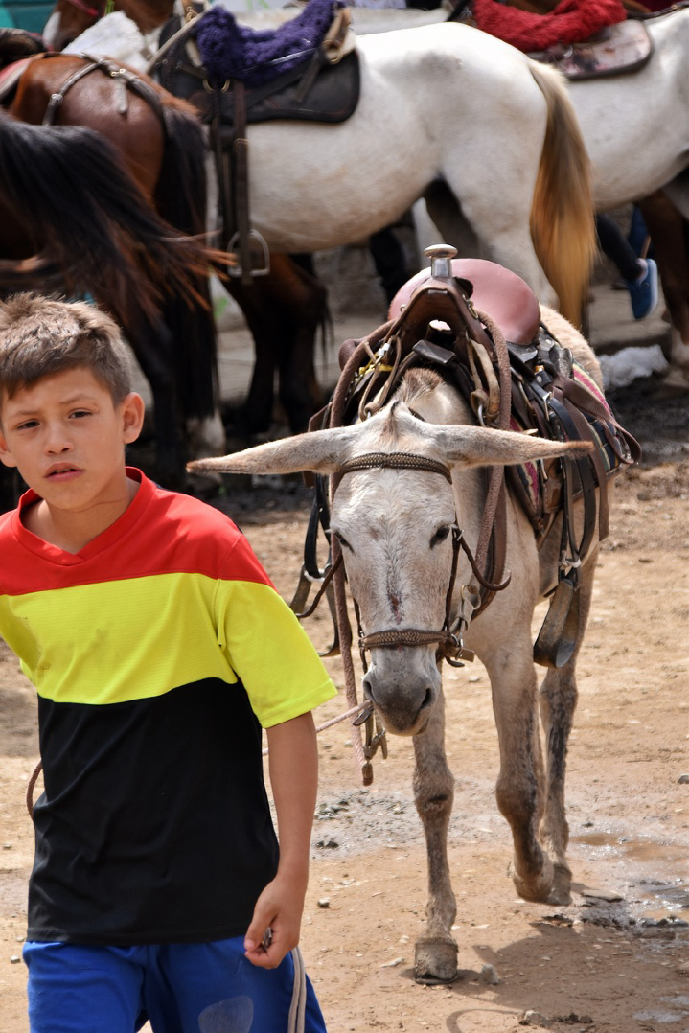
In Colombia, we have 20,7 million people living in rural areas, and they represent the 41% of the total population. 70% of rural families in Colombia, present a lack of access to quality didactic material to support earlychildhood and children cognitive development, and their social, emotional and creative skills to improve their own expression, that increases the social, cultural and economical gap and the circle of poverty where they are immersed.

Slide 5
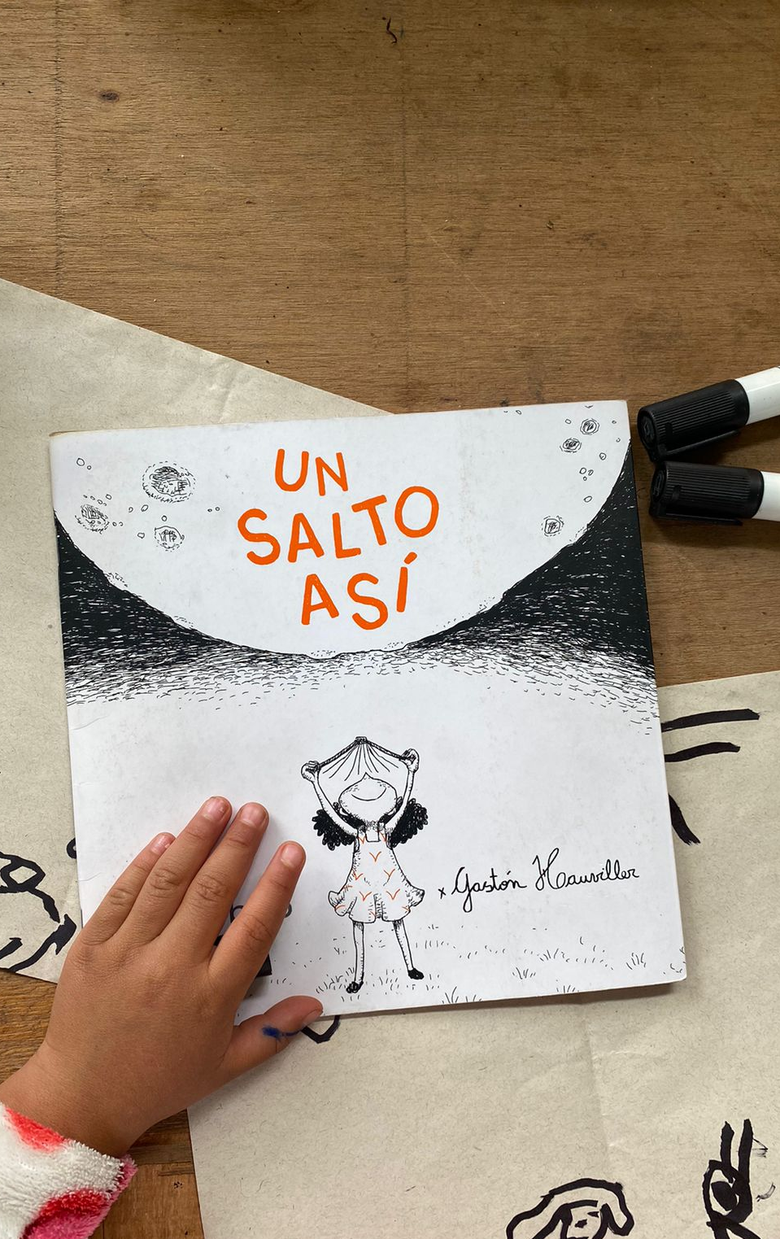
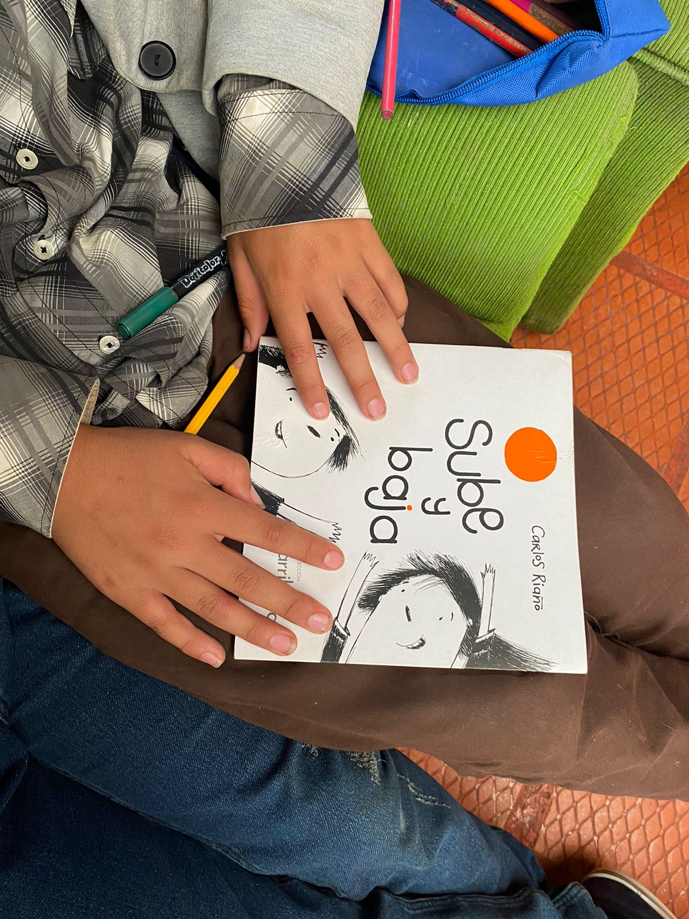

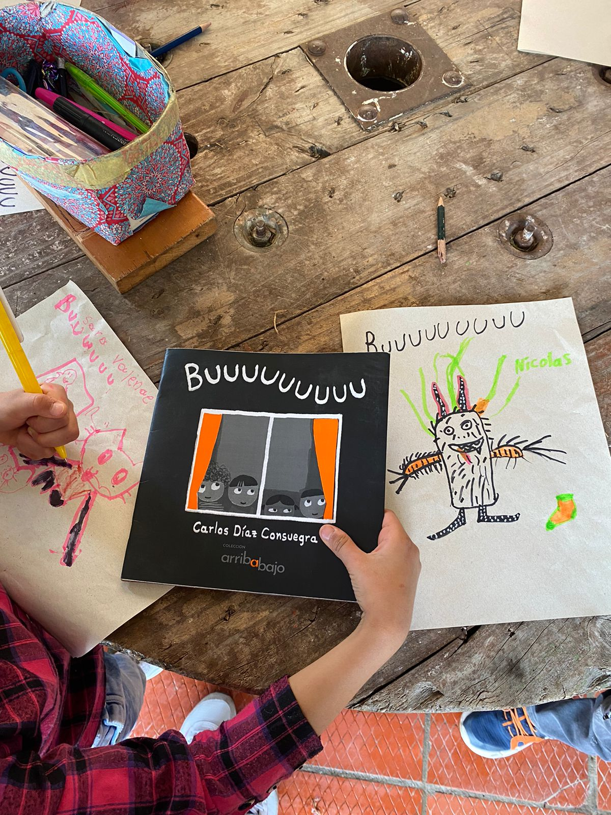
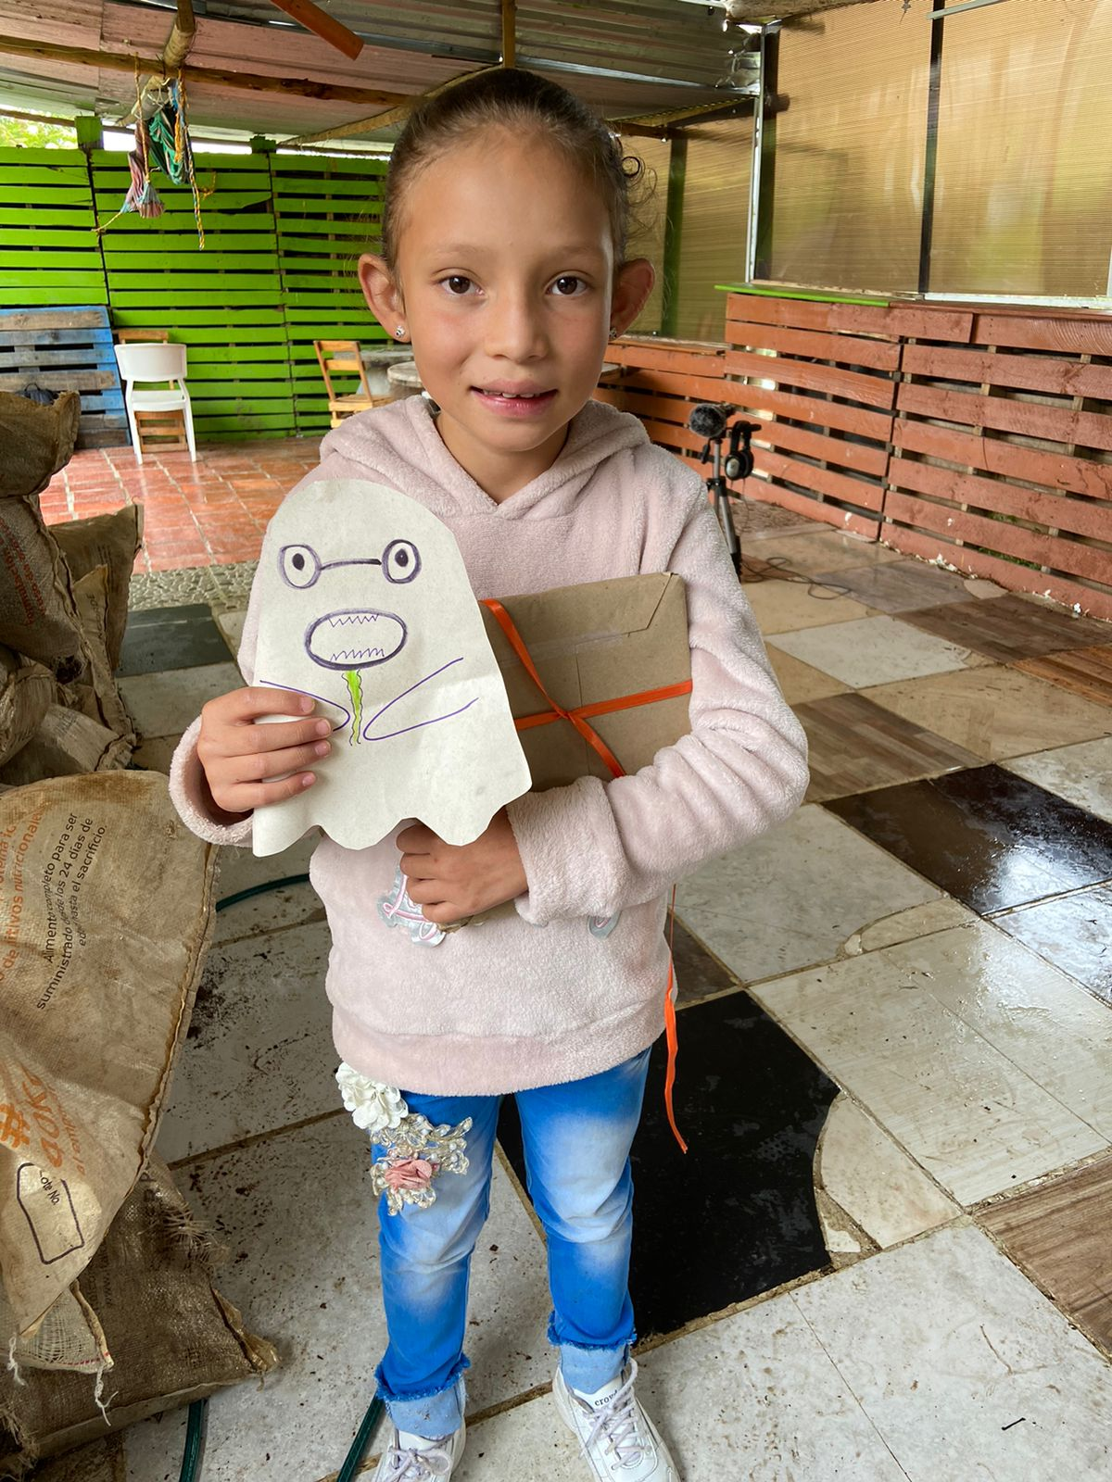
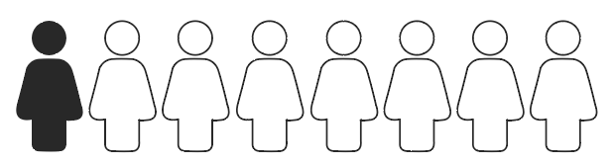
37.5%
5.5%
OF HOUSEHOLDS IN COLOMBIA DO NOT HAVE ACCESS TO BOOKS
OF THE COUNTRY'S PUBLIC LIBRARIES WERE LOCATED IN RURAL AREAS
7 OUT OF 10 CHILDREN IN LOW- AND
MIDDLE-INCOME COUNTRIES COULD NOW BE
SUFFERING FROM LEARNING POVERTY.
1 OUT OF EVERY 8 CHILDREN IN LOW- AND
MIDDLE-INCOME COUNTRIES IS NOW IN
LEARNING POVERTY.
The increases in learning poverty have likely been largest in South Asia and in Latin America and the Caribbean, due to the very long school closures in those regions
(World Bank, Learning Poverty Report, 2022, p. 8-9).

Slide 6
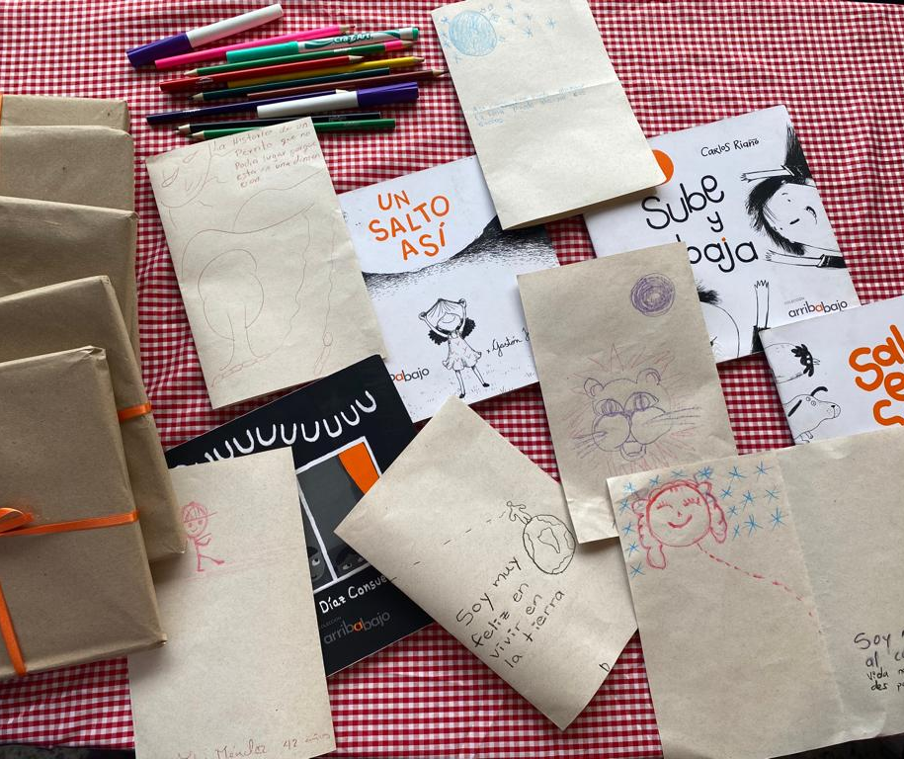
Our MVP to test the relevance
of our premise has been divided
into three stages:
1
Launching the 1st Children’s books collection.
2
Implementing the methodology through in-person workshops involved design thinking and validating our impact.
3
Measuring the impact and
gathering feedback about the
families’ perception and relationship with books and reading.

Slide 7
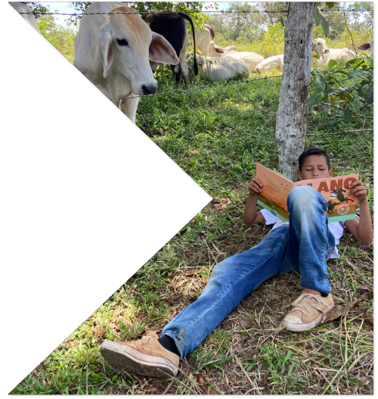
1. WHY IS ACCESS TO QUALITY BOOKS RELEVANT?
To support the cognitive development of early childhood in rural areas.
2. WHY SUPPORT COGNITIVE DEVELOPMENT?
To subscribe to the closure of social and economic gaps between children with access to quality material and those without access.
3. WHY IS IMPORTANT TO SUPPORT THE CLOSURE OF SOCIAL AND ECONOMIC GAPS?
To take measures and provide tools to families to break the cycle of poverty they are in.
4. WHY DO WE TAKE THESE MEASURES?
To raise awareness among families about their role as mediators and the importance of reading, art, and education in childhood for cognitive and emotional development.
5. WHY RAISE AWARENESS AMONG FAMILIES?
Empower them in their role, take responsibility for their actions, spend quality time with their children, and guarantee them a better future by encouraging their development and learning process.

Slide 8
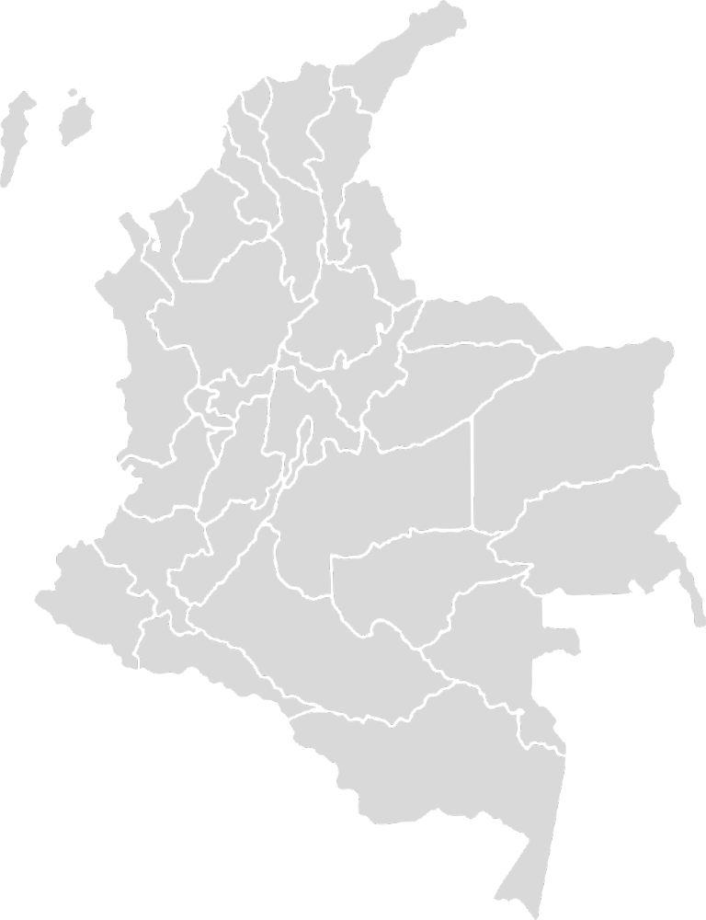
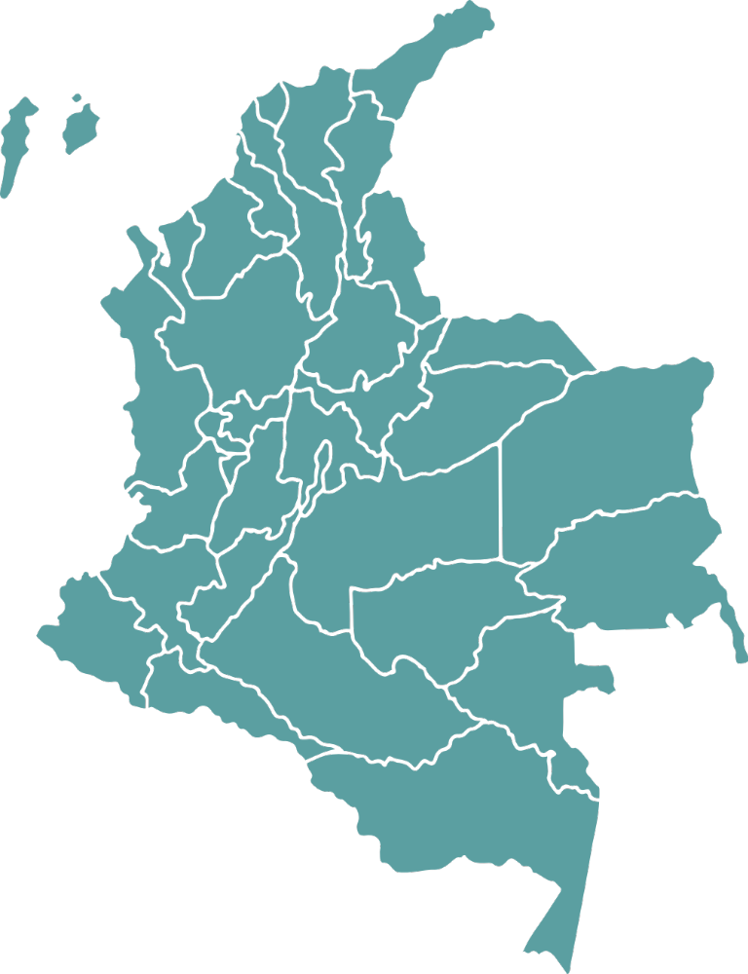
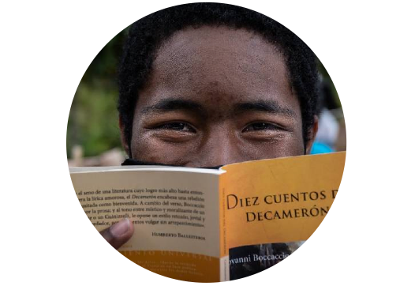
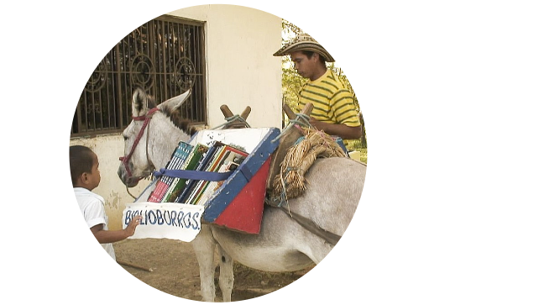
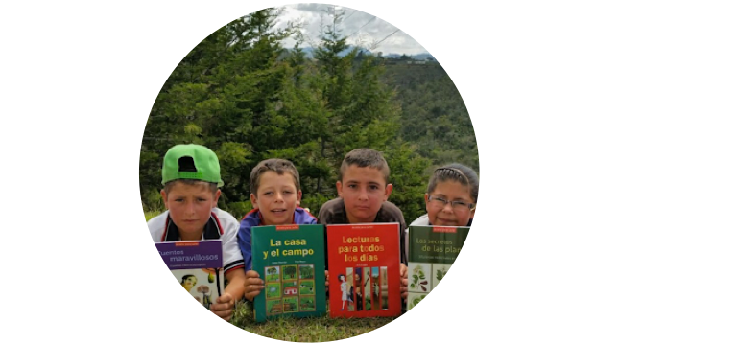
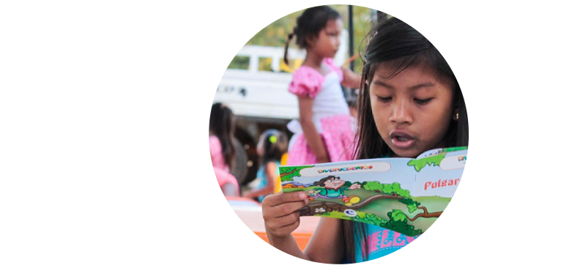
LUIS SORIANO: BIBLIOBURRO
a successful case that went around the world, where a reading promoter on a donkey brings books to very remote areas in the Colombian Caribbean and shares them with children in rural villages.
IDARTES: LIBRO AL VIENTO
is a project sponsored by the Bogota
District Art Institute, which publishes large print runs of books to circulate and move around the city and the country.
FUNDACIÓN SECRETOS PARA CONTAR
(SECRETS TO TELL FOUNDATION)
supports rural areas in Antioquia with books that meet the needs of the communities.
MINISTRY OF CULTURE AND MINISTRY OF
EDUCATION - LEER ES MI CUENTO:
a program that sends collections of stories to libraries and educational institutions serving early childhood throughout the country.

Slide 9
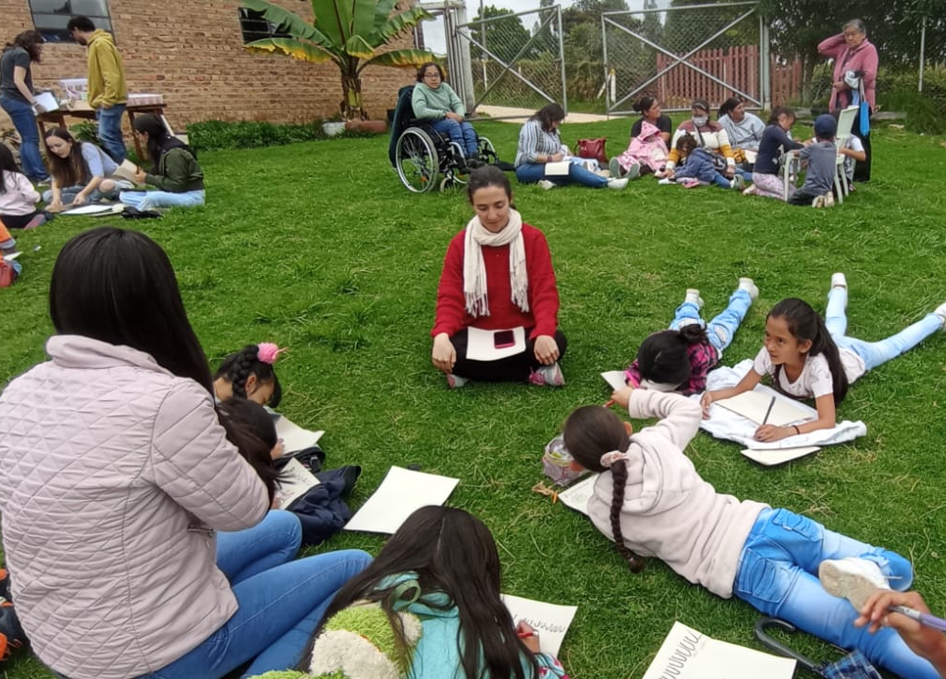
Social solution design:
How we can support families´
reading practices in rural areas?
CHILDREN'S BOOKS COLLECTIONS
+
WORKSHOPS
+
IMPLEMENTATION
Results: Access to books designed specifically to inspire rural families' desire to read and reread, create, draw, and tell their own stories.

Slide 11
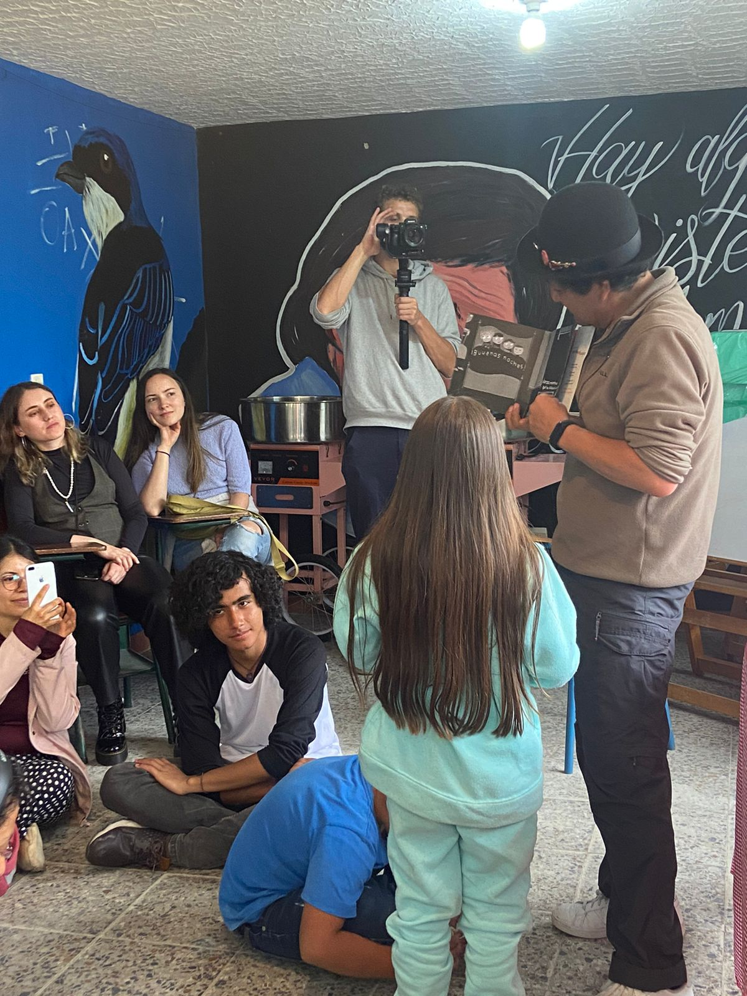
“A study shows that there is an important role for parents in the development and educational performance of their children. Parental reading to children increases the child’s reading and other cognitive skills at least up to the age of 10–11. This is an early-life intervention that seems to be beneficial for the rest of their lives.
The results indicate a direct causal effect from reading to children at a young age and their future schooling outcomes regardless of parental income, education level or cultural background.”
(G Kalb, JC Van Ours - Economics of Education Review, 2014, p. 5)

Slide 12
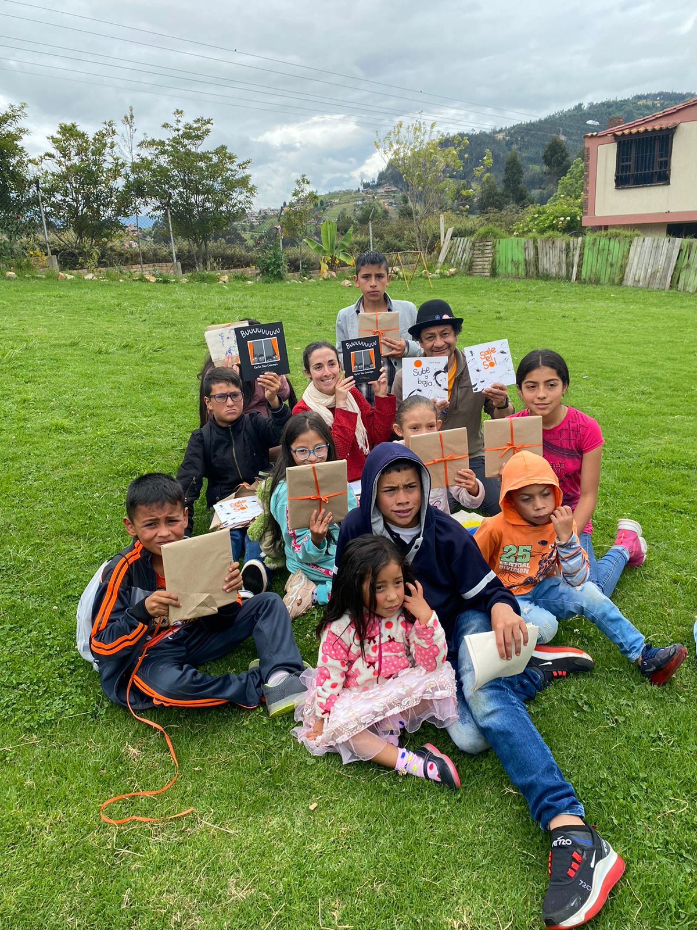
We created access to high-quality books at an affordable price, their time. We are bringing together writers, designers, and children’s literature experts to create and socialize a collection for the specific target and their needs.

Slide 13
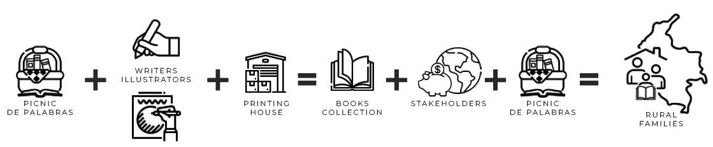

Slide 14
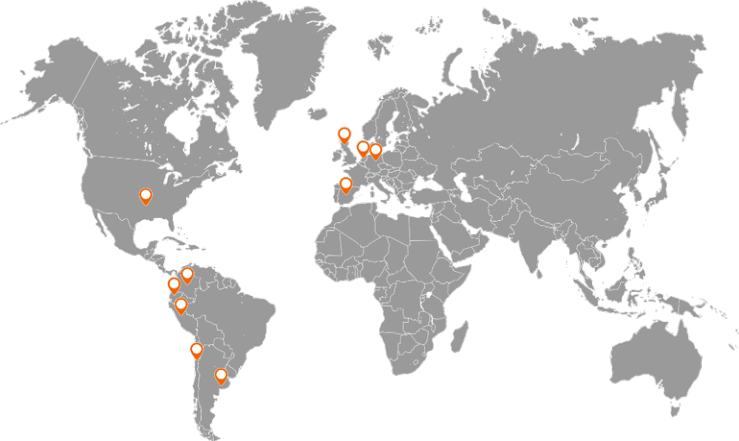
Over time, the result is creating a community supporting local and global projects. More than 20 collections have reached:
The United States
Argentina
Chile
Spain
Scotland
Germany
The Netherlands
Peru
Ecuador
Colombia
- Bogotá
- Medellín
- Barranquilla
- Bucaramanga
Sharing information on social networks allows us to reach more people and organizations.
It is essential to publish and share the alliances we have created to strengthen:
- The social impact ecosystem
- Confidence for them to invest in us
- New businesses with allies aligned with the
purpose and impact of our social enterprise

Slide 15
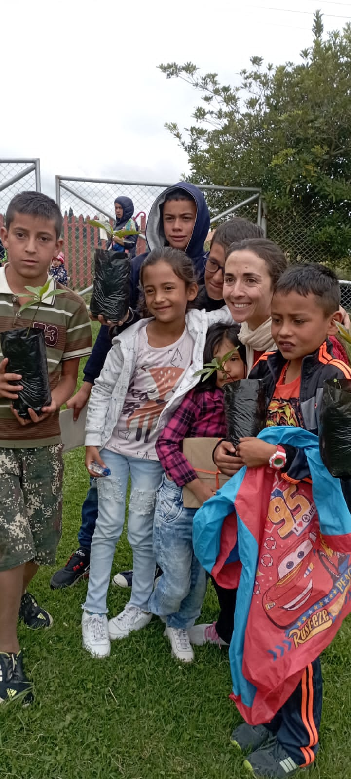
WHAT I HAVE LEARNED AND HOW I IMPROVE:
TAKE CARE OF THE DETAILS: Everything is important, and there will be unforeseen events.
BEING FLEXIBLE: each team member has their own timing for doing things.
KEY: Clarity of purpose and keeping in mind the impact we generate with each of our actions.
NETWORK: I belong to a network that is willing to support me.
TEAM: A social enterprise needs people for whom the mission and vision of the project make sense in their lives to add value.
ORGANIZATION: Reviewing what is and what is not under control and acting accordingly.
Emotions: Managing emotions, frustration, and success.

Slide 16
Bibliography
----- Ministerio de Cultura, Ministerio de Educación. (2021) Plan Nacional de Lectura, Escritura y Oralidad (pnleo) «Leer es mi cuento» 2018-2022
https://www.mineducacion.gov.co/1780/articles-411450_recurso_01.pdf#page=14&zoom=100,0,0
----- Red Nacional de Bibliotecas Públicas. (2022) Bibliotecas rurales itinerantes: un programa para fortalecer la lectura, la escritura y la oralidad en los territorios colombianos. Biblioteca Nacional de Colombia.
https://bibliotecanacional.gov.co/es-co/actividades/noticias/en-la-rnbp/programa-bibliotecas-rurales-itinerantes-2022
----- The World Bank et al. (2022). The State of Global Learning Poverty: 2022 Update, conference edition, June 23, 2022.
https://thedocs.worldbank.org/en/doc/e52f55322528903b27f1b7e61238e416-0200022022/original/Learning-poverty-report-2022-06-21-final-V7-0-conferenceEdition.pdf

