Slide 1







MAYPAPERFLOWER
“Handmade paper flowers for traditional art preservation and job creation”

Slide 2
TABLE OF CONTENTS
01
TEAM & BUSINESS INTRODUCTION
02
OUR TARGETED
SOCIAL ISSUES
03
CURRENT SOLUTION LANDSCAPE
04
OUR SOLUTION
05
STAKEHOLDERS

Slide 3
TABLE OF CONTENTS
01
TEAM & BUSINESS INTRODUCTION
02
OUR TARGETED
SOCIAL ISSUES
03
CURRENT SOLUTION LANDSCAPE
04
OUR SOLUTION
05
STAKEHOLDERS

Slide 4
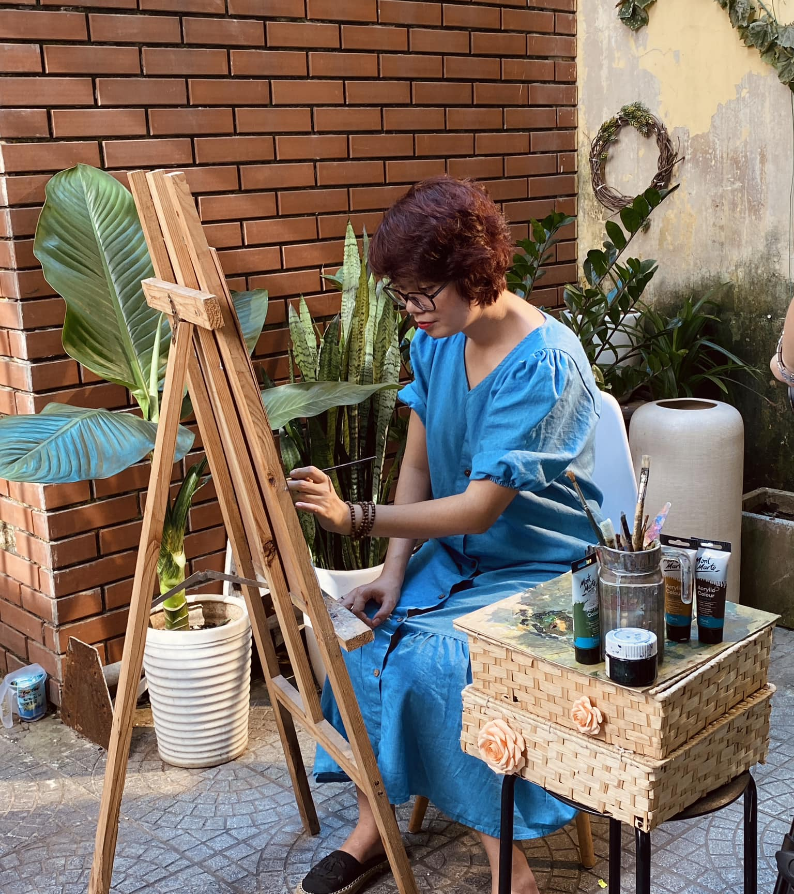
MS. PHAN NGOC HIEU
CEO/FOUNDER - MAYPAPERFLOWER
8 years of experience in banking & finance.
12 in-depth research in the field of confetti
Second prize in the Vietnam Handicraft Design Contest 2022 organized by the Ministry of Agriculture and Rural Development
Managing Hue handmade paper flower project, which was ranked in the top 1 of 29 social impact projects funded by UNDP
Imprint Award - Women create, change the future launched by Vietnam Startup Fund and Standard Chartered.

Slide 5
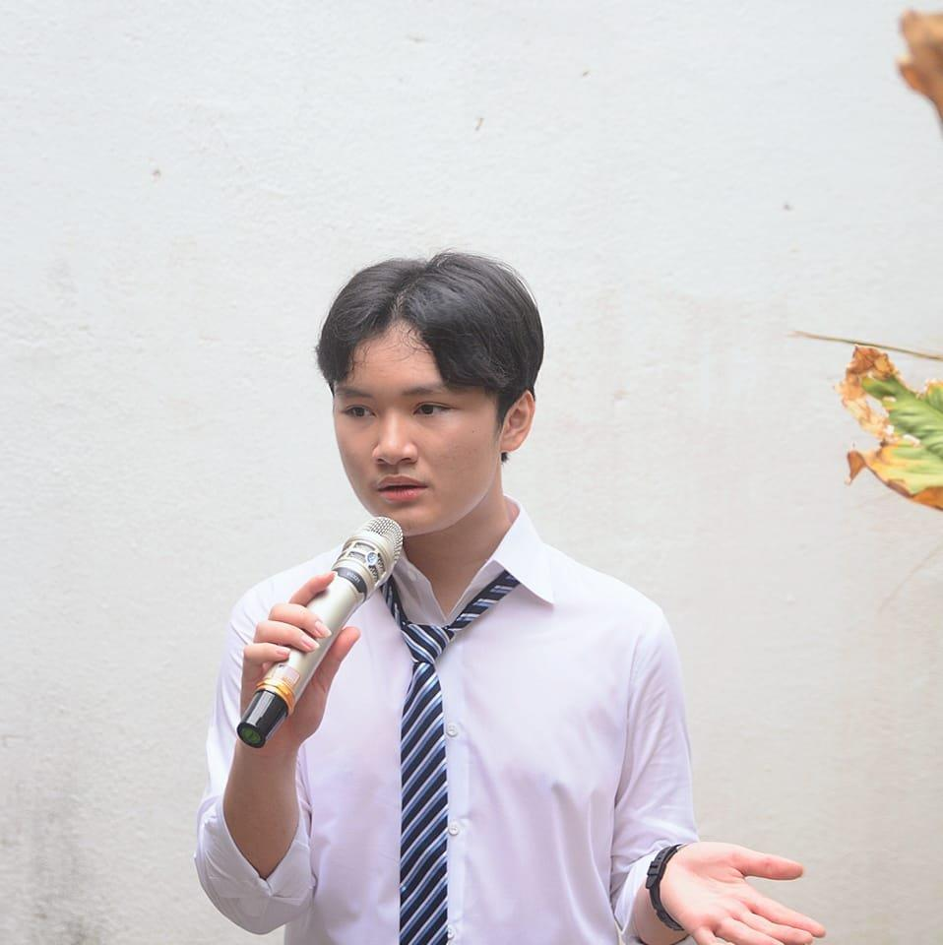
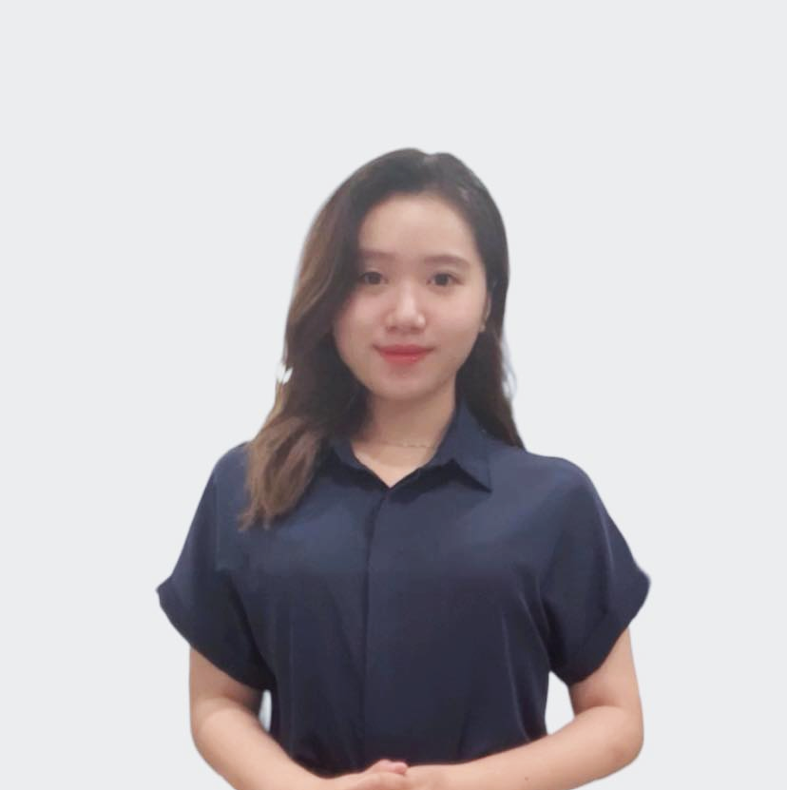

OUR TEAM [1]
Thai Vu Duc Anh
Tran Phuong Anh
Team Leader & Business Development Manager
Marketing & Communications Manager

Slide 6

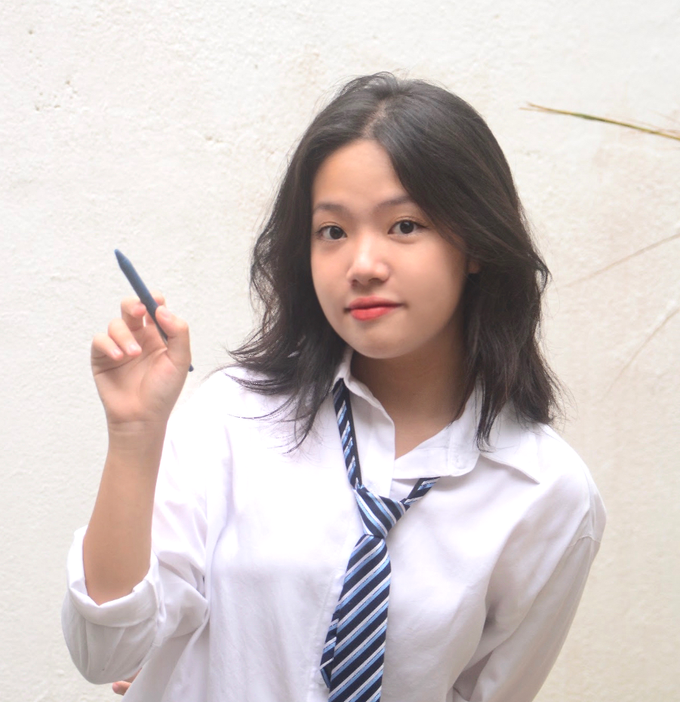
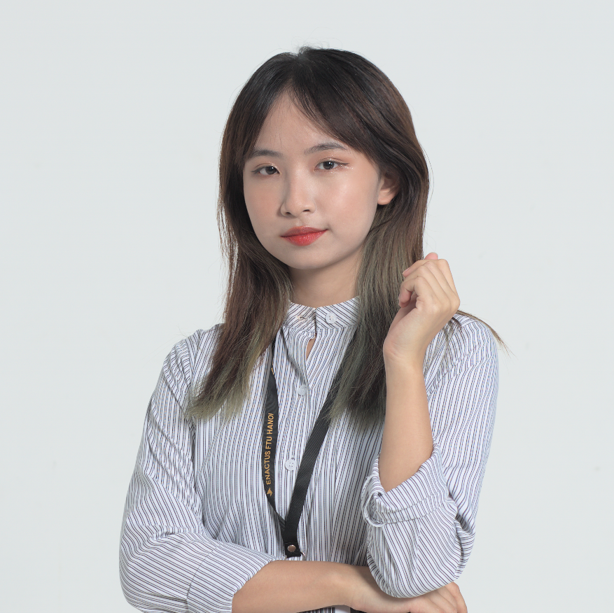
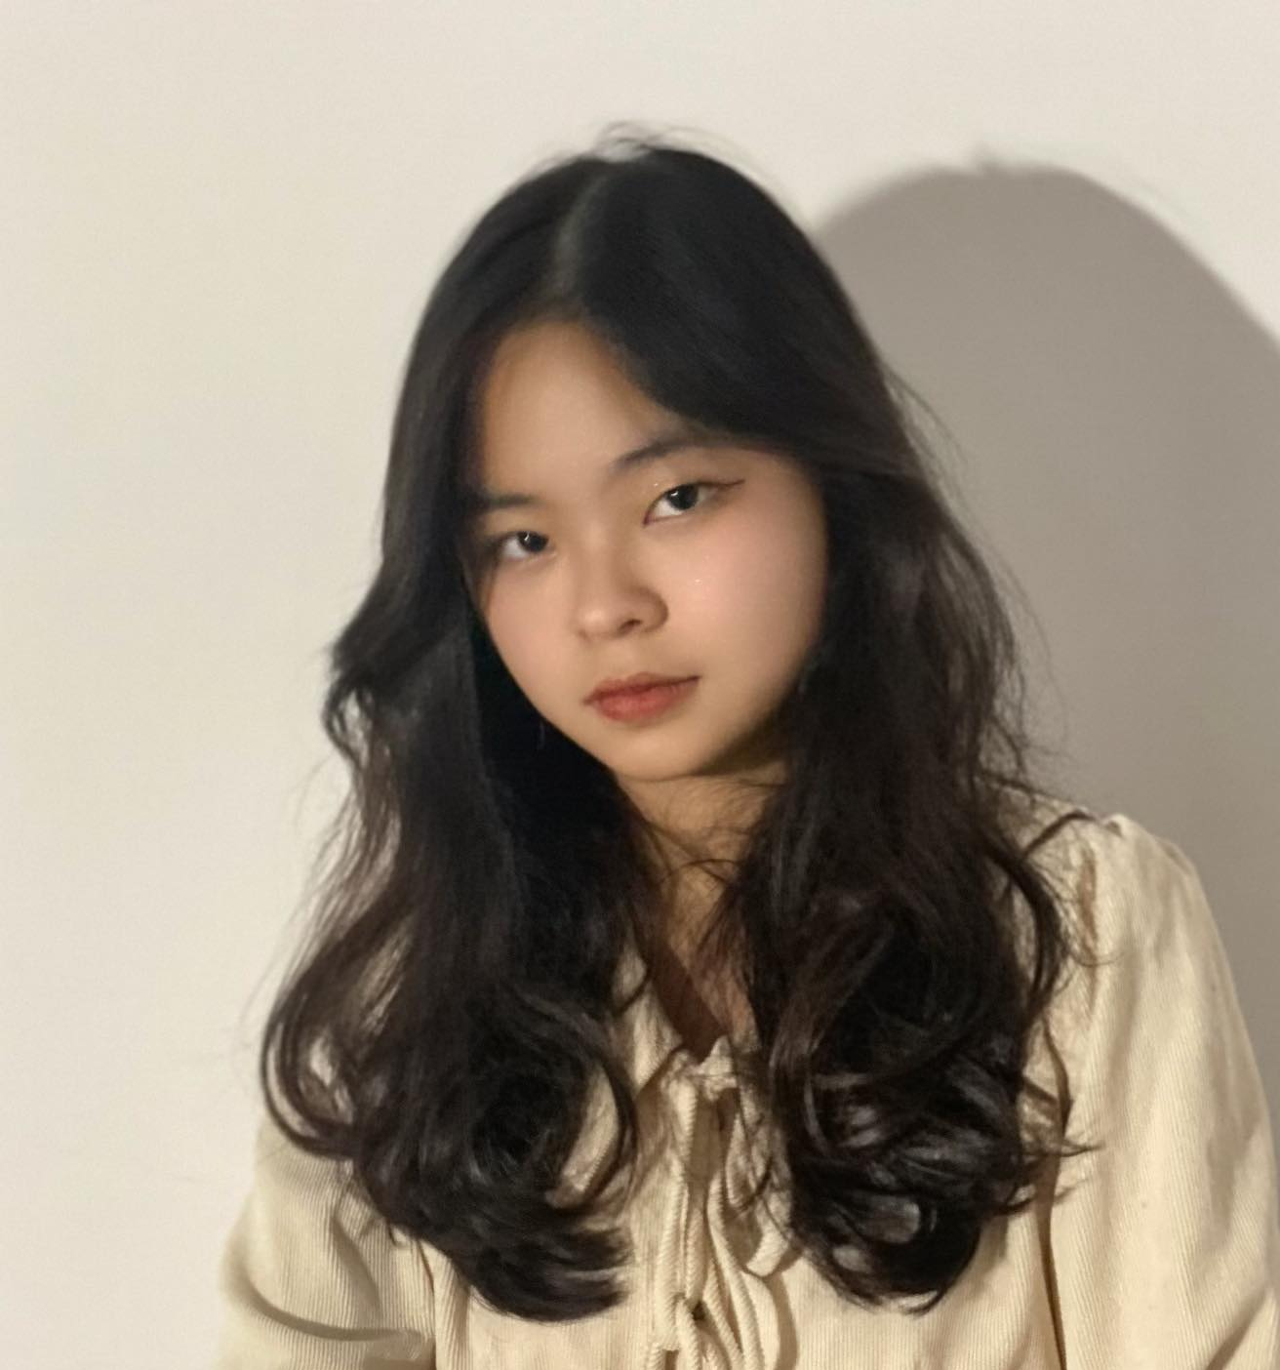
OUR TEAM [2]
Nguyen Thi Ngan Ha
Nguyen Thi Ha Van
Marketing &
Communications Executive
Research & Development Executive
Luong Thi Minh Huyen
Hoang Linh Trang
Sales Executive
Finance Executive
Partnership Specialist

Slide 7
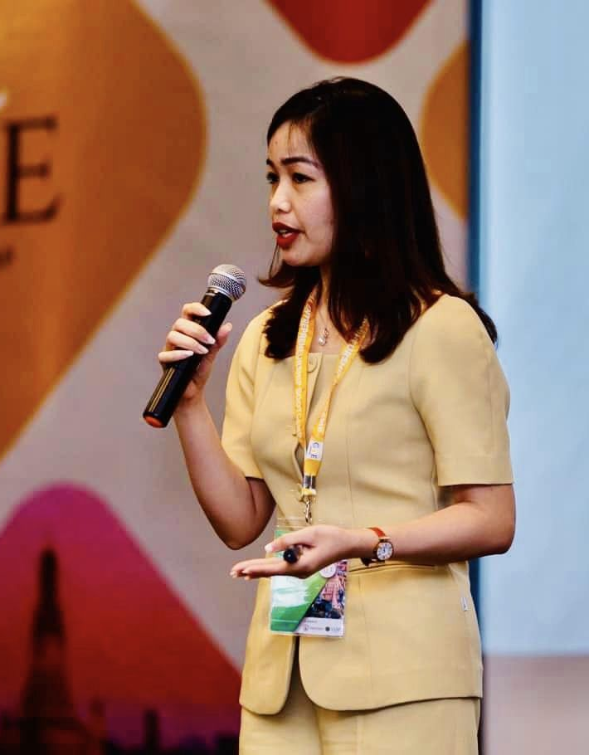
MS. NGUYEN THU HANG
COACH
- Deputy Director of FTU Innovation and Incubation Center (FIIS)
- Lecturer of International Trade Department, Foreign Trade University
- Managing SBC Program in Vietnam
- Coach of the Global Champion project and Finalist of SBC 2021, achieved certificate of SBC expert level consultant
- Facilitator Certificate in Active Citizenship - Social Enterprise (ACSE) issued by British Council
- 15 years of international trade research, agribusiness, export-oriented private sector
- 15 years of experience in training, consulting and coaching SMEs in the field of import and export, international market research
- 4 years of experience in mentoring and supporting startups

Slide 8

MS. NGUYEN THI LAN ANH
COACH
- CFO at Boxme Asia Company - A company providing logistics services and e-commerce solutions with a network in 5 Southeast Asian countries including Vietnam, Thailand, Malaysia, Indonesia and the Philippines .
- Having 8 years of experience in auditing and tax consulting services at large consulting firms. Accounting, financial and tax review consulting for more than 100 businesses in many fields.
- Training and guiding at tax seminars for CFOs, chief accountants and in charge of accounting in several companies.

Slide 9
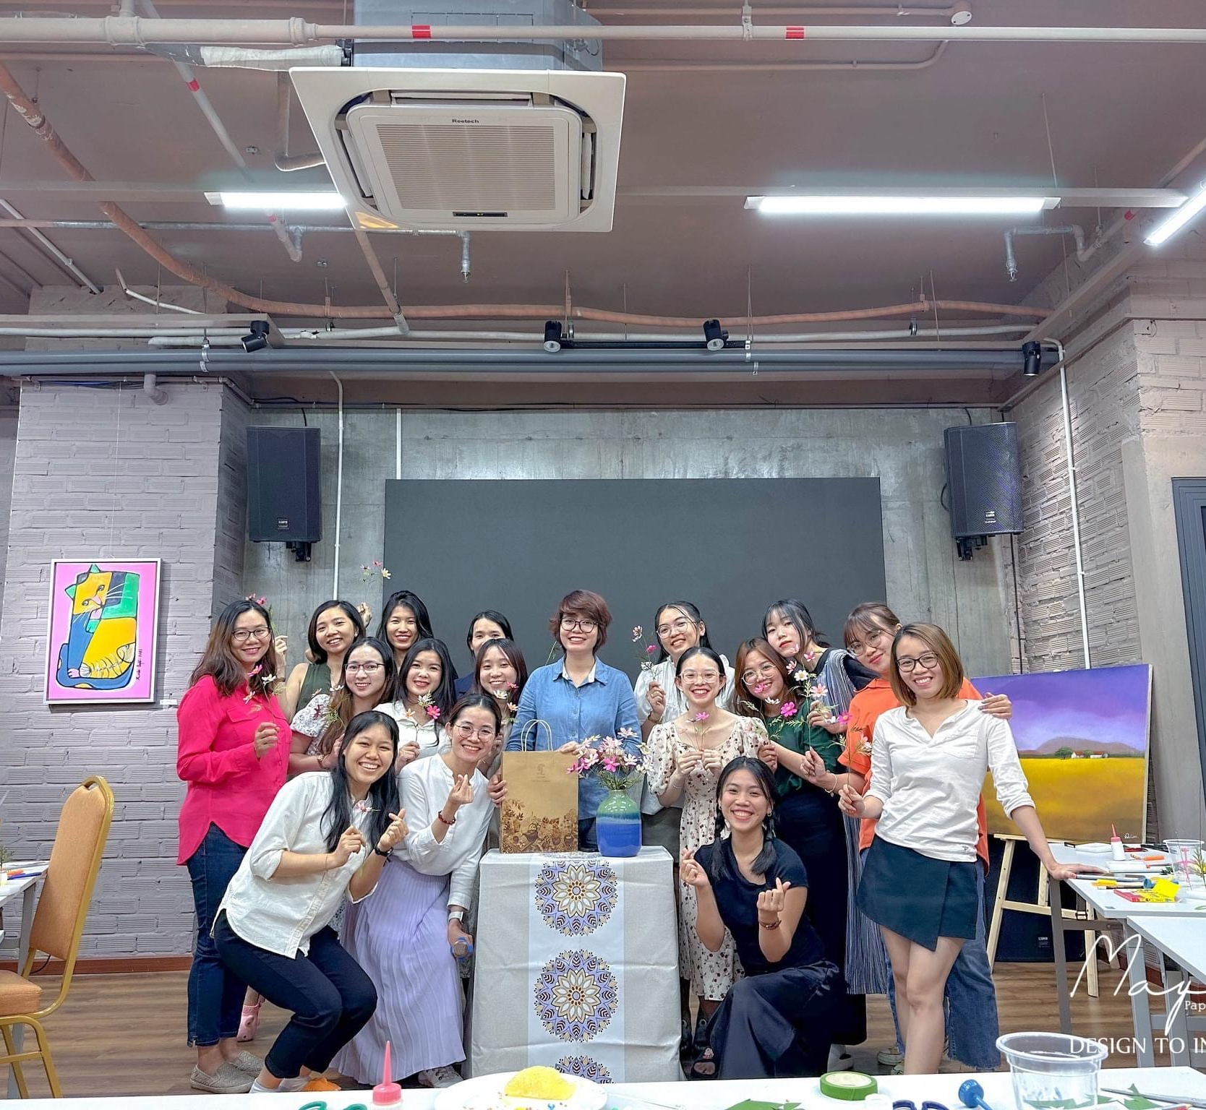
MAYPAPERFLOWER
Maypaperflower and our products are inherited and inspired by the traditional craft village of Thanh Tien paper flowers art - more than 300 years of age in Hue city, VN

Slide 10
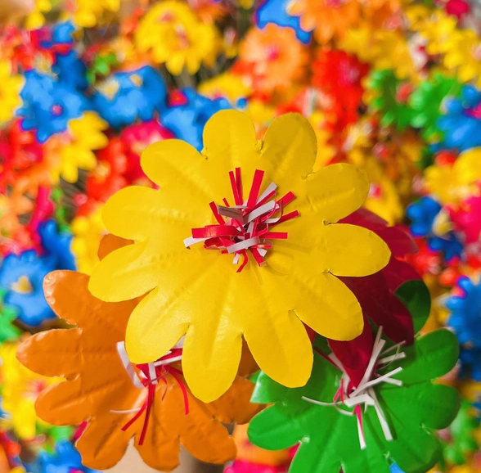

MAYPAPERFLOWER
MORE CREATIVE ART PIECES
that combine
TRADITIONAL
TECHNIQUES
MODERN
DEMANDS
Create more attractive products that best fit the customers’ changing needs nowadays

Slide 11
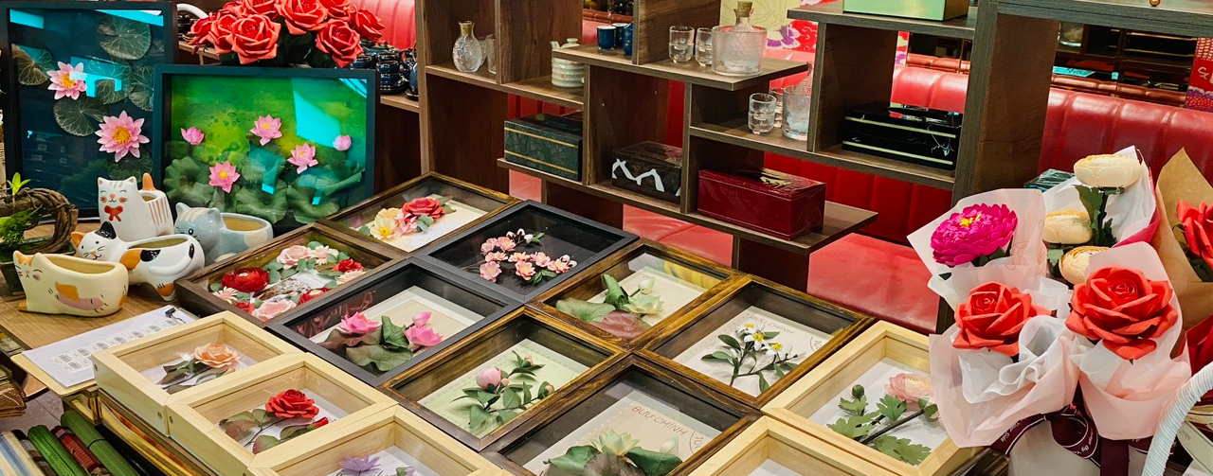
MAYPAPERFLOWER’s PRODUCTS

Slide 12
OUR AIMS
AND VISIONS
Preserve the Vietnamese traditional arts and cultural values
Support the development of the local economy and solve the employment problems for disadvantaged groups
Orient customers to use eco-friendly art pieces

Slide 13
TABLE OF CONTENTS
01
TEAM & BUSINESS INTRODUCTION
02
OUR TARGETED
SOCIAL ISSUES
03
CURRENT SOLUTION LANDSCAPE
04
OUR SOLUTION
05
STAKEHOLDERS

Slide 14
TABLE OF CONTENTS
02
OUR TARGETED
SOCIAL ISSUES
01
TEAM & BUSINESS INTRODUCTION
03
CURRENT SOLUTION LANDSCAPE
04
OUR SOLUTION
05
STAKEHOLDERS

Slide 15
5WHYs
Noone realized the potential labor groups & the cheap, green product materials made from redundant substances
As handmade products are expensive, customers opt for modern art products from profit-maximized companies, irrespective of its harms to themselves & to the environment
No sellers provide products that are both cheap and eco-friendly
Eroded traditional Values
Customers have no consciousness of the bad impacts of such products on themselves &the environment
Less appearance, fewer traditional products sold, exhibited or traded
No customers
Only small businesses are selling these products, and they lack labour resources
They have not realized the potential labour groups, such as the disadvantaged people
Lack of improvement in current traditional products’ designs

Slide 16
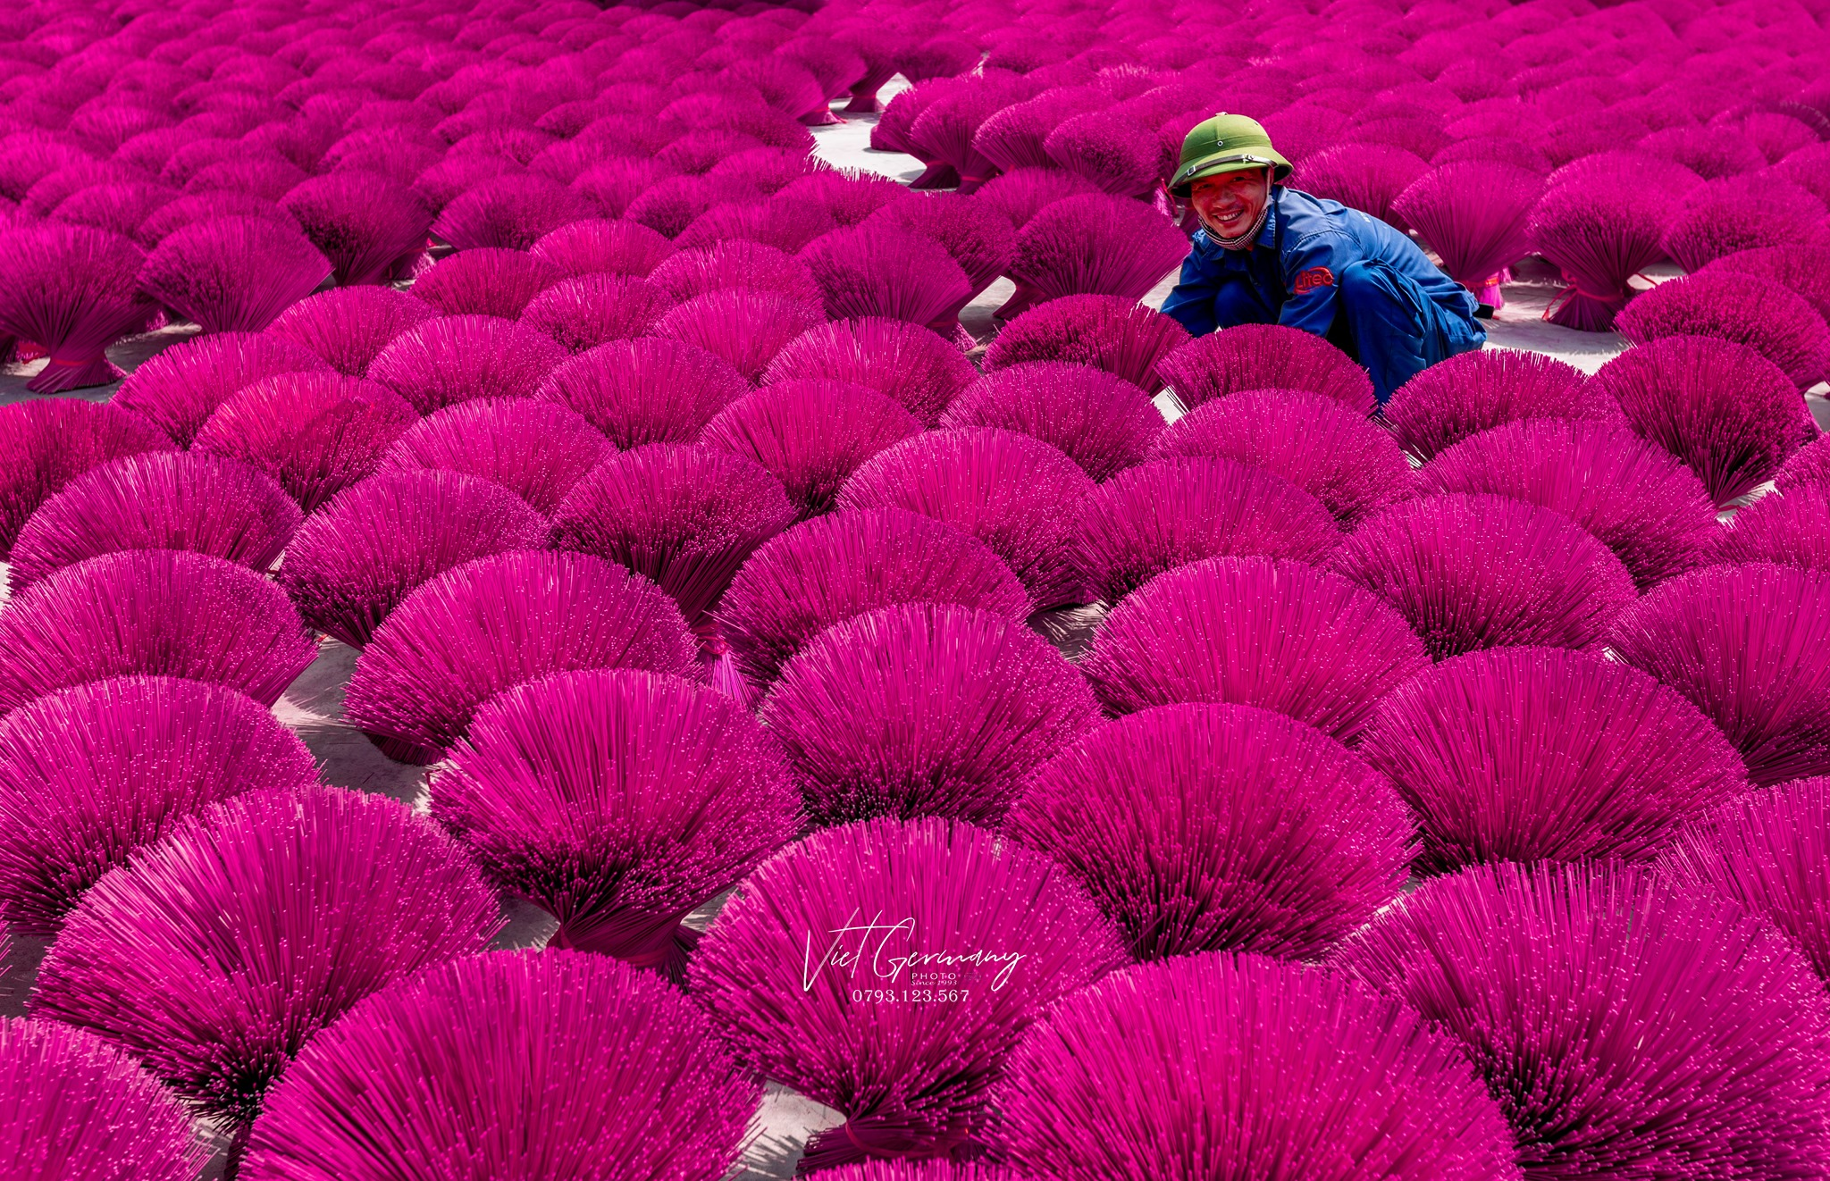
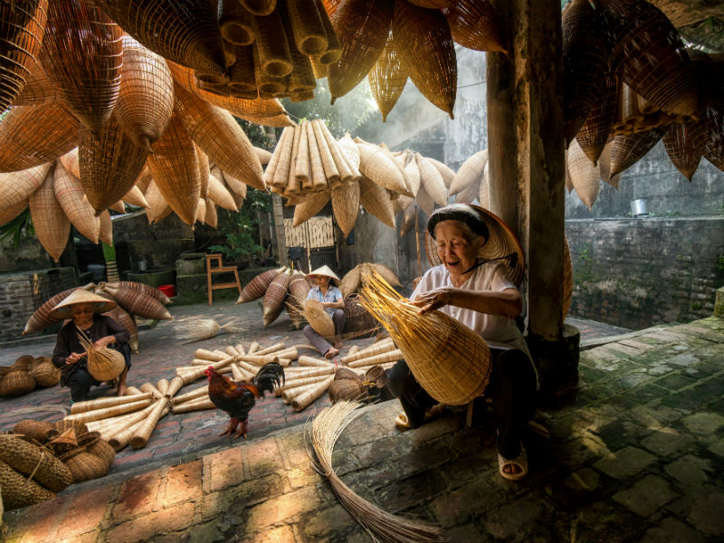
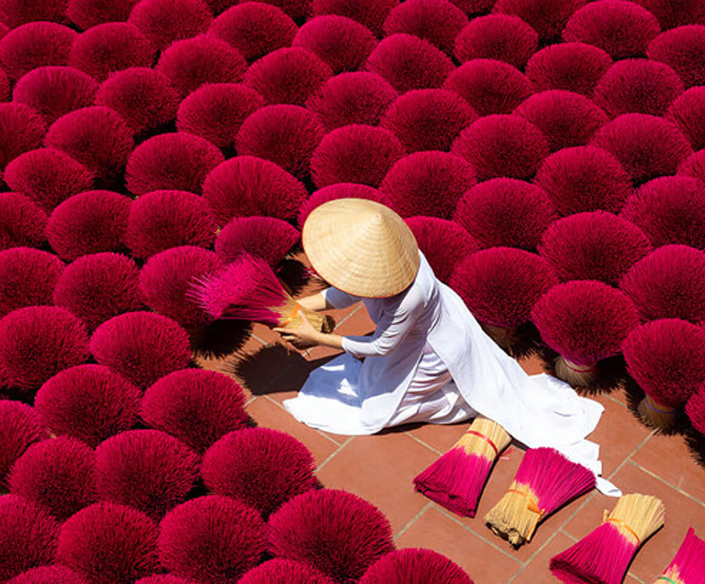
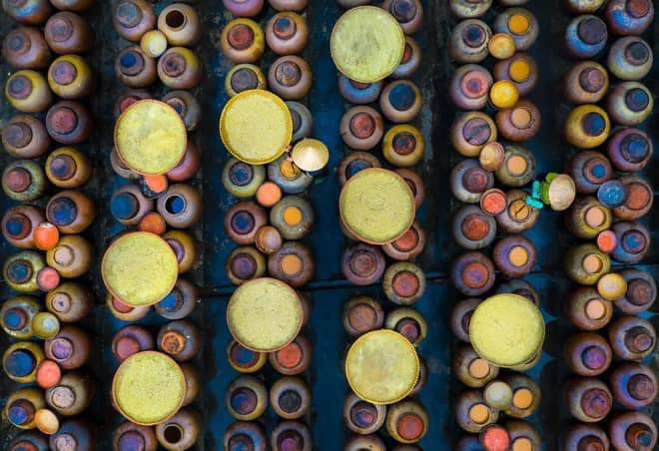
Maintaining and conserving traditional craft communities
“CHANGING DEMANDS”
In Hanoi: 544 villages have disappeared

Slide 17
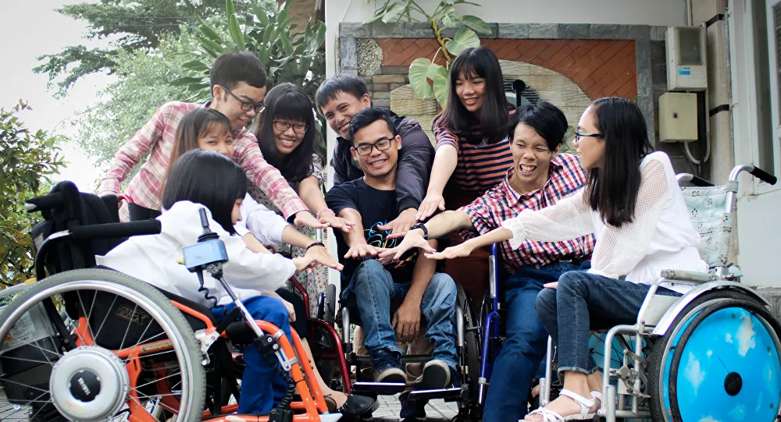
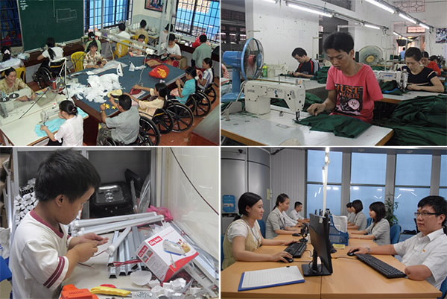
Career prospects for people with impairments and those in challenging circumstances
There are few career prospects for those with impairments
People with disabilities can not have the same job opportunities as others, as modern social development requires higher diplomas and working abilities

Slide 18


Gender Inequality
In 2019, while unpaid family labor for men is 9.2%, the figure for women is 19.4%
Average income of women is always lower than that of men
Male workers (6.5 million VND)
Female workers(4.6 million VND)

Slide 19
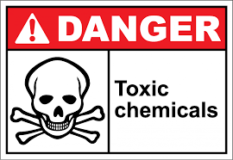
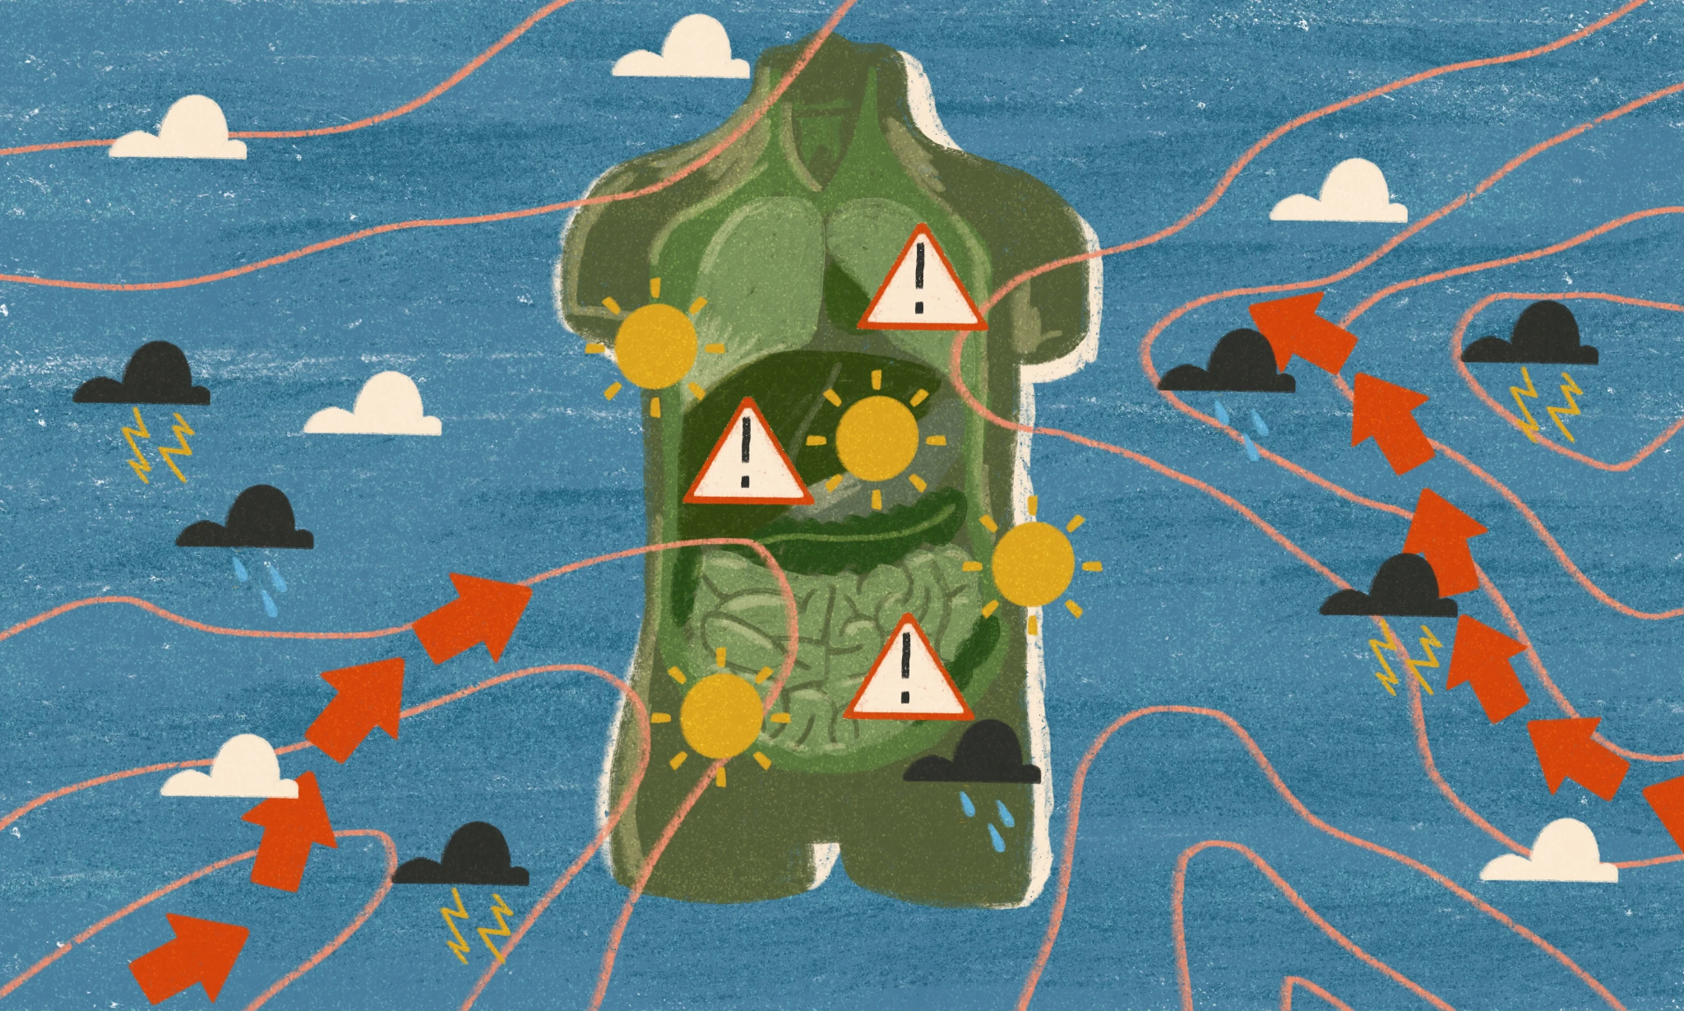
Environment
As businesses want to maximize their profits, art pieces nowadays are damaging both the environment and the health of their owners due to the number of toxic chemicals and natural sources required to produce

Slide 20
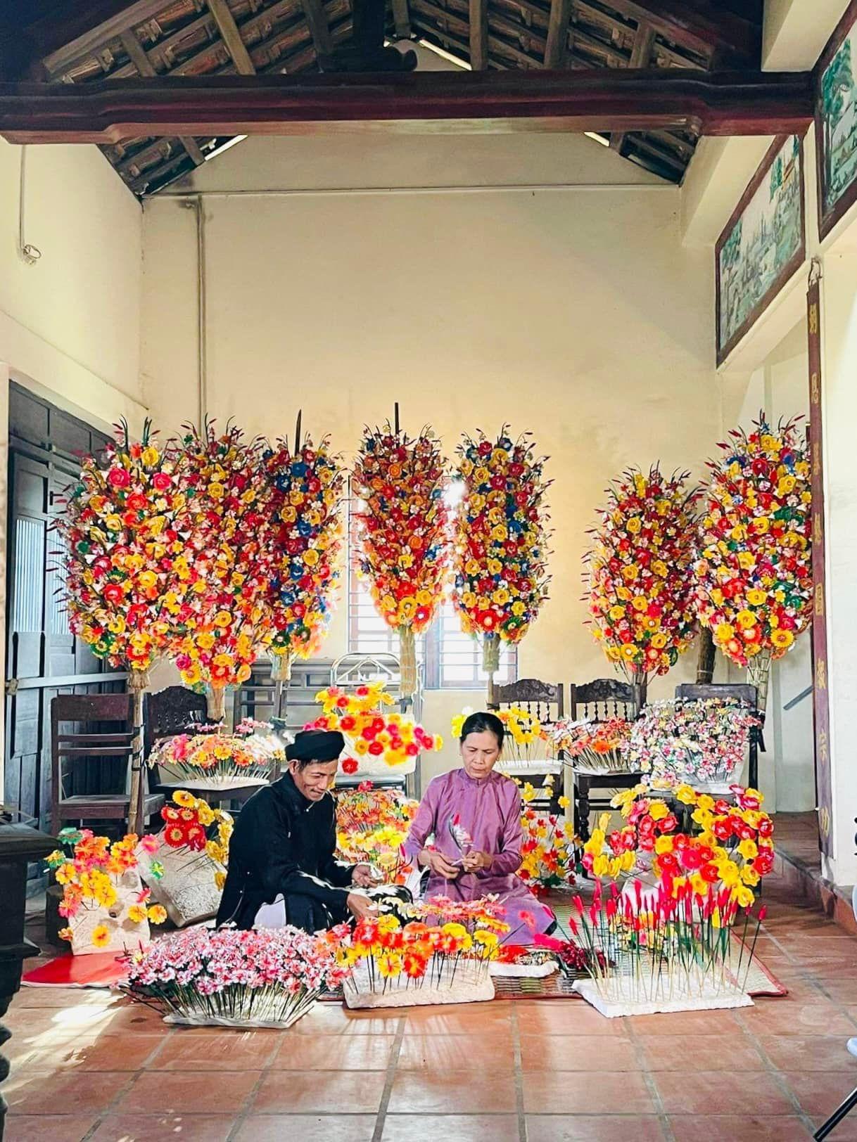
“Handmade paper flowers for traditional art preservation and job creation”

Slide 21
TABLE OF CONTENTS
02
OUR TARGETED
SOCIAL ISSUES
01
TEAM & BUSINESS INTRODUCTION
03
CURRENT SOLUTION LANDSCAPE
04
OUR SOLUTION
05
STAKEHOLDERS

Slide 22
TABLE OF CONTENTS
03
CURRENT SOLUTION LANDSCAPE
01
TEAM & BUSINESS INTRODUCTION
02
OUR TARGETED
SOCIAL ISSUES
04
OUR SOLUTION
05
STAKEHOLDERS

Slide 23
NGOC LAN ART & CRAFT
Eroded traditional values
Manufacturing high-class lacquer handicraft products. However, there are some drawbacks:
No innovation
& creativity
Cannot attract modern customers
Cannot keep up with modern demands
Fall into oblivion

Slide 24
TABLE OF CONTENTS
03
CURRENT SOLUTION LANDSCAPE
01
TEAM & BUSINESS INTRODUCTION
02
OUR TARGETED
SOCIAL ISSUES
04
OUR SOLUTION
05
STAKEHOLDERS

Slide 25
TABLE OF CONTENTS
04
OUR SOLUTION
01
TEAM & BUSINESS INTRODUCTION
02
OUR TARGETED
SOCIAL ISSUES
03
CURRENT SOLUTION LANDSCAPE
05
STAKEHOLDERS

Slide 26


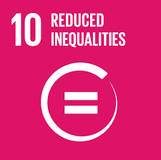
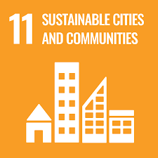
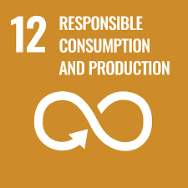
4 SUSTAINABLE DEVELOPMENT GOALS
SDG8: Decent work & economic growth
SDG10: Reduced Inequalities
SDG11: Sustainable Cities and Communities
United Nations
SDG12: Responsible consumption & production

Slide 27
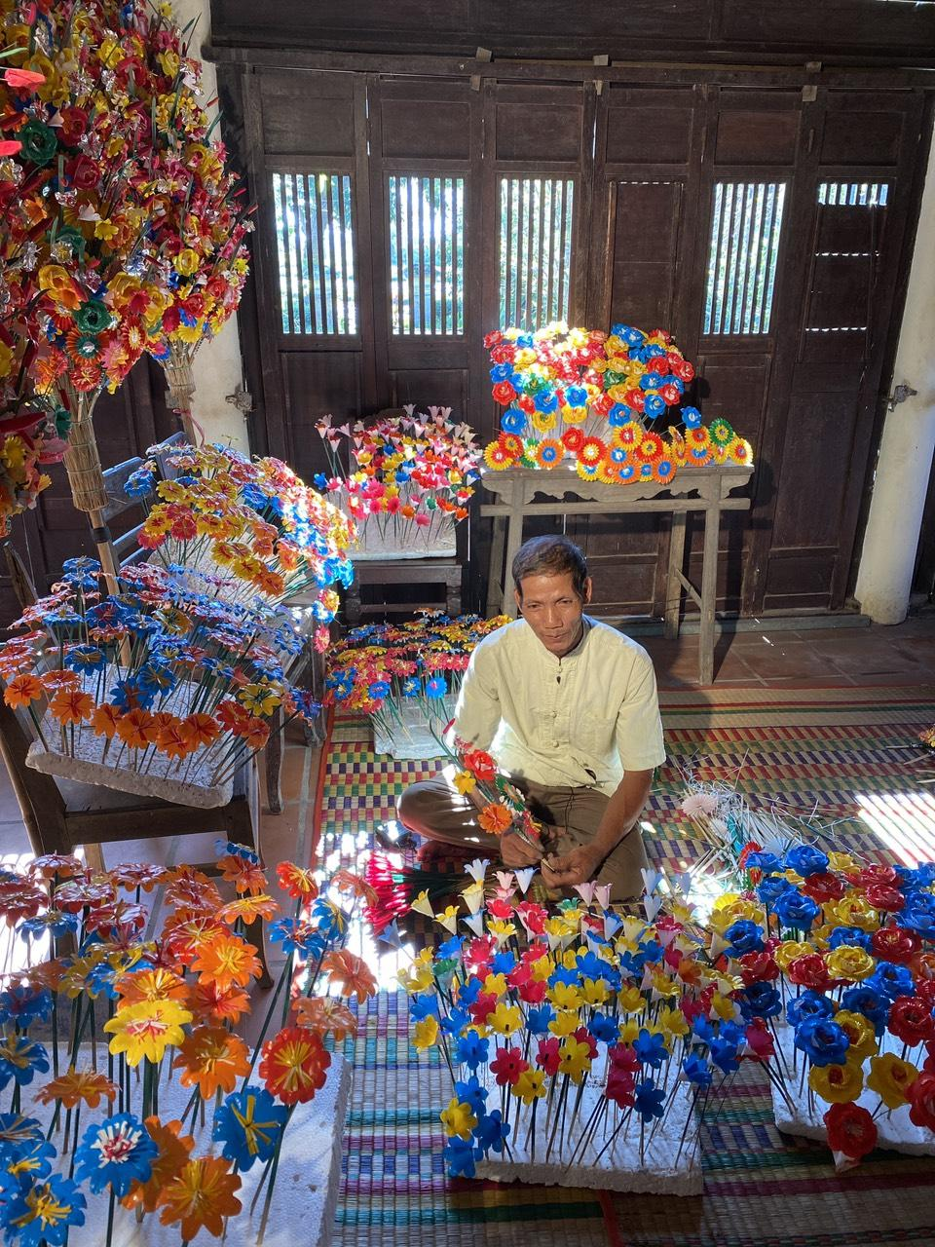
SOCIAL
BRICOLEUR
We perceive and act upon opportunities to address local social needs that we are motivated.

Slide 28
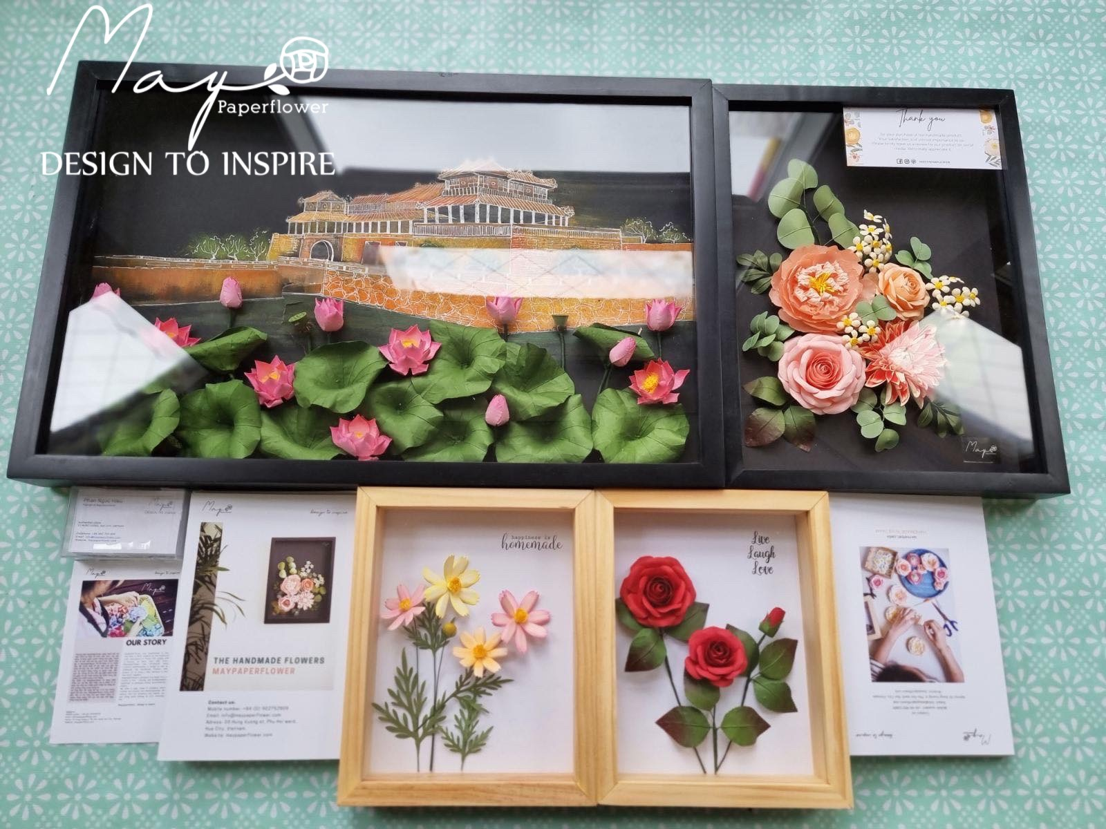
3 Main social impacts
Preserve Vietnam traditional arts and cultural values
Create job opportunities and solve income problems for disadvantaged people and Vietnamese artists
Orient customers to use eco-friendly products

Slide 29
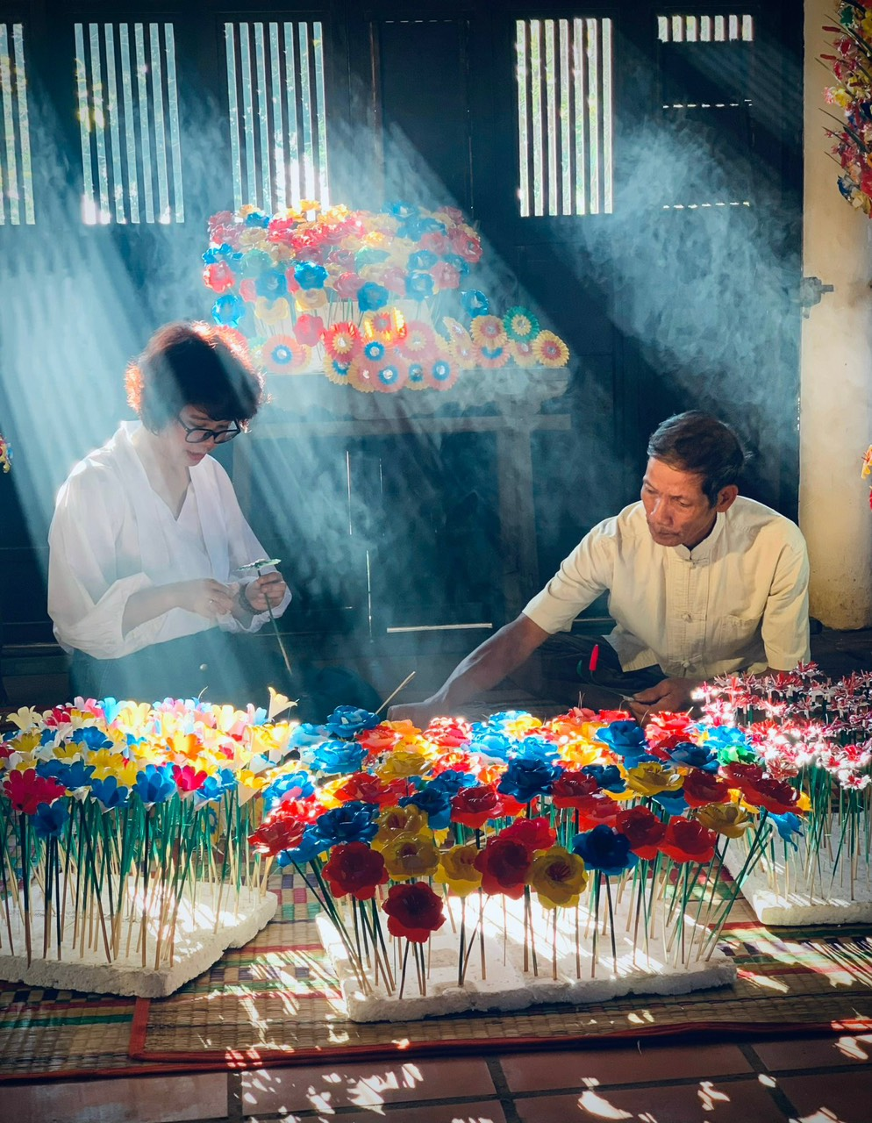
Social impact 1:
PRESERVE VIETNAM TRADITIONAL ART & CULTURAL VALUES

Slide 30
MAYPAPERFLOWER wants to be the first business in Vietnam to rebuild this market by creating products that combine:
Modern demand
Traditional techniques
Raise international awareness about the importance of country’s cultural values
SDG 11: SUSTAINABLE COMMUNITY

Slide 31


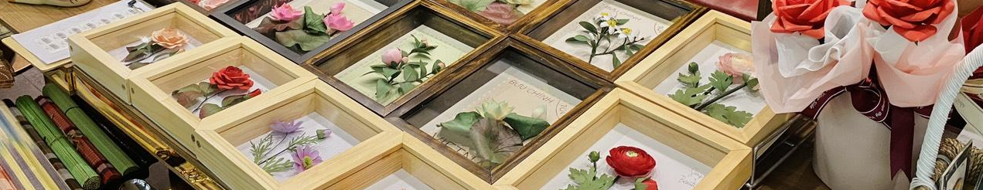
It’s hard for other business to copy our solution because:
It requires:
Local resources
Expertise related to paper flower arts
Maypaperflower already had trademark registration

Slide 32
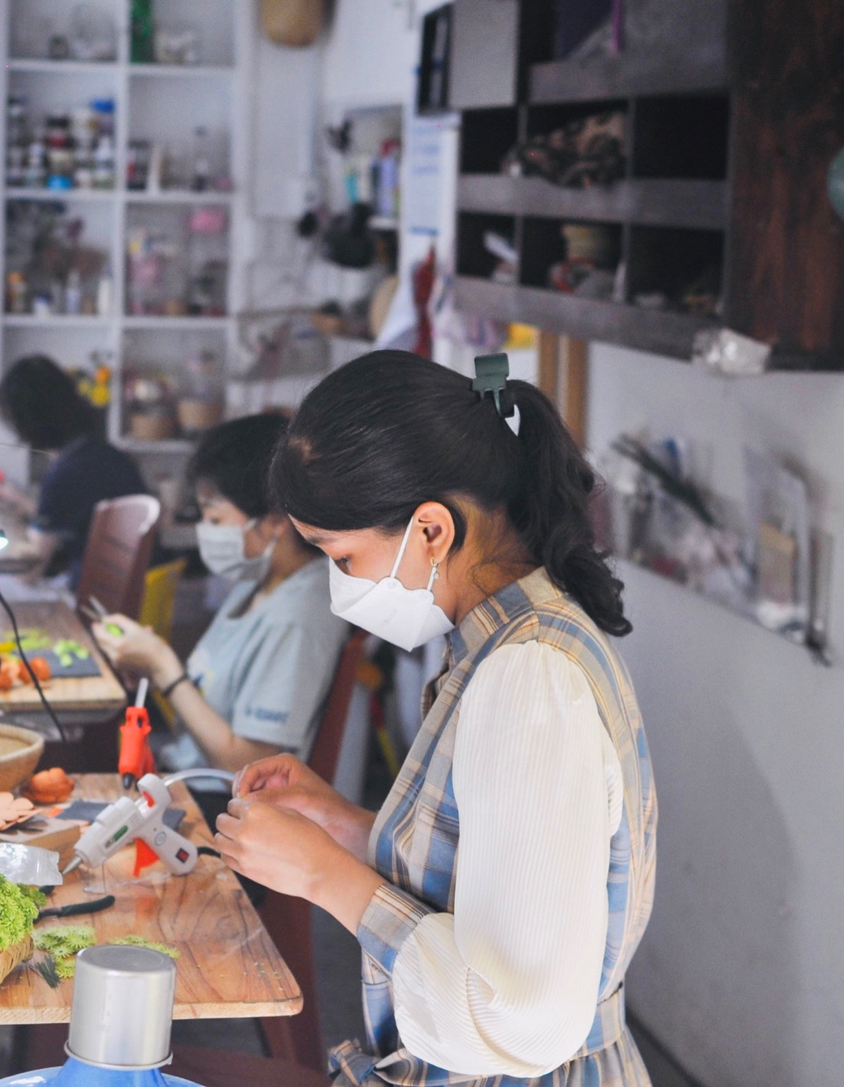
Social impact 2:
CREATE JOB OPPORTUNITIES

Slide 33
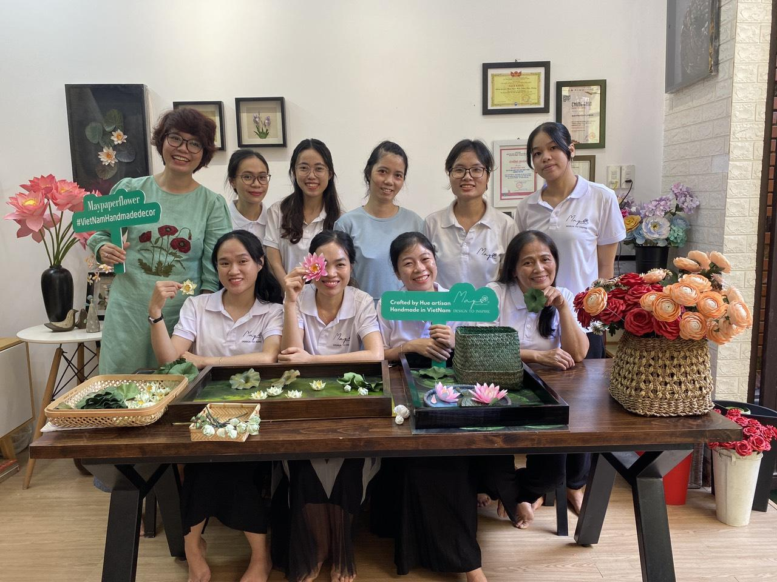
Job opportunities for:
Disadvantaged people (especially women)
Vietnamese artists
Flexible working opportunities
Specialized training suited to individuals
Suitable working positions
Equal income

Slide 34
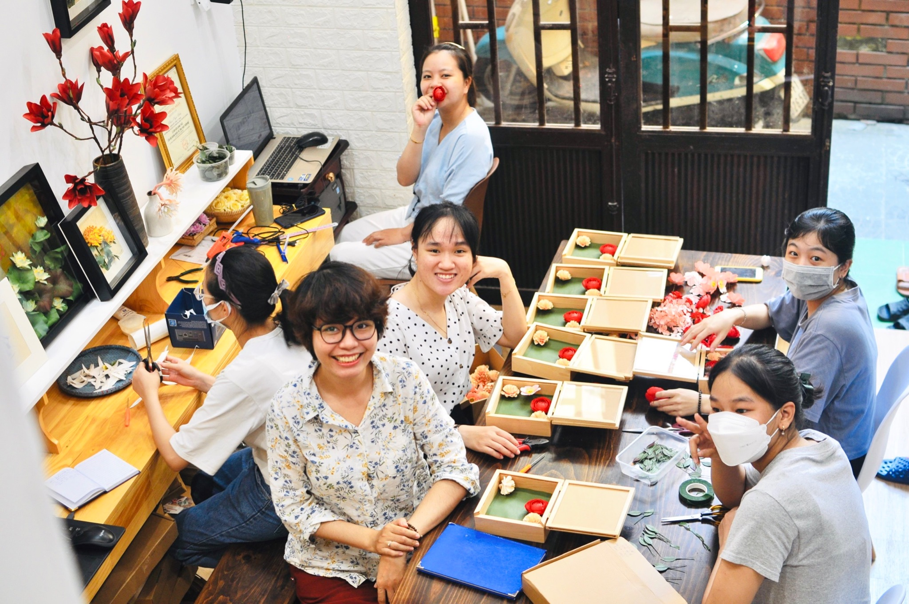
SDG 10:
Reduce inequalities
After survey,
All workers are satisfied
Government are happy

Slide 35
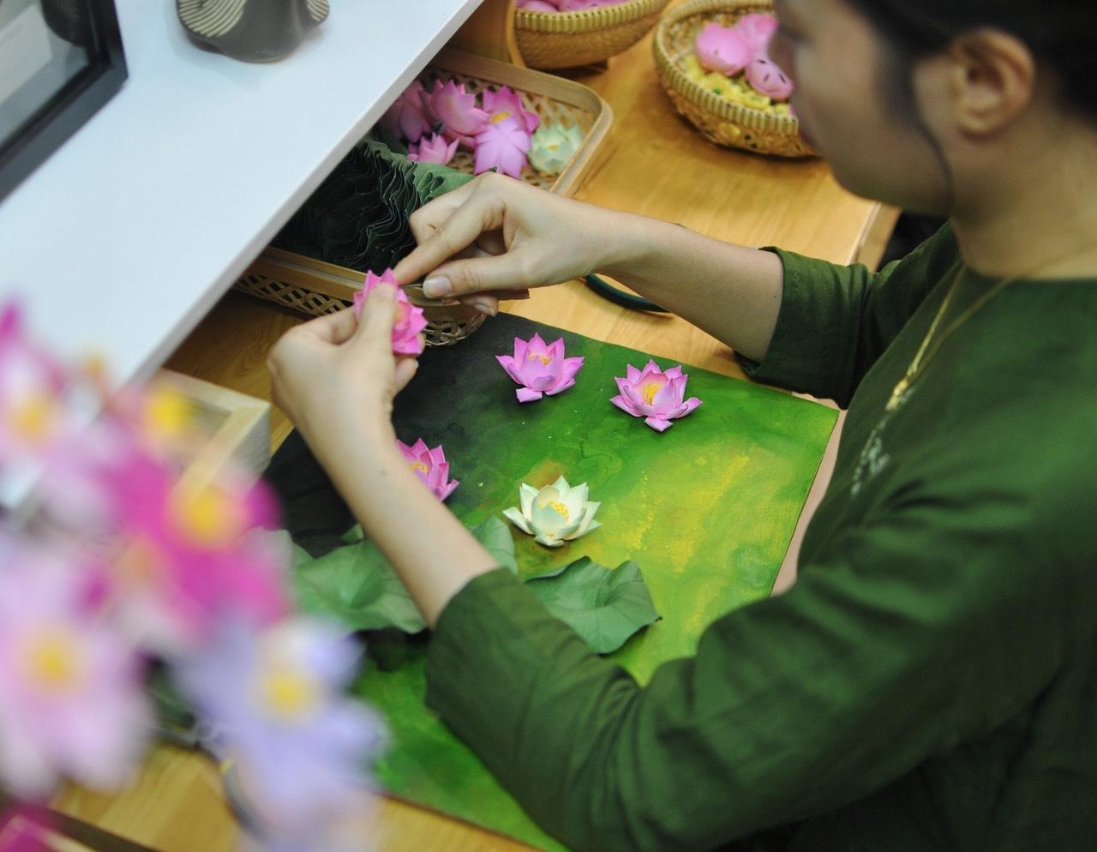
Social impact 3
ORIENT CUSTOMERS TO USE ECO-FRIENDLY PRODUCTS

Slide 36
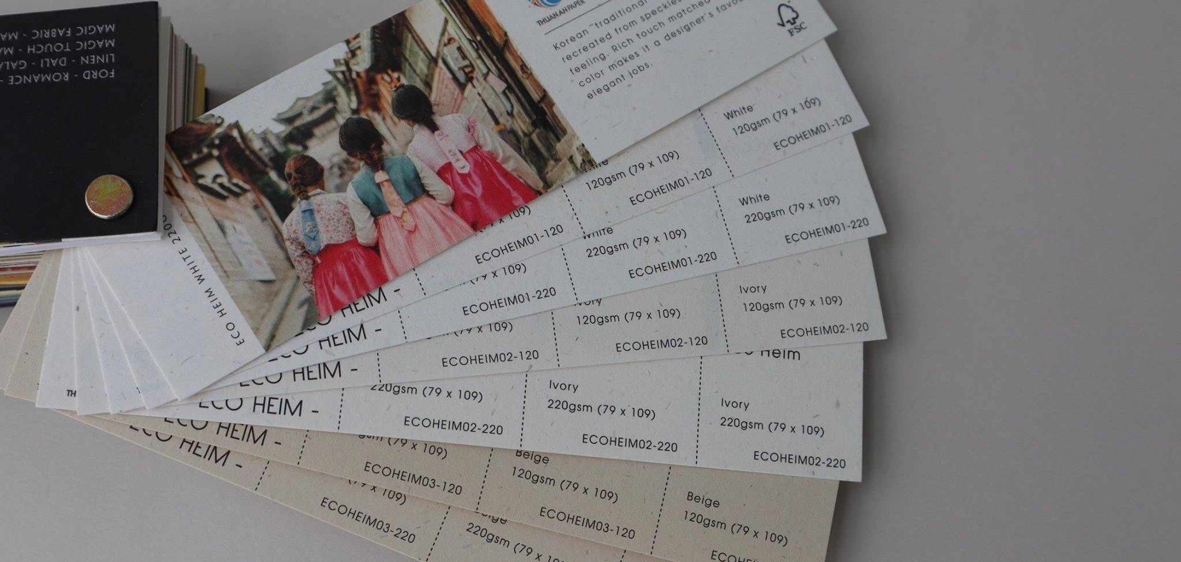
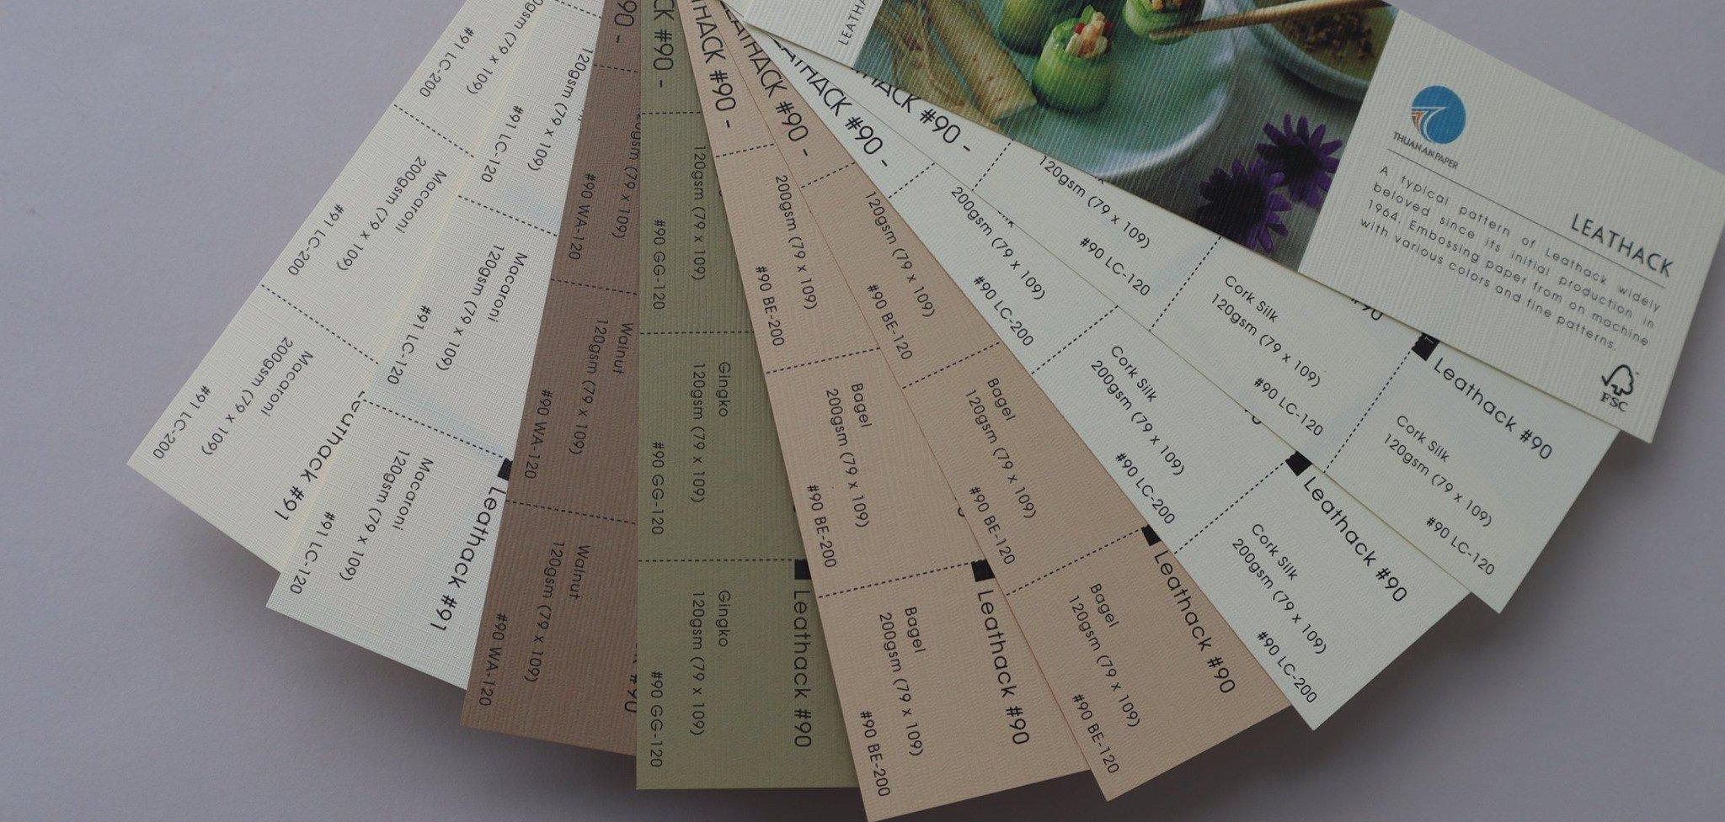
All art pieces are made from papers given by suppliers with FSC qualifications.
FSC certification in Vietnam is only available at some of the largest factories in Vietnam for wood import.

Slide 37

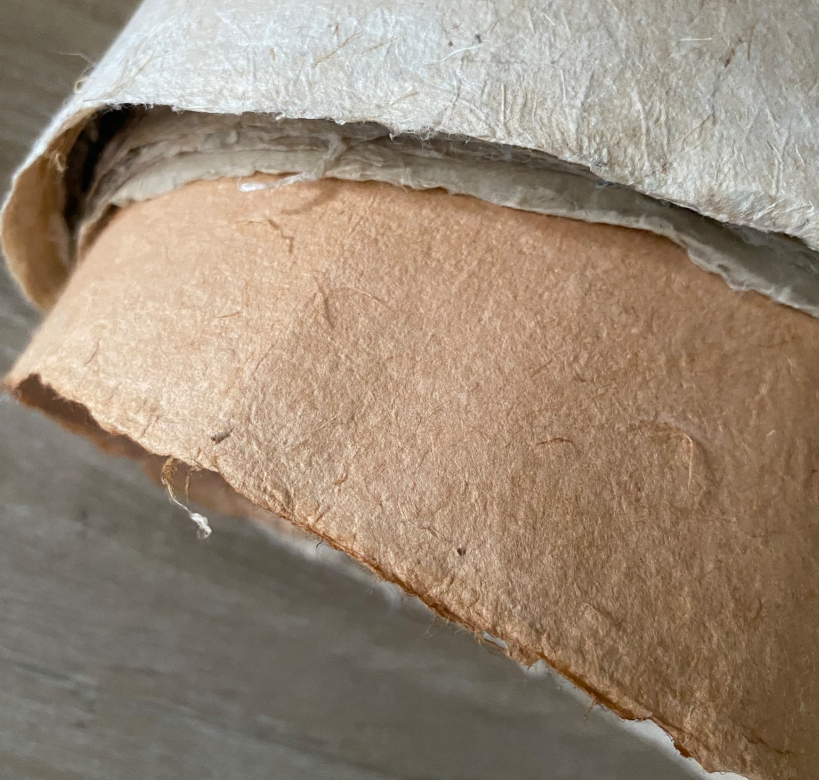
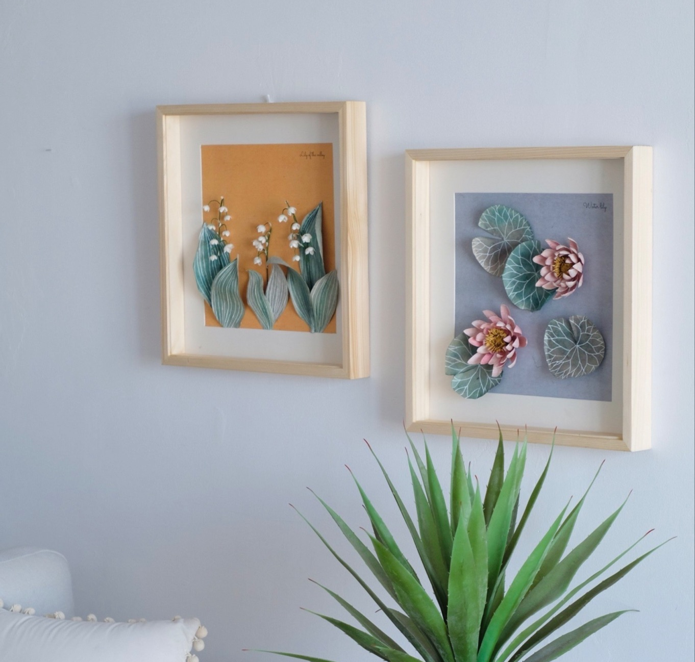

Papers made from redundant substances such as banana trees trunks, etc
Art frames made from solid pine: Longevous and reusable
With all that, we’re making art consumption and production more sustainable.

Slide 38
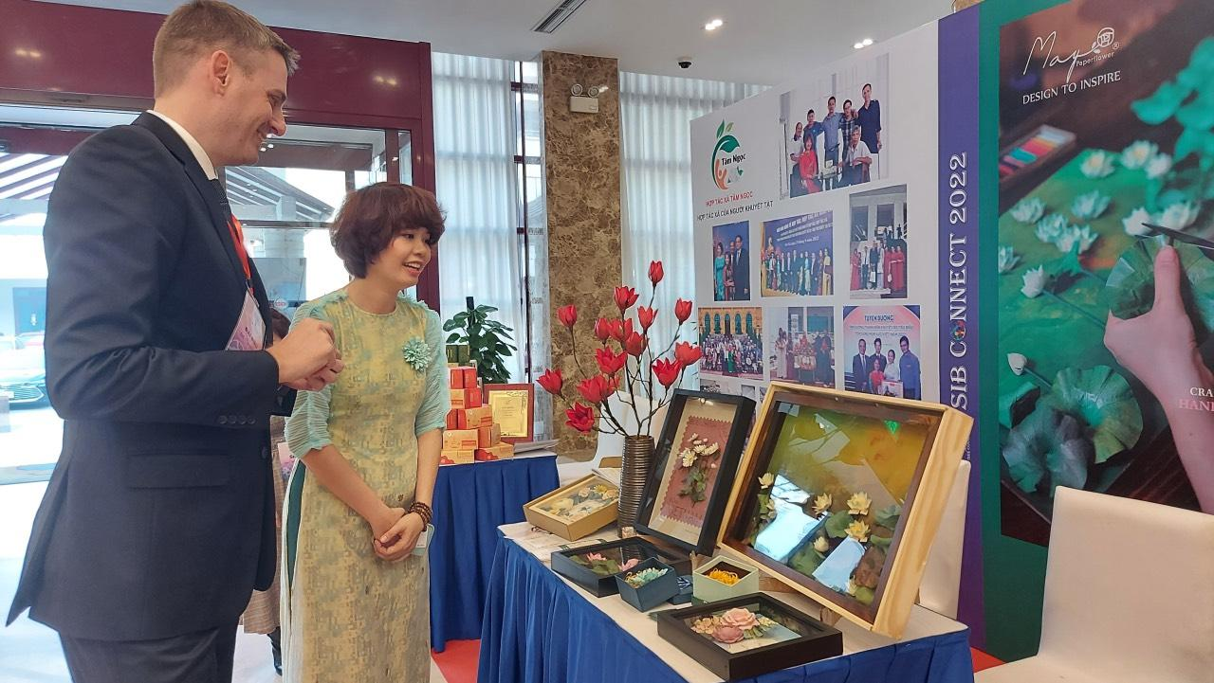
MAYPAPERFLOWER:
Unique, distinctive, strong vision-oriented social entrepreneur
Our beneficiaries include women, disadvantaged people, Vietnamese artists, art traditions, art factories, and our customers who want to use nontoxic art pieces

Slide 39
TABLE OF CONTENTS
04
OUR SOLUTION
01
TEAM & BUSINESS INTRODUCTION
02
OUR TARGETED
SOCIAL ISSUES
03
CURRENT SOLUTION LANDSCAPE
05
STAKEHOLDERS

Slide 40
TABLE OF CONTENTS
05
STAKEHOLDERS
01
TEAM & BUSINESS INTRODUCTION
02
OUR TARGETED
SOCIAL ISSUES
03
CURRENT SOLUTION LANDSCAPE
04
OUR SOLUTION

Slide 41
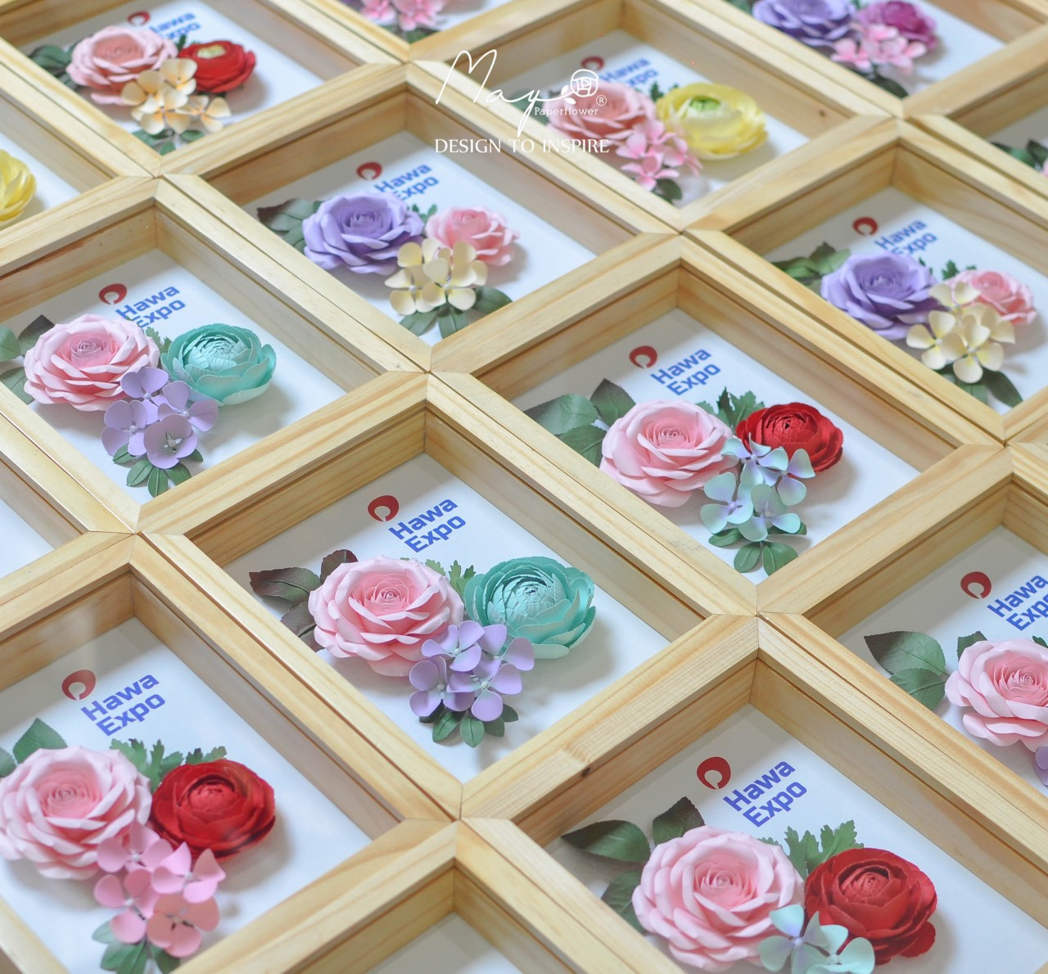
OUR VISION
Market
Product
Expanding the market
Diversifying the product

Slide 42
STAKEHOLDERS
Customers
Government
Sponsors/Investors
Affected Communities
Partners
Suppliers

Slide 43
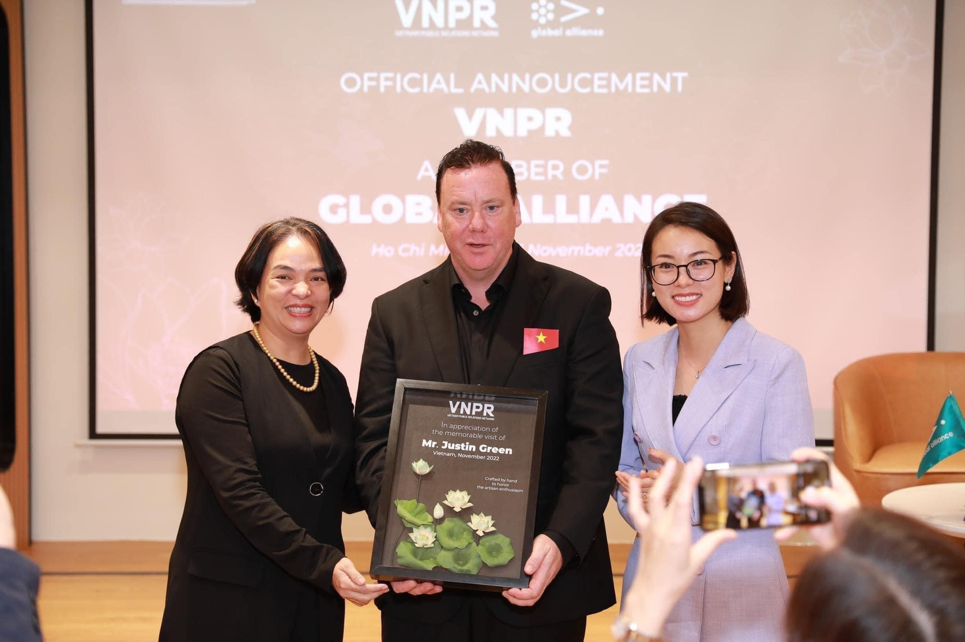
CUSTOMERS
B2B
B2C
Business & Firms
Locals, foreigners, Vietnamese overseas
Main market
Depends on personal preferences

Slide 44
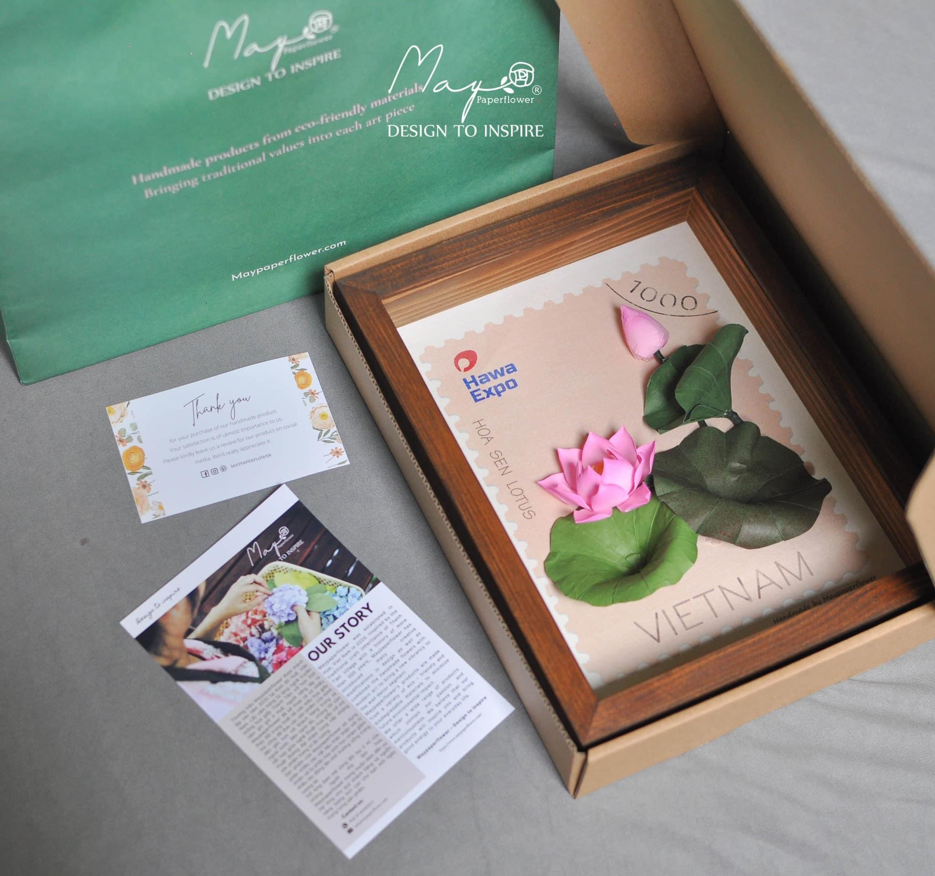
CUSTOMERS
Their benefits
Support needed
B2B
B2C
Purchase of products
Feedback, reviews
Cost-effectiveness
Convenient Distribution channel
Mental health
Reducing stress
High durability
Trustworthiness
Create good impressions on targeted customers
Increase sales
Cut marketing costs,
Become May’s strategic partner.

Slide 45
GOVERNMENT
Government’ funds
Investment
Reduced costs and lengthy business process

Slide 46
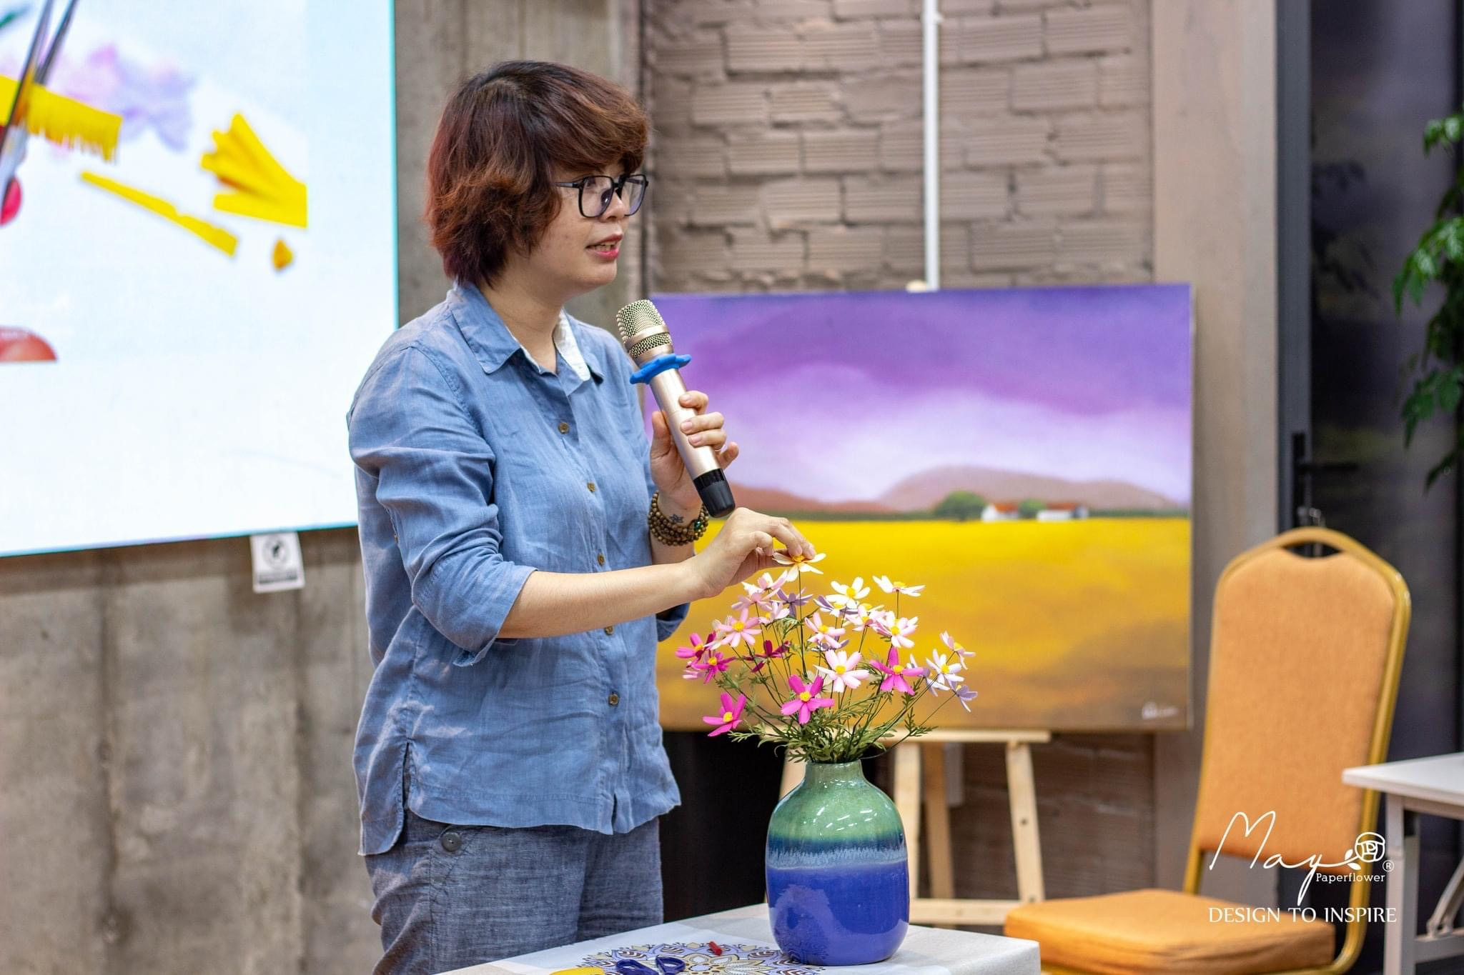
SPONSORS
INVESTORS
—NGOs, Banks
UNDP, United Nations, Unesco
—Non-government fund
I-SEE COVID, Viet Nam Start-up Fund SVF
—Business & big firms
Parties who have need to buy gifts for their partners: Prudential, PWD, …
“Any parties wanting to create Social Impacts & have a desire to boost their brand recognition”

Slide 47
SPONSORS/INVESTORS
Their benefits | Support needed
Increase the branding power, credibility | Funds, Cash
Promote & spread their image | Training for staffs, Promotion, Media Support
Create social impacts and use funds for meaningful purposes | In-kind sponsors (vouchers, samples, etc)

Slide 48
PARTNERS
Prestigious parties that can gain benefits derived from collaborating
Create a Win-Win situation where contracts are signed to protect the rights of both sides.
Art universities
Businesses & firms
Souvenir shops
Restaurants

Slide 49
PARTNERS
Their benefits | Support needed
Economic benefit | Understand customers' tastes, update new product types.
Reputation, promotion | Promote our business.
More customers | Places with a reduced fee.

Slide 50

SUPPLIERS
Suppliers for materials such as wooden frame, paper
Able to ensure their proper working condition
Able to provide evidence for their qualified products.

Slide 51
SUPPLIERS
Their benefits | Support needed
Economic benefit | Providing Materials at affordable/reduced prices.
Loyal customers, long-term partner
Stable sales and revenues

Slide 52
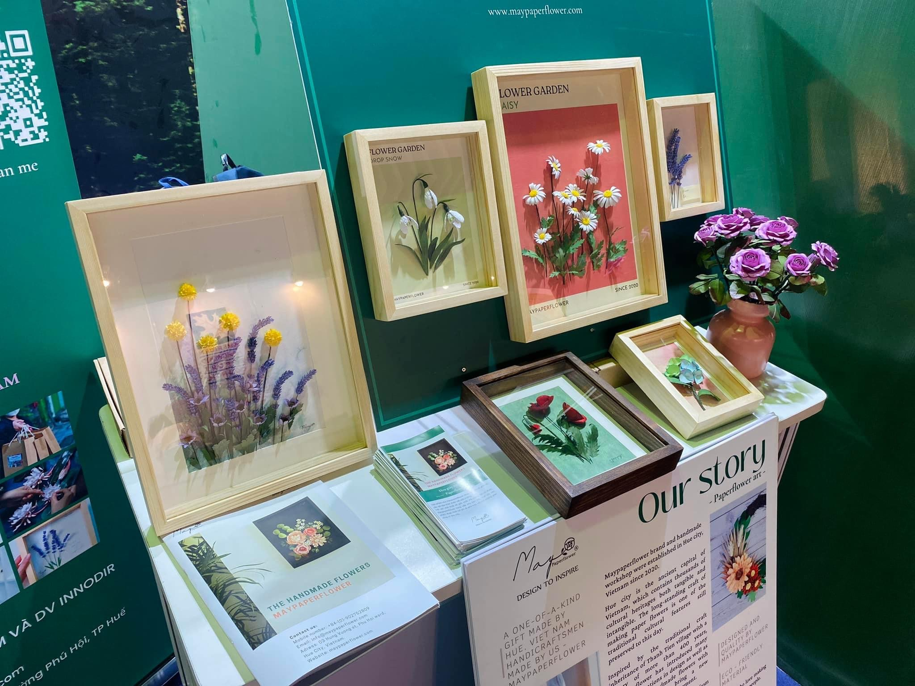
AFFECTED COMMUNITIES
Female and people with disabilities in Hue
Employment, salary
Network, learning motivation
Create social impacts by participating in the business to inspire others.

Slide 53
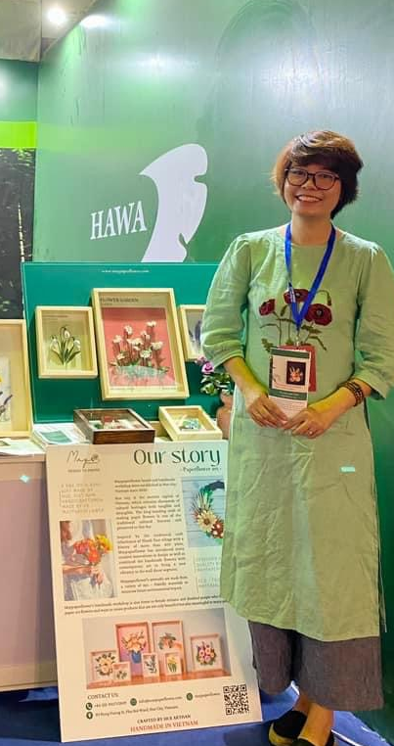
ENTRY POINTS TO REACH
STAKEHOLDERS
01
02
03
04
Email, personal contact
Marketing campaigns
By email, personal contact to introduce May
By marketing campaigns to spread the image and connect with stakeholders
Samples and gifts
Media
Send samples, gifts to stakeholders for them to test the product and create long-term relationships
Collaborate with the media to spread our image.

Slide 54
Social support
campaign performance

Slide 55
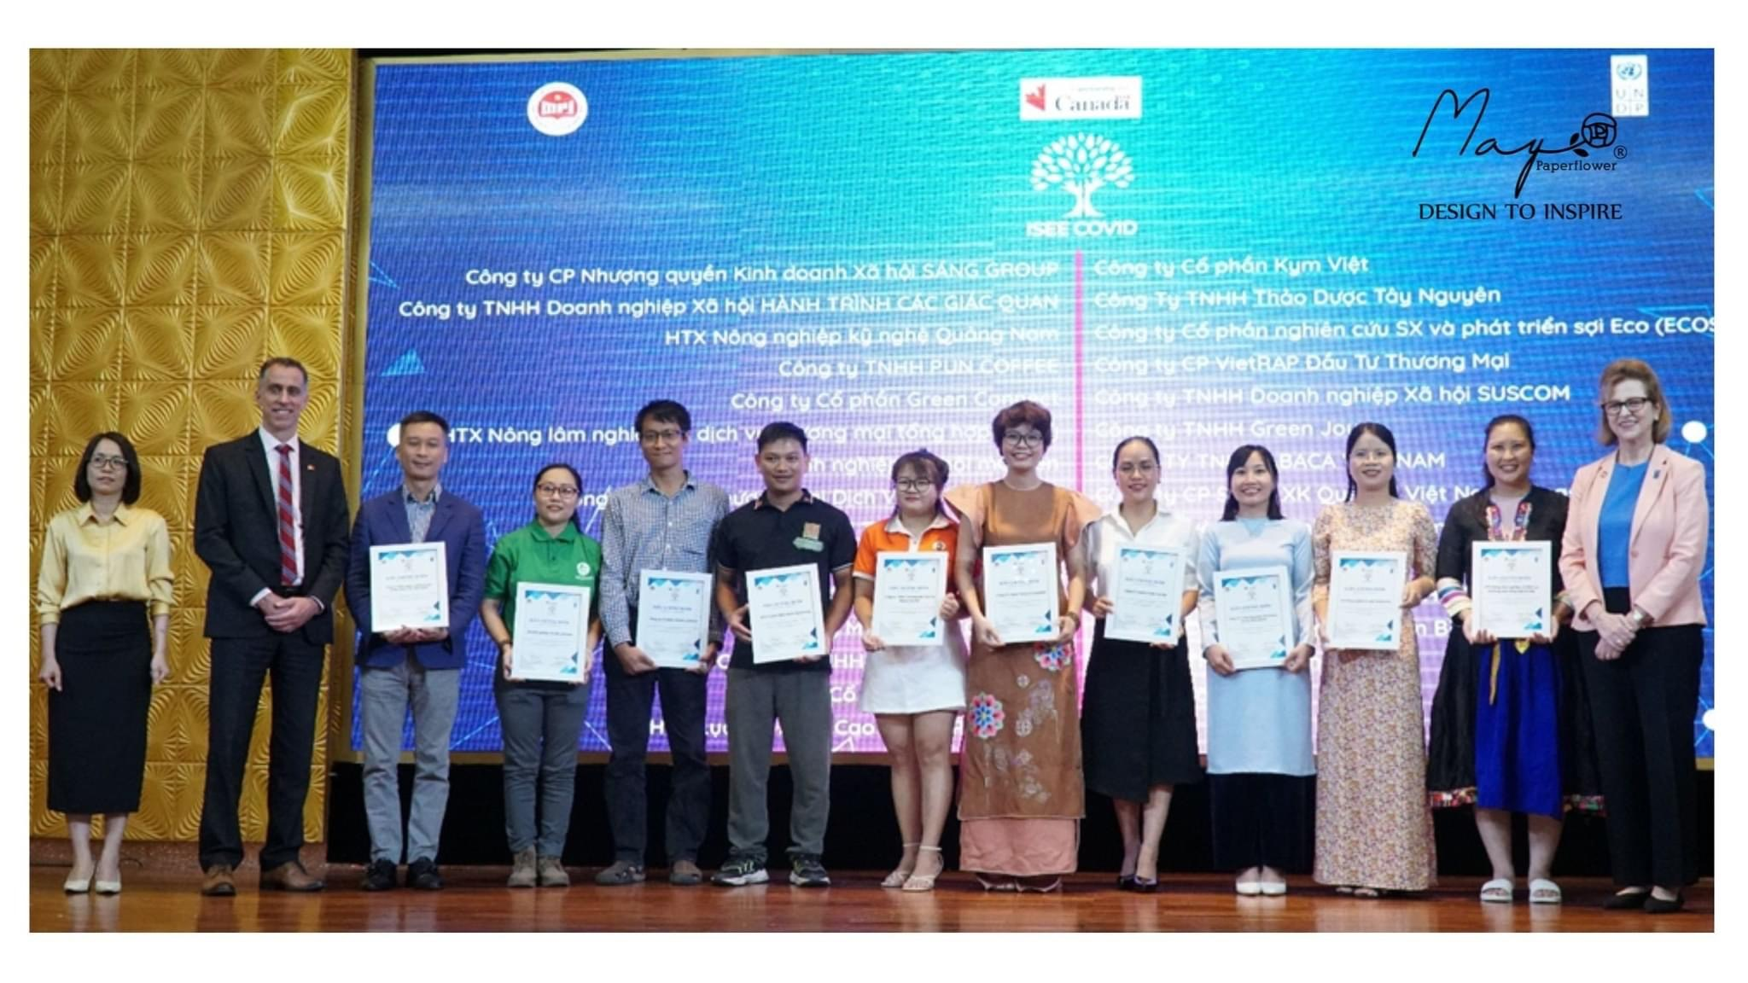
1 OF THE TOP 29
Businesses in Vietnam with strong social impact, recognized, certified, and funded in the IseeCovid program.

Slide 56
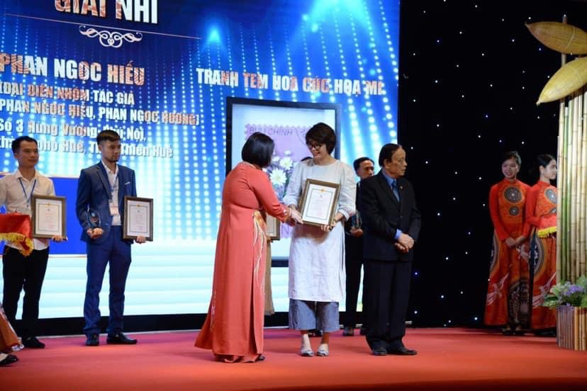
SHOWROOMS
Maypaperflower's showroom was exhibited in Malaysia and Eastern countries

Slide 57
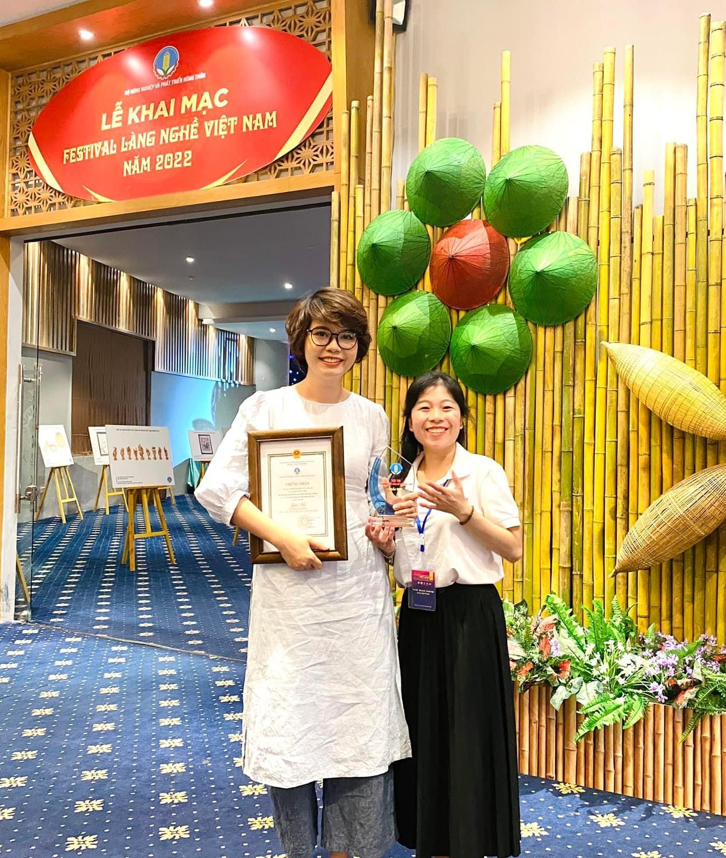
Prize A
Hue provincial startup competition 2020

Slide 58
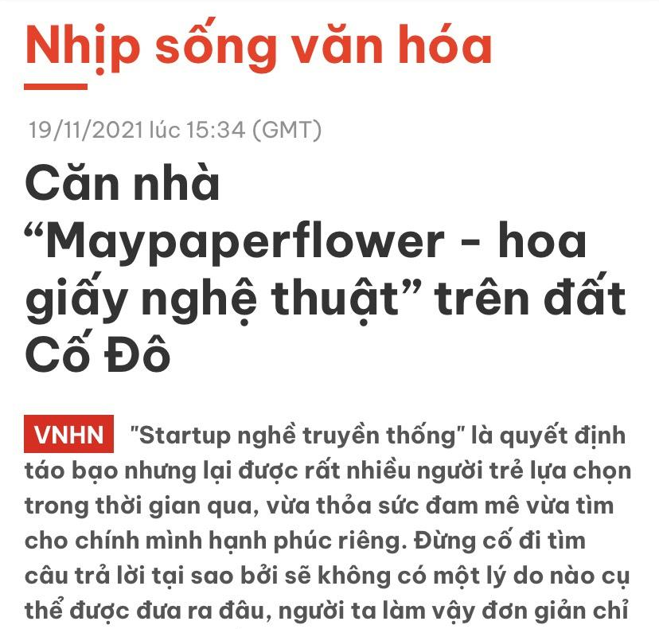
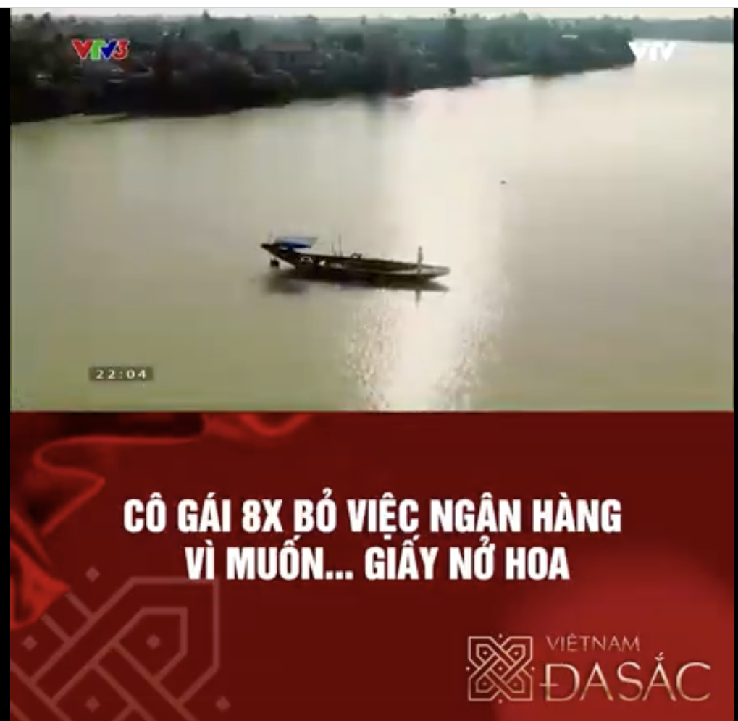
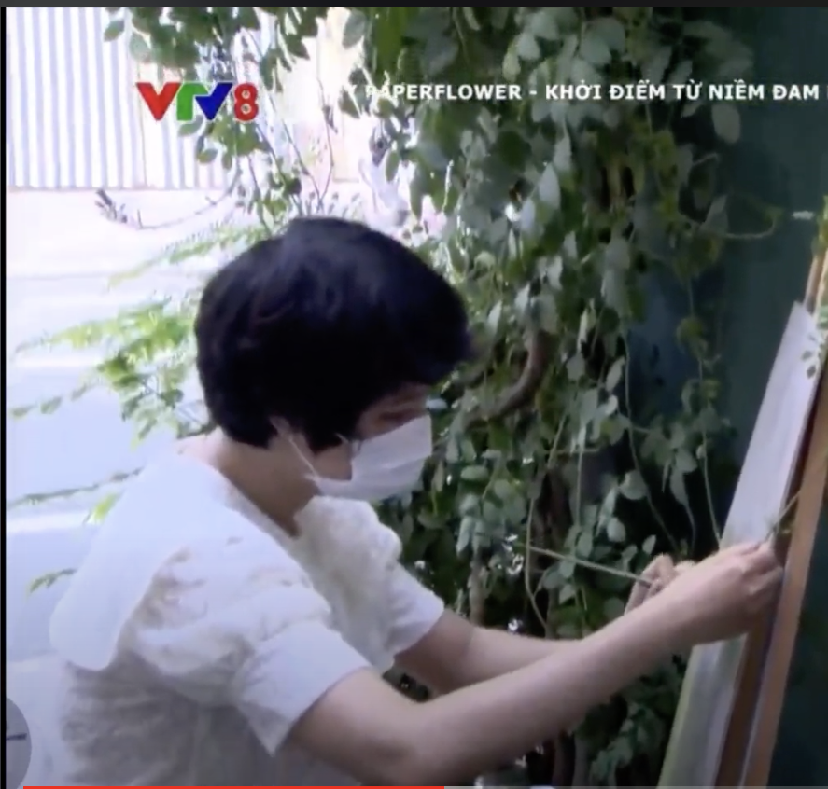
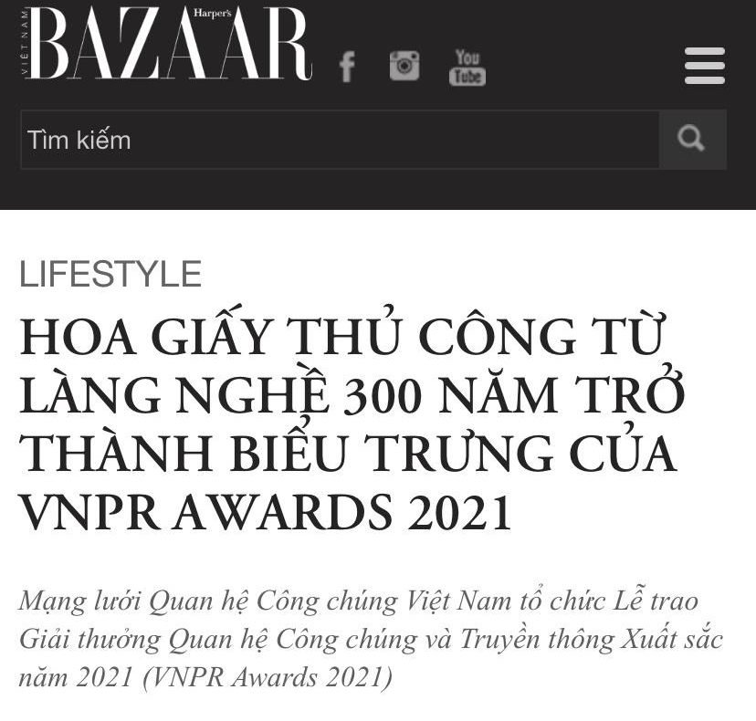
Frequently featured in television news

Slide 59

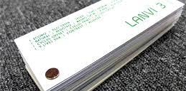
Long-term partners and suppliers inside and outside Vietnam

Slide 60

Thank you!
We have learnt about social business and how to apply business models that have been learnt
Iceberg model
The 5 WHYs
etc
Clearer view of our target social issues and our solution idea

Slide 61
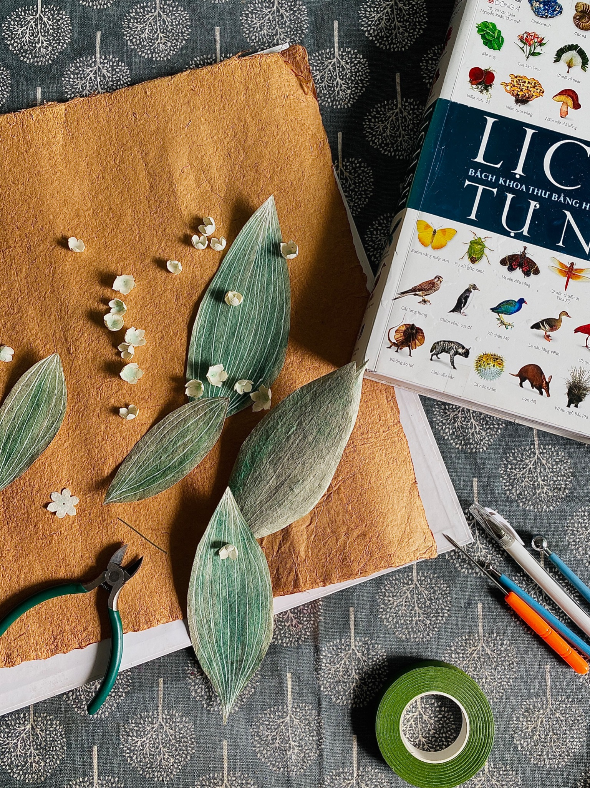
Our vision
Diversify source of paper:
Focusing on making use of the excess and redundant ones, such as banana tree trunks

Slide 62
Thank you for listening !

