Slide 1


Have you ever been educated
to know yourself, trust yourself,
and develop the power to move forward in society?

Slide 2
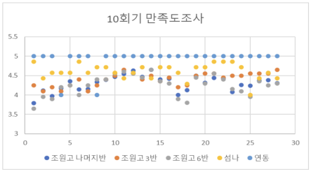
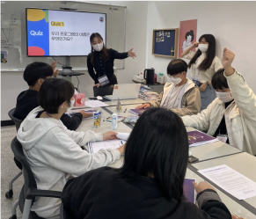
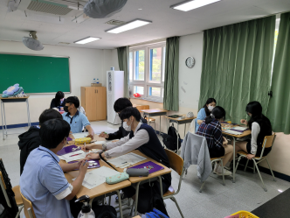



















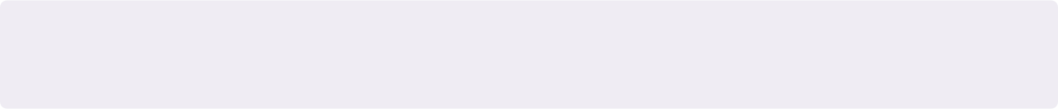

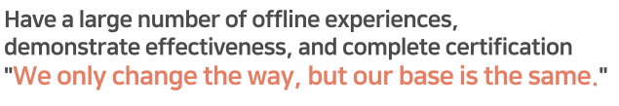
01
Problem definition
Personal experience: Provide identity education for approximately
600 people over a two-year period to help them understand themselves
about 10 schools and institutions
about 600 students
- approximately 100 hours of training

Slide 3
01
Problem definition
WHY College Students?
College students in their early 20s corresponding
to the adult age (emerging adulthood; Arnett, 2004),
known as the right time to form an identity
to find what you think is valuable in your youth's time
and draw a trajectory of life along the value.
교육인류학연구 2019, 22(1), pp. 1-26
지금의 흰곰이 있기까지:어느 청년 교육혁신가의 정체성 형성 과정
Survey: Early young people whose lack of self-understanding led to increased confusion
Q4. Do you think college students have many opportunities to find their own dreams or values?
Q5. (Disagree or Strongly Disagree)
Why do you think so?
Q1. Do you think you need "self-understanding" in your life?
Strongly agree
Neutral
Disagree
Strongly Disagree
Strongly agree
Neutral
Disagree
Strongly Disagree
Conducting its own survey of 50 college students (2023.03.20 to 03.22)

Slide 4
01
Problem definition
Social background: Many college students choose to take
a leave of absence due to concerns about the direction of life
He experienced a leave of absence and a suspended graduation due to career concerns and exploration
Four-year college graduates = 75,700
additional living expenses for
1.4 years of college students = 19 million won
66.5%
19 million won per college student
/ 1.4 years' time
Social costs = 1.5 trillion won
출처: 잡코리아X알바몬

Slide 5
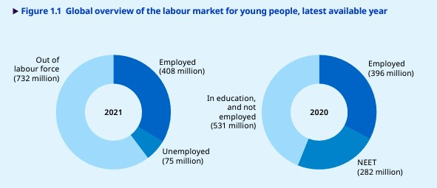
01
Problem definition
Global trends: Youth NEET (young people who do not participate in employment, education, and training) has increased rapidly recently
(2022) Youth unemployment: 73 million
(2020) Global Youth neet Size: 282 million, 23.3% of the total youth population
International Labor Organization (ILO) Global Youth Employment Trend Report

Slide 6



01
Problem definition
root cause of target social issues: There is no easy way to help college students understand themselves and build values beyond their careers.
young people spend most of their lives just getting a good job and making a lot of money, rather than discovering their own value.
Reading and Humanities Lectures
Career lectures and programs
a psychology
-based test
Need to realize for yourself
Content difficulties and burdens
Focus only on job and Job duty search
Cost incurred
Quantify yourself based on piecemeal understanding
Cost incurred

Slide 7










←
Making an essay
STEP5
An experience archiving-based autobiographical essay production app
to establish the values of college students
About "Uncertainty and Life"
complete
Previously, I thought everything in life was uncertain and I saw it very negatively. Uncertainty was a pain for me. I hated what I couldn't take the initiative in uncertain situations, and I don't expect results because everything is uncertain, and I think I tried to lower my anxiety by increasing my control a little bit.
My thoughts are a little different now. Still, the idea that everything in life is uncertain remains unchanged. However, now I understand the subjectivity of life from the uncertainty mentioned in existentialism.
2023.03.01.23:52
already completed 10 articles!
Trying to write a new article
essay
Go to modify an existing article
Simji_pioneer
Home
Experience data
Community
essay
My Page
P7

Slide 8
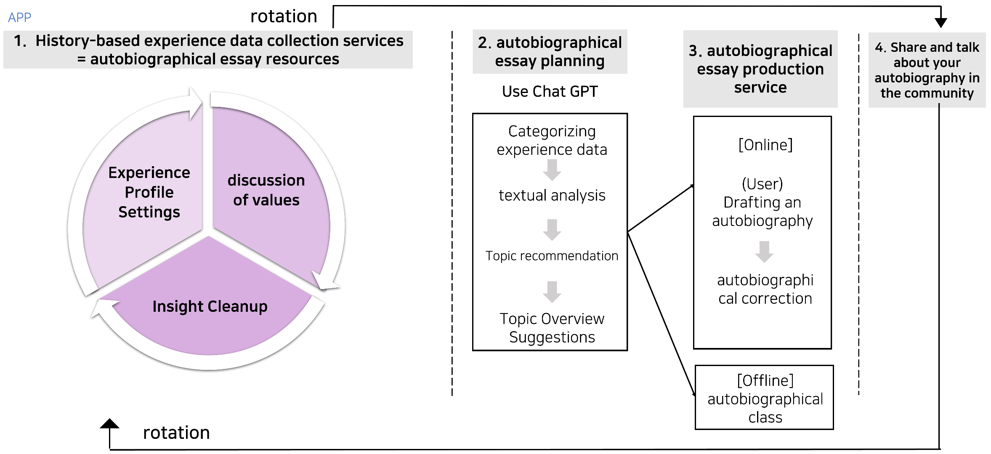
02
Solution
① Accumulation of experience data through self-exploration
② Writing an autobiographical essay using experience data

Slide 9







02
Solution
① Set up your experience profile:
Provides analysis tools that make it easier for you to understand yourself
←
Edit Profile
Sympathy Point 250
Storage
Amily
change
Build experience data
Value that customers receive
#Relaxed #strong #bright
change
Emily's Experience Data
Providing 'analysis tools' for self-understanding based on educational psychology
Complete a different record book of myself
Emily’s Life Graph
Life
Satisfaction
0
8
14
age
20
Going to see the graph
2 months ago
Set up my experience profile
before accessing by community
May emotional coordinates
Problem graph
Joy
Seldom
often
Set up your own experience profile for each community to disclose to others
Communicate through trust and understanding
family
Sadness
dream
love
Going to see your emotions and concerns
1 months ago
Home
Experience data
Community
essay
My Page

Slide 10










02
Solution
② Discussion: Discussing values on philosophical topics
←
Community > Family
Create a post within the community
Jenny
300
2023.02.25.15:32
[Should I make my parents' dreams come true?]
Value that customers receive
I didn't start looking for my dream until I came to college. It's about children from single-parent families
I want to set up a center for...Should we do ……………?
1. Author creates a post that fits the topic
2. asking philosophical questions that fit the subject
Q.Let's think about it together
The path my parents and
I want What should I do?
Knowing various philosophical concerns that you have to think about while living your life
Discussing
389 Viewers
208 people clapped
Amily
Get My Experience Data
Katy’s Life Graph
Clip
Follow
0
8
14
20
I had the same problem when I was 17. I don't think I was happy then. I'm the owner of my life. Wouldn't it be kind of independent to have my dream?
Sympathy Point
a philosophical discussion
Zeeto
Insight
If you think about it in a way, you know,
It shows that we're not ready to be independent. I think so.
Use the Discussion tab to share your own experiences Bring
to discussion
Sharing
Share values of 'right' with others and expand thinking
Write a beautiful comment :)
Enter
@
359
1,300
Home
Experience data
Community
essay
My Page

Slide 11

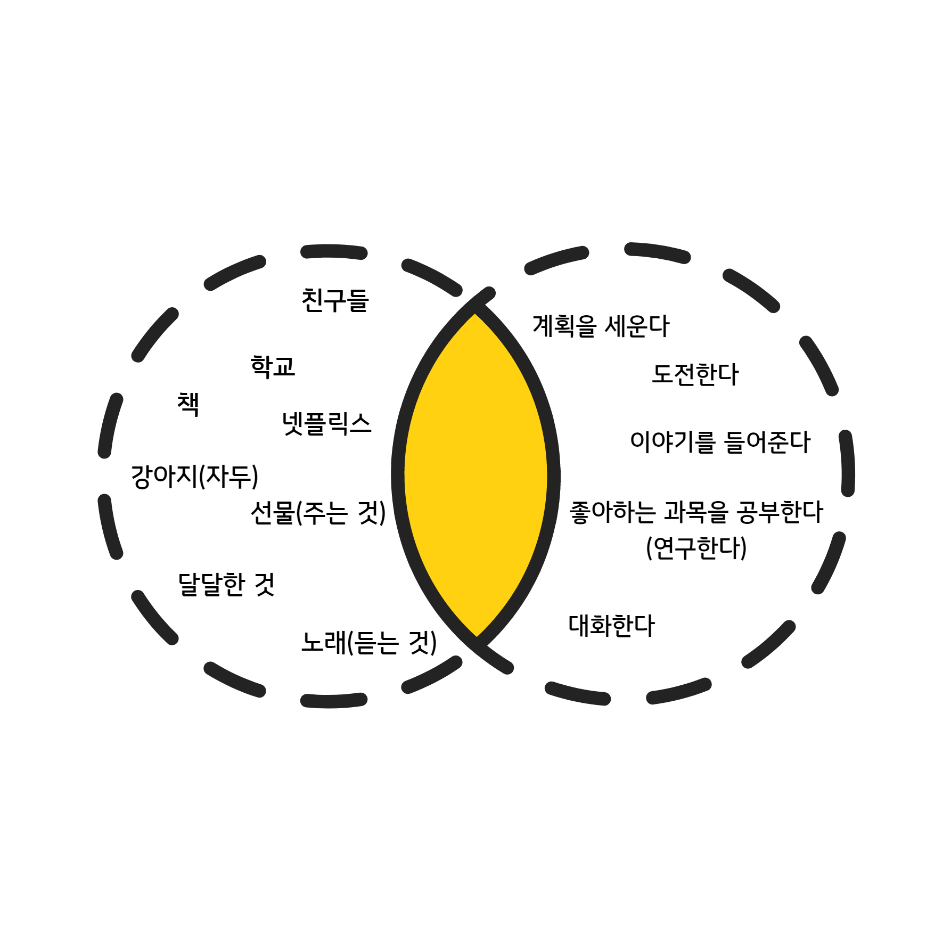





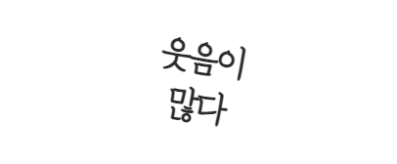








02
Solution
③ Organize Insight based on enlightenment after discussion
←
Community > Insight
#Wisdom CommunityㅣUncertainty in Lifeㅣby. Zeeto
If you think about it in a way, you know, that we're not ready to be independent
I think I'm showing you.
Insight Cleanup
Value that customers receive
Insight Cleanup
The insights that you felt through the discussion
The attitude of life is different by topic
Recording and organizing
………
Clip
Family
Love
Dream
·
Did you feel anything during the discussion?
Follow
Create another experience data
Can record horizons of thought
·
Sympathy Point
How did you change your mind after the discussion?
·
Insight
Sharing
Recommended content for Amily
Brave
Honest
Create Value Keywords
Create a
personality card
a tree of strengths/weakness
Home
Experience data
Community
essay
My Page

Slide 12






02
Solution
④ Autobiography planning: Analyze cumulative experience data and organize data customization by topic
←
Making an essay
STEP2
Experience Data Analysis Results
Analyzing Experience Data
Value that customers receive
Go to Profile
Go to Insight
Experience data such as community and insight accumulation
Analyze and recommend custom topics
→ Help with planning an autobiographical essay
Add / Continue
Emily's analysis of her experience data shows her
‘stories, thoughts,Value, personality, and frequency of 'likes' were high.
Topic recommendation
the whole project of a piece of writing.
Easy to write
How did you come to love your personality
Uncertainty and Life
When I learned the value of together
the wisdom of life that begins with thought
Why I try to overcome discrimination
The moment I affirm my sadness
Next Step
Home
Experience data
Community
essay
My Page

Slide 13
02
Solution
④ Autobiography planning: Analyze cumulative experience data and organize data customization by topic
←
Making an essay
STEP4
About "Uncertainty and Life"
Get experience data information for each topic of writing
→ Organize resources for easy writing
Value that customers receive
Experience profile analysis data
#Experience ProfileㅣSentence completion game
● The thing that bothers me the most is that there's nothing I can do better than I thought, and I can't predict what I can live on
You can write using existing experience data
Ability to write life-intensive essay
Community Engagement Data
# Community ㅣUncertainty in life
I think everything in life is uncertain.
I think that the future, as well as the past, and in fact, our memories can be distorted through reconstruction, and open facts can be intentionally distorted.
2023.02.12
글 쓰러가기
Home
Experience data
Community
essay
My Page

Slide 14

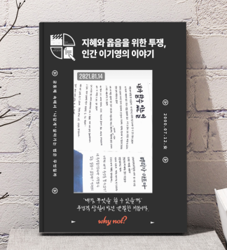
02
Solution
④ Writing autobiographical essays and publishing them in practice
←
Making an essay
Put my philosophy of life once a day
STEP5
About "Uncertainty and Life"
complete
Complete an autobiographical essay with your own philosophy of life
Previously, I thought everything in life was uncertain and I saw it very negatively. Uncertainty was a pain for me. I hated what I couldn't take the initiative in uncertain situations, and I don't expect results because everything is uncertain, and I think I tried to lower my anxiety by increasing my control a little bit.
My thoughts are a little different now. Still, the idea that everything in life is uncertain remains unchanged. However, now I understand the subjectivity of life from the uncertainty mentioned in existentialism.
Completion of an autobiographical essay
2023.03.01.23:52
already completed 10 articles!
Trying to write a new article
Completion of a philosophical autobiographical essay containing the narrative of my life and my philosophy
essay
Go to modify an existing article
Home
Experience data
Community
essay
My Page

Slide 15
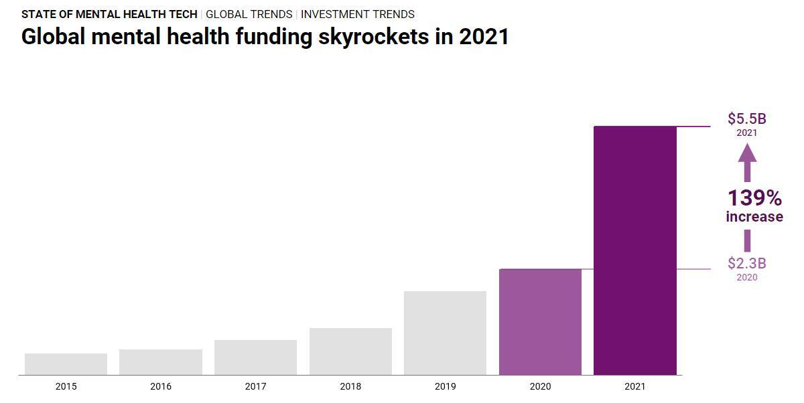
03
Market opportunity
Market Size
The global mental healthcare-related app market was $4.2 billion (about 5.29 trillion won) in 2021,
up 55% from 2019 (2.7 billion dollars).
Grand View Research, a U.S. market research firm

Slide 16
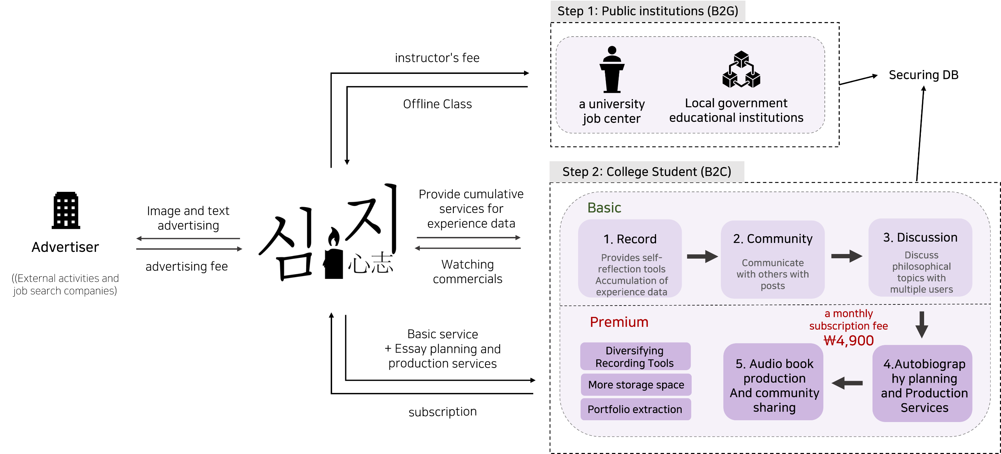
04
Business Model
Stakeholder engagement strategy

Slide 17
05
current solution landscape
A differentiated strategy
SIMJI
밑미
스텐드랩
로드 투
커리어
미션캠프
PRICE
4,900원
90,000원
8,900원
60,000원
300,000원
Record
O
X
O
O
O
Community
O
O
X
X
X
Discussion
O
X
X
X
X
Output
Experience Data and Autobiography
Meetings and Records
Study papers and diaries
a career decision
Work paper
Tool
App
Online/Offline Programs
books / phrases
Online/Offline Programs
online lecture
Purpose
Developing Values and Philosophy
self-growth
Solving career concerns
Finding a Career
found a new me
Period
Freedom
3-4 weeks
individual differences
4-12 weeks
4-5 weeks

Slide 18
06
market reaction
2 surveys
3 MVP Tests
10 Interview
Market Test Attempts and Customer Responses
23.01.29~23.02.02
21people
23.01.30~23.02.05
5 people
23.03.09~23.03.10
5 people
23.03.02~23.03.05
51people
23.03.06~23.03.08
5 people
23.04.21~23.04.28
5 people
23.04.20~23.05.15
5 people

Slide 19
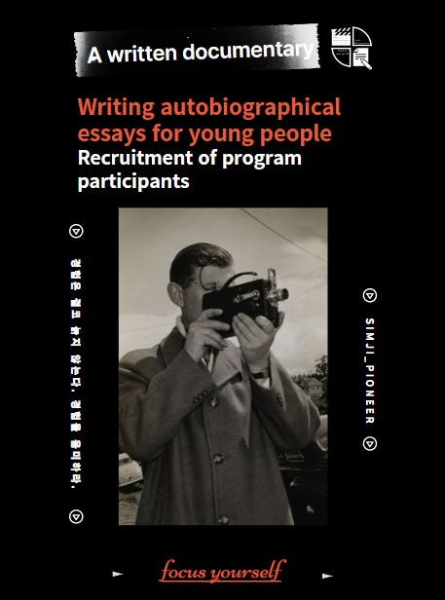
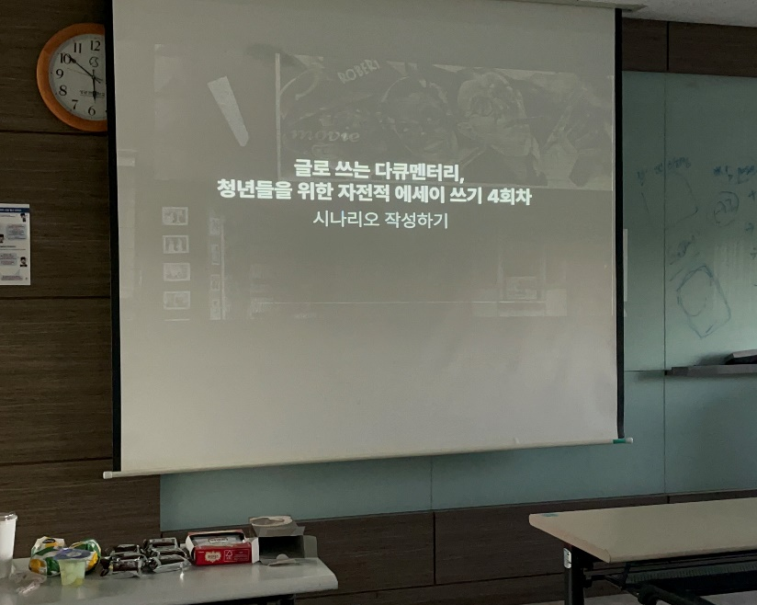
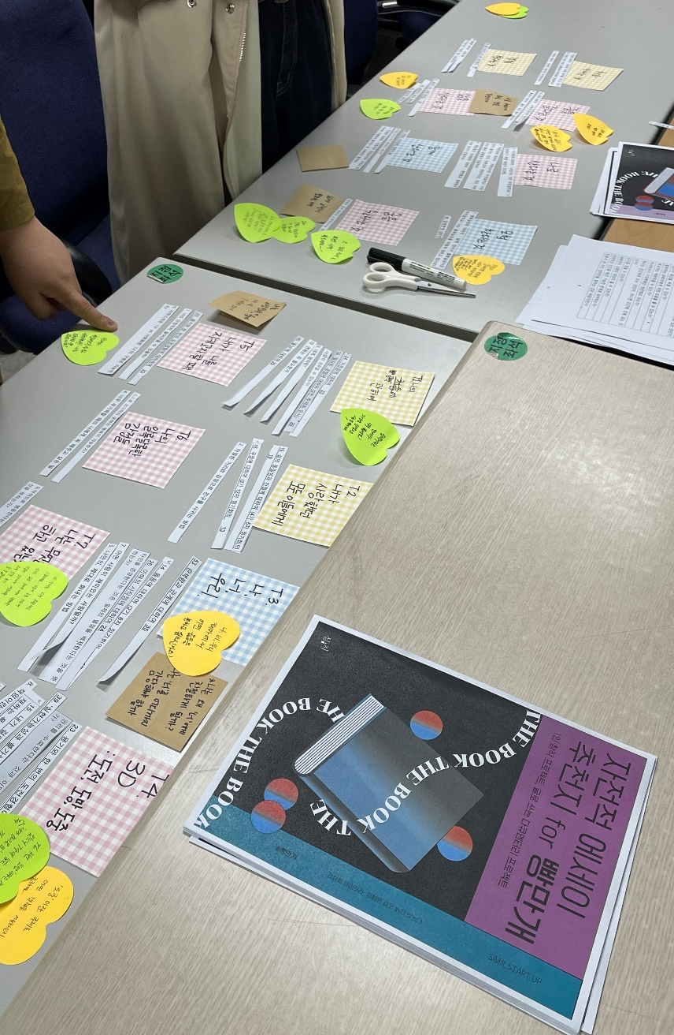
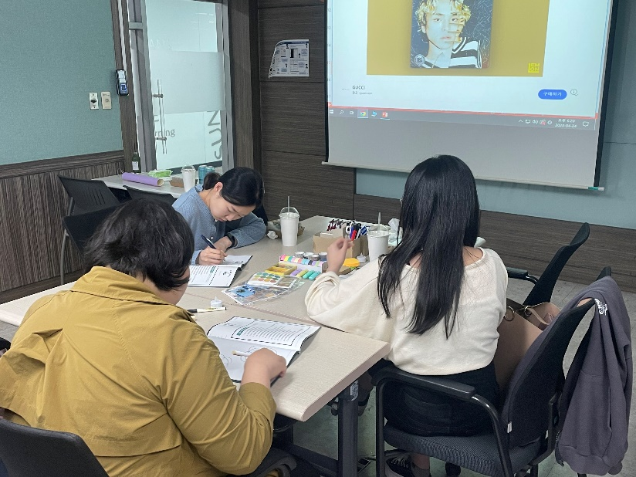
06
Market reaction
Customer Interviews and MVP Tests

Slide 20

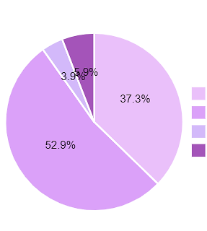



06
market reaction
Key Insights1. If it's less than 5,000 won per month,
I'm willing to use it for a fee
[Actual Survey Answers] Why did you answer as above?
15. Would you be willing to use it for a fee
if you provided a service to write an autobiography based on my experience?
I think that having your own autobiography can find your problems and solutions in the past.
90.2%
I think it's a good idea to write about your life once in a book.
Strongly agree
agree
Disagree
Strongly Disagree
I think it will be a fun and interesting service because I don't think I will have a chance to write an autobiography for the rest of my life.
It is likely to be of great interest in discovering an ego that the user himself/herself did not know or expanding his/her values
2023년 대학생 50명 대상 설문조사 자체 진행

Slide 21

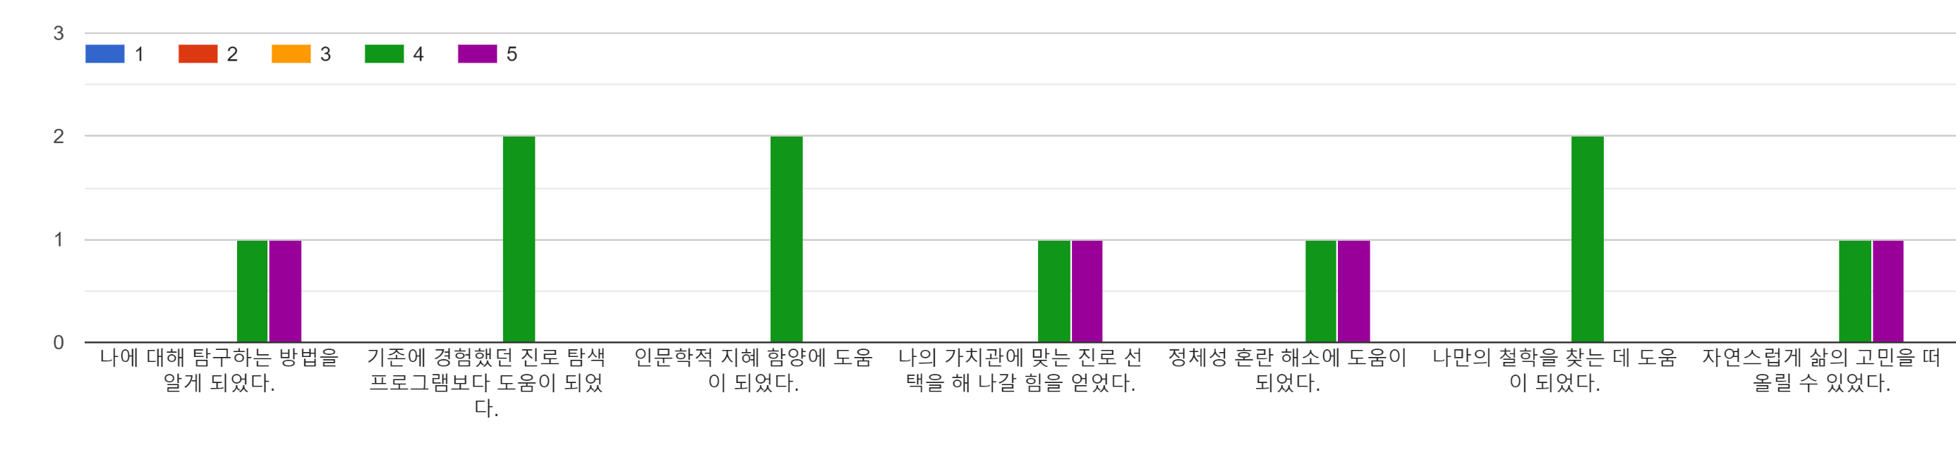
06
market reaction
Key Insights2.
Increased self-understanding, changing mindset
“The whole process of writing, sharing, and finally organizing my attitude in life based on my records came to me as a process of deep consideration for one person, "I," and I used it well. Thank you”
mvp test satisfaction survey
I learned how to explore myself. | It was more helpful than the career exploration program I experienced before. | It helped to cultivate humanistic wisdom. | I gained the strength to make career choices that fit my values. | It helped to resolve identity confusion. | It helped me find my own philosophy. | I could naturally think of life's worries.

Slide 22
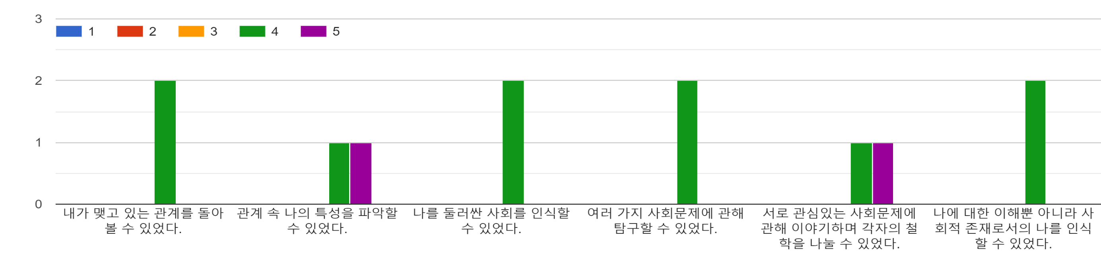
06
market reaction
Key Insights3.
the restoration of social connections and communities
mvp test satisfaction survey
I could look back on the relationship I had. | I was able to grasp my characteristics in the relationship. | I could recognize the society surrounding me. | I was able to explore various social problems. | We were able to share our philosophy by talking about social problems that we were interested in. | I was able to recognize myself as a social being as well as understanding myself. | I could look back on the relationship I had.

Slide 23
06
market reaction
Key insights and improvement strategies
Emotional immersion in the process of exploring myself
the pressure
to write good things
Worries about the business model. Is the monthly subscription appropriate?
Creating a comfortable atmosphere
Making the story itself feel like a healing moment
Recall that you don't have to write completely
Recalling that it is my story, not for evaluation purposes
Consider diversifying self-understanding analysis tools, not monthly subscriptions, and measuring plans based on number of posts

Slide 24

07
Contributions to UN goals
◦ Functioning as education for fostering social existence and community recovery
UN SDGs: 4.7.
VISION
The fall of community due to the absolutization of postmodernism and the confusion of individualism and egoism
All young people create a world that aims
for us as the masters and social beings of life.
Provide appropriate solutions to social problems in the process of discussion
by individuals with their own philosophy.
- Through the process of communicating together on a single topic, one can recognize oneself as a social being and cultivate a sense of community.
→ Functioning as Global Citizenship Education
◦ Solving talent discovery and career choice issues
sustainable education
It promotes the discovery of talent in various fields by allowing young people to function as subjects of life with their own characteristics based on self-understanding, away from quantitative and uniform standards.
From a long-term perspective, it can contribute to social job diversification, excessive competition rate problem solving, and unemployment rate reduction by facilitating job setting.

