Slide 1
This presentation has a high metaphorical and analogy content.
It is recommended turn on the Creativity that we ALL have inside ourselves

Slide 2

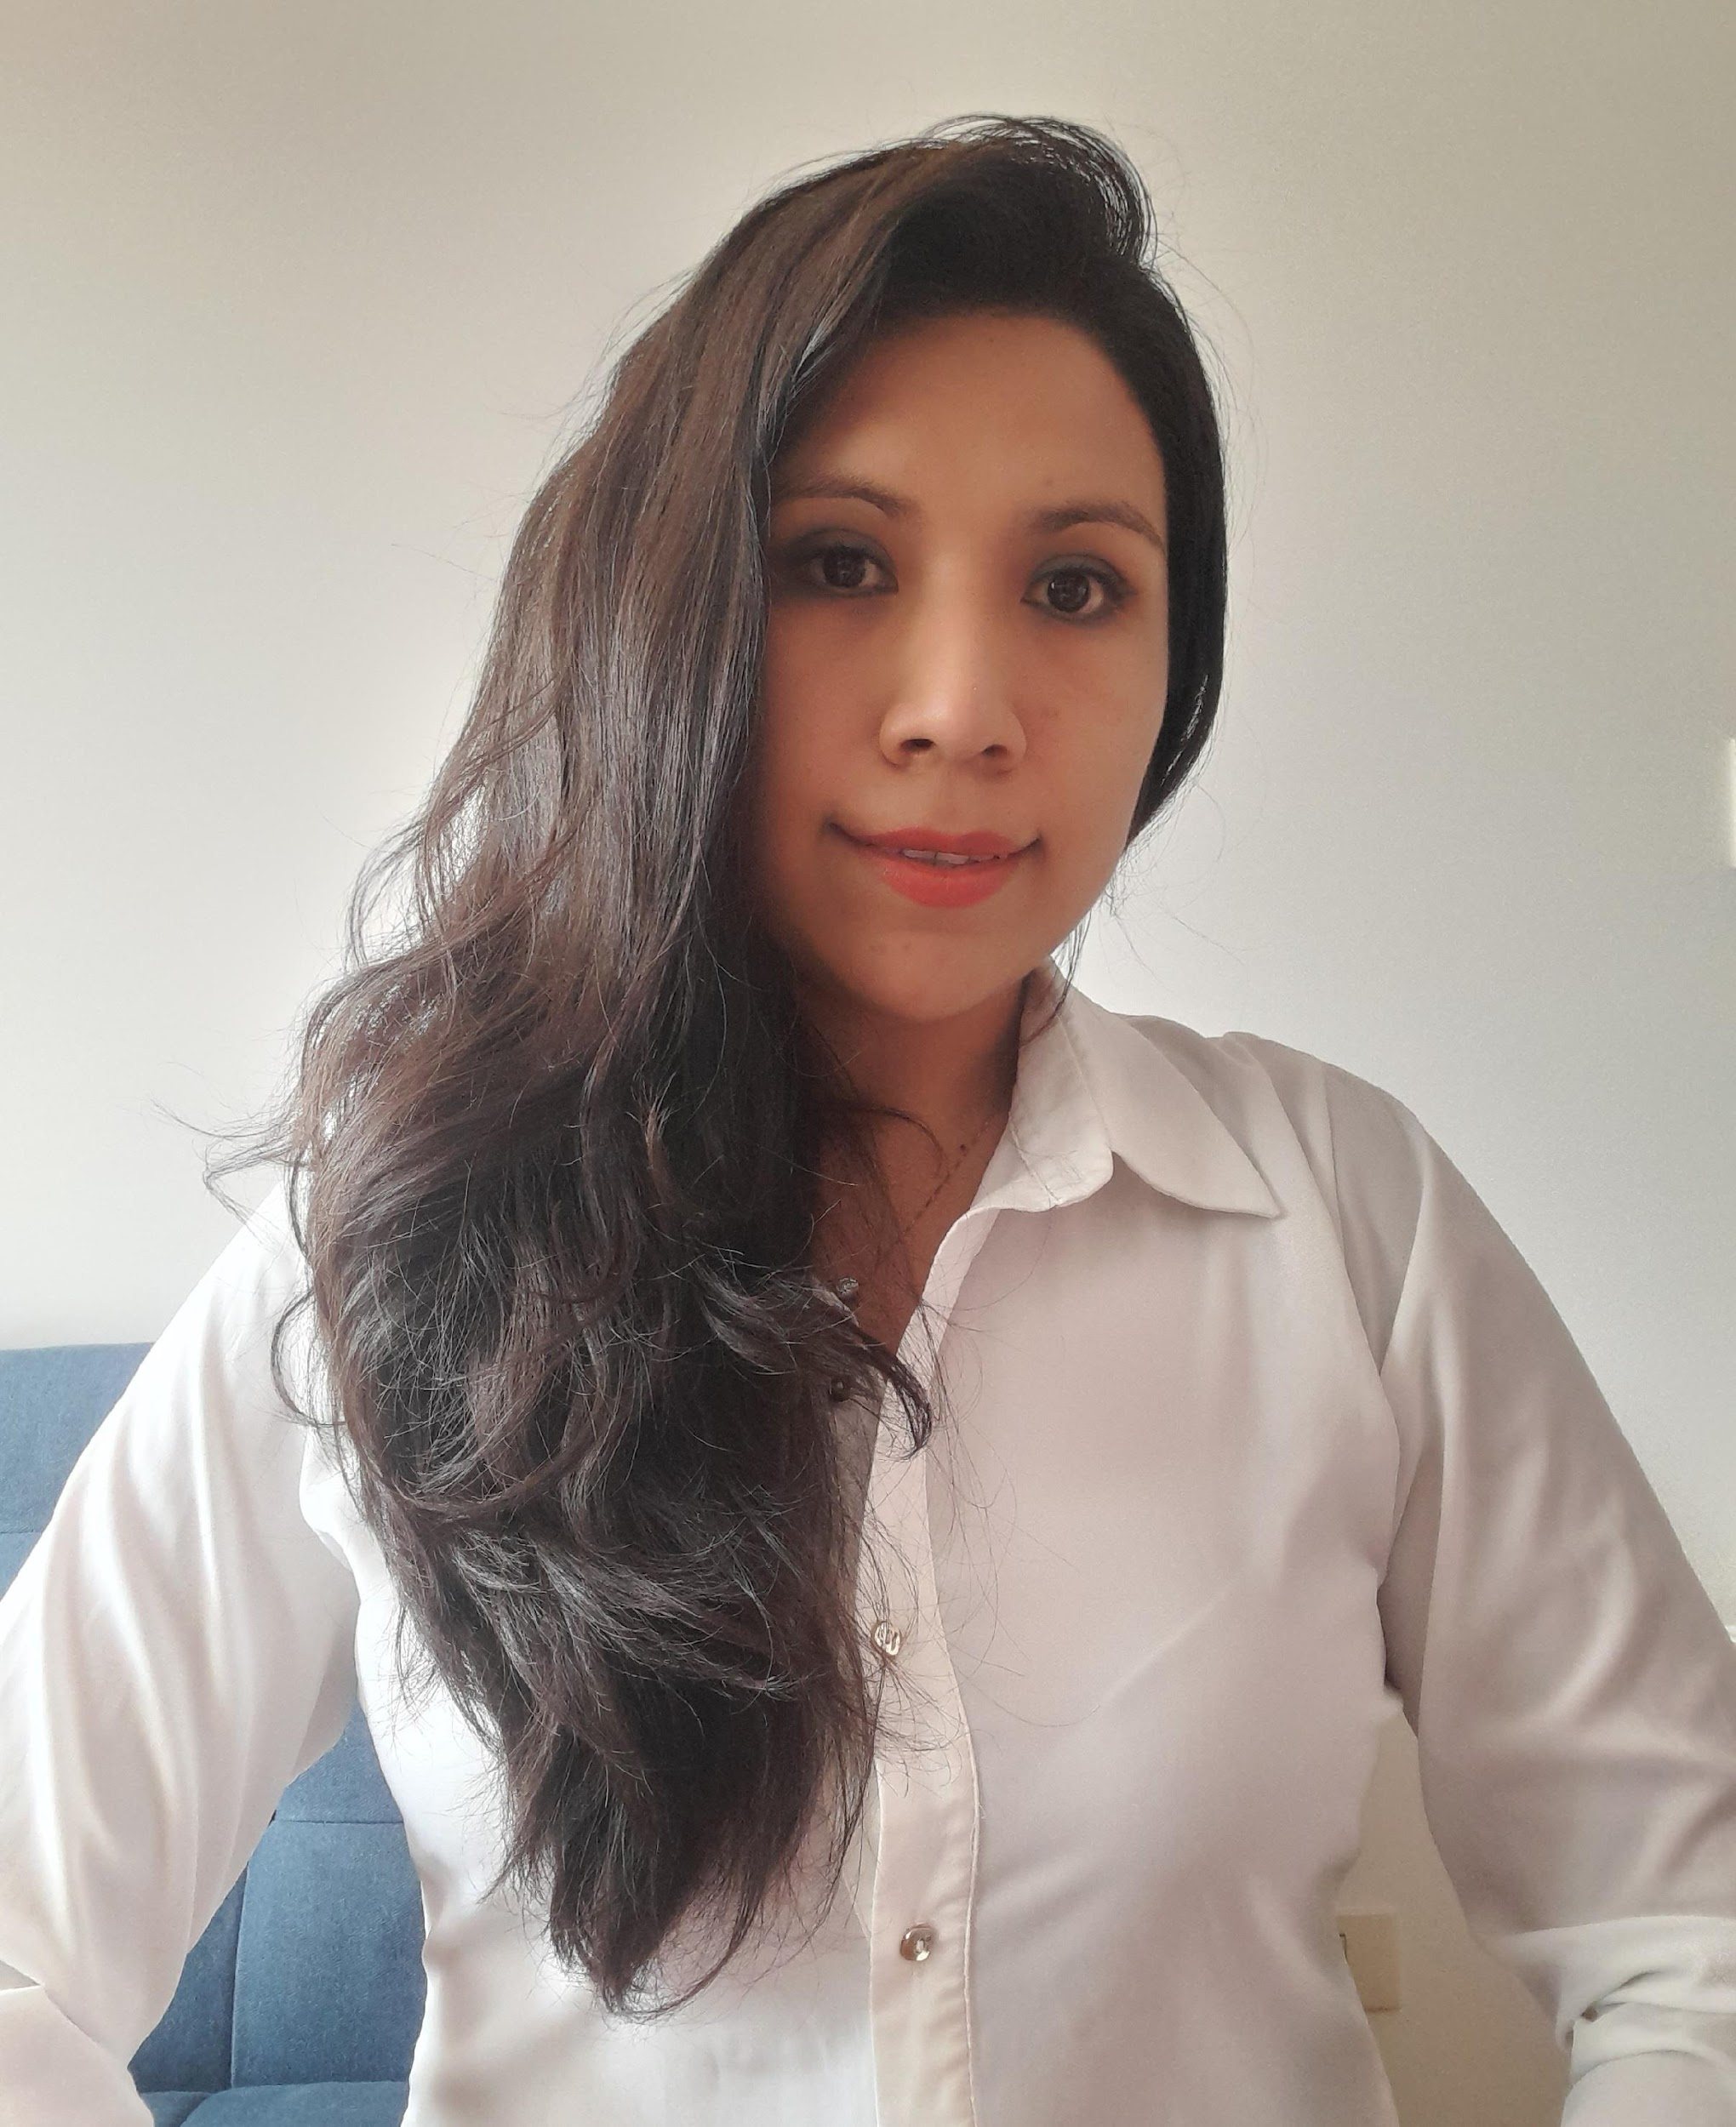
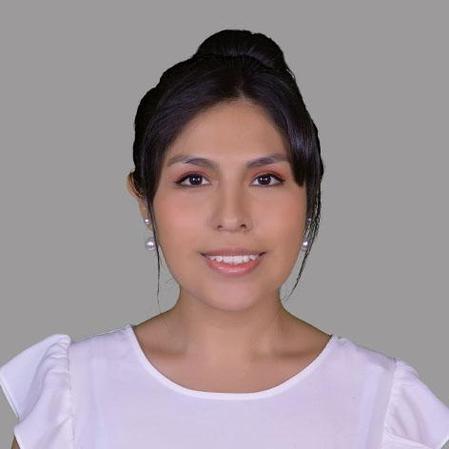


BERSE
BANK OF ECONOMIES AT RISK OF BEING EXCLUDED

Slide 3


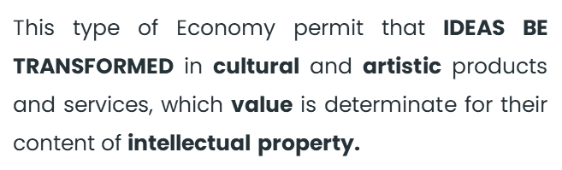






ORANGE ECONOMY

Slide 4
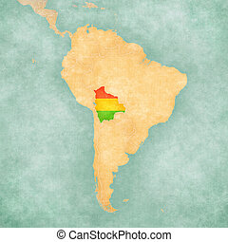
BOLIVIA
Bolivia is a country located in the center of Latin America.
It has a huge natural and pluricultural diversity
It is made up of 9 departments.

Slide 5
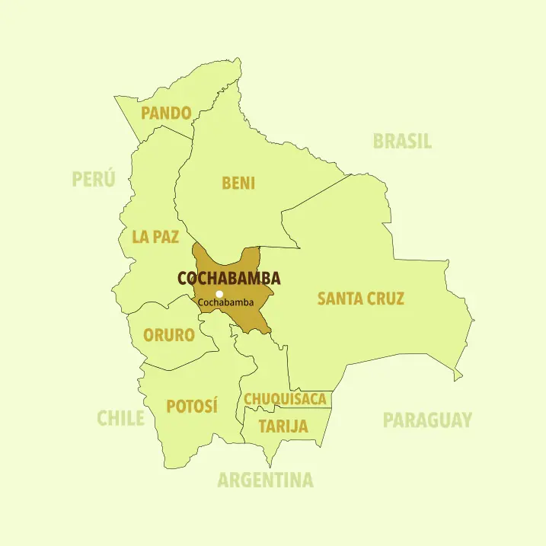
COCHABAMBA
It is located in the center of Bolivia
It is the third department with the largest population
It stands out for its gastronomy
It has been nominated Gastronomic Capital by UNESCO
It has been nominated Literary City
According to governmental agencies, Cochabamba will host National and International Events

Slide 6





UN Goals

Slide 7
The scale and scope of our target social problems:
TARGET SOCIAL ISSUE
Geographic Area | People Affected (directly) | People Affected (indirectly) | Severity
Cochabamba | 1.111.343 525.388 women | 2.117.112 1.065.739 women | High average High

Slide 8
ORANGE ECOSYSTEM IN COCHABAMBA
IPEE - INSTITUTE OF BUSINESS ECONOMIC PROGRESS
From 1060 enterprises:
Gastronomy:
Industrial Products:
Handicrafts and Antiques:
Support media for digital content:
Creative education:
Books, newspapers and magazines:
Fashion - Haute Couture:
From 285 virtual entreprises:
Art and Heritage: A. Visuals
Tourism and Heritage:
Performing Arts and Show:
Ind. Food and beverages:
Ind. Editorial, Audiovisual, Fot.:
37,1 %
11, 2%
10,3 %
3,7 %
5%
5,7 %
7,6%
12,3%
54%
1,8%
13,3 %
9,1%

Slide 9
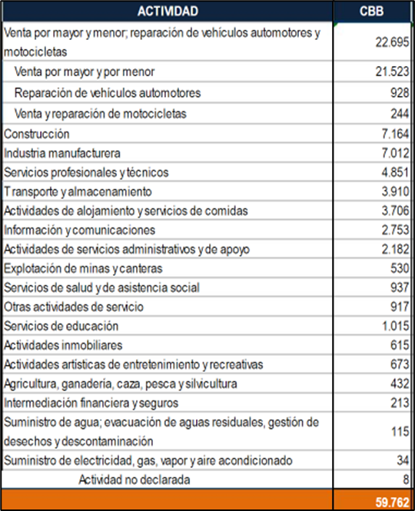
Quantity of Potencial Traditional Companies Beneficiares

Slide 10

Our target social issues are:
1
2
Limited Acceptance and Adaptation to the Orange Approach in Traditional Companies.
Few Effective Education about "Acceptance of Differences", different ways of think, be, live and do.

Slide 11
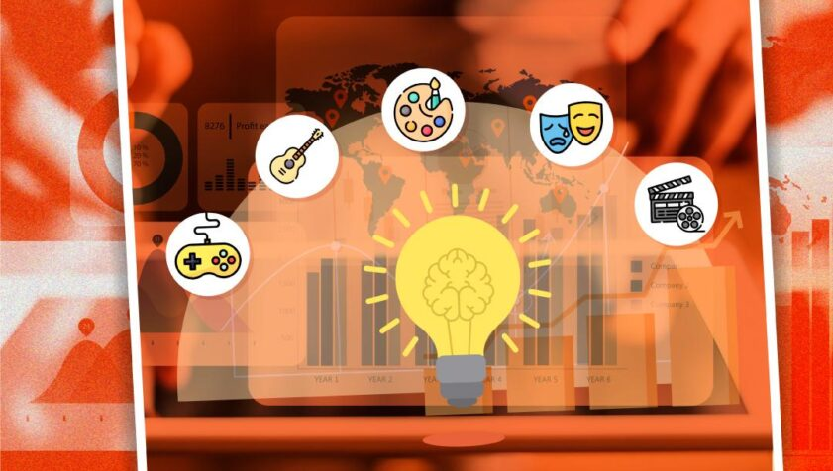
Stakeholders concerned by the social issues:
Orange companies
General population
Traditional companies

Slide 12
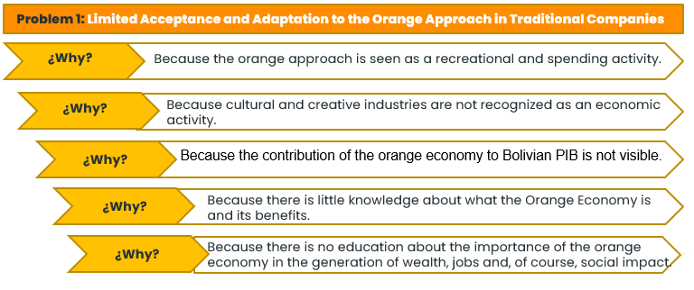
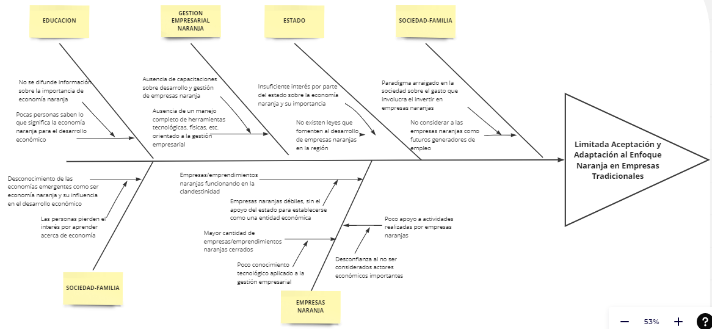
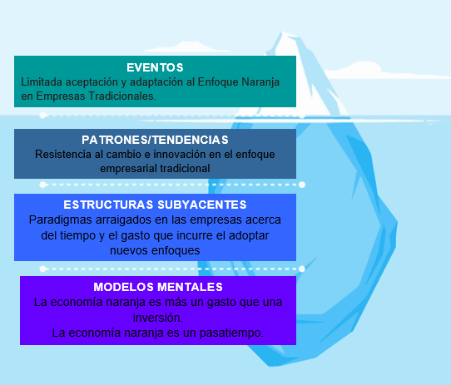
The root cause of our target social issues
"5 why" Method
Cause diagram
Iceberg model

Slide 13

The root causes of our target social issues are:
Lack of education about the importance of the orange economy in the generation of wealth, jobs and, of course, social impact.
Educational models still focused on the MAJORITY, but not on ALL.

Slide 14



According to where the Causes and Symptoms of the Problems are located, the FACTORS with which we must interact to generate the most appropriate solutions are:

Slide 15


Gradually unlink or redirect certain patterns that generate unhealthy mental models such as:
“The orange economy is more an expense than an investment.”
“Life is a competition where the only thing that matters is that you win.”

Slide 16
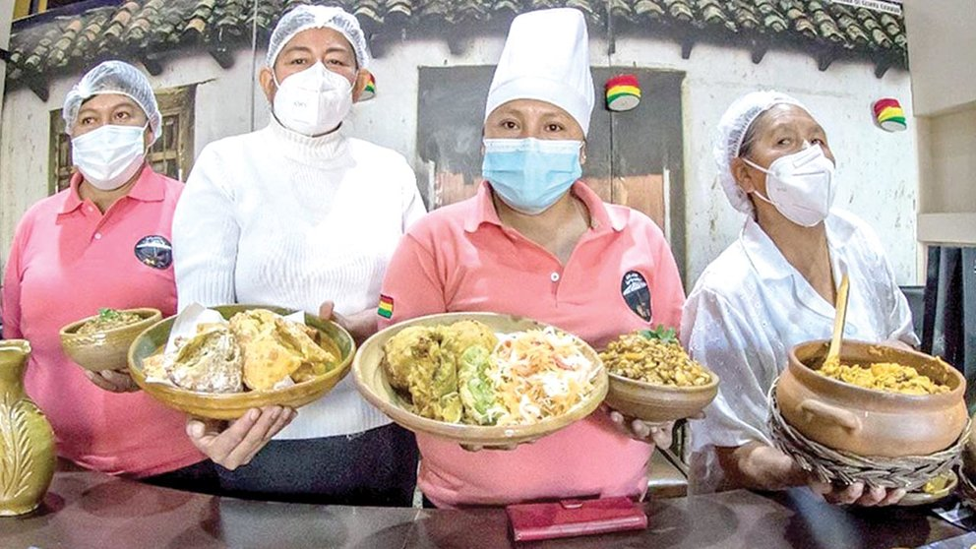
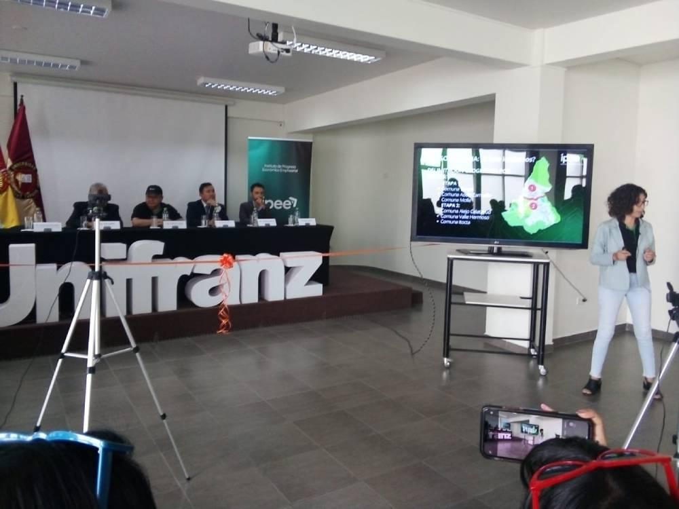
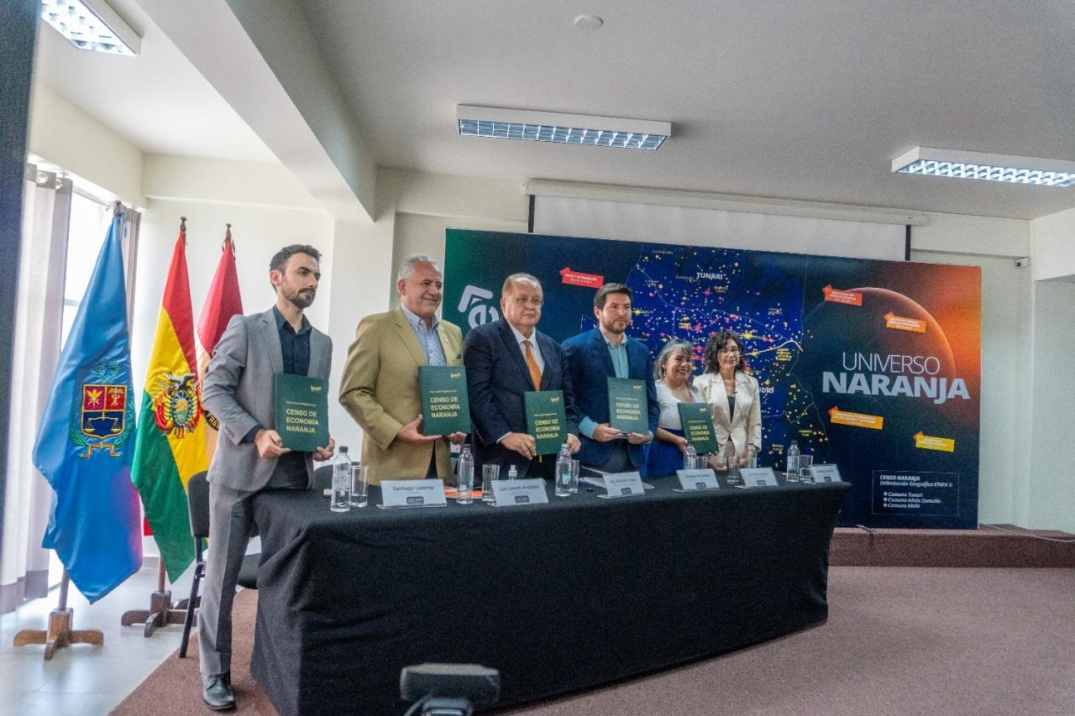
THE CURRENT SOLUTION LANDSCAPE
1) Limited Acceptance and Adaptation to the Orange Approach in Traditional Companies.
https://www.opinion.com.bo/articulo/cultura/estudio-gastronomia-mujeres-lideran-economia-creativa-pais/20220331224952861191.html
https://activosbolivia.com/censo-de-la-economia-naranja-se-amplia-hacia-la-region-metropolitana-de-cochabamba/
https://www.la-razon.com/economia/2022/12/01/la-economia-naranja-gana-terreno-en-cochabamba/

Slide 17
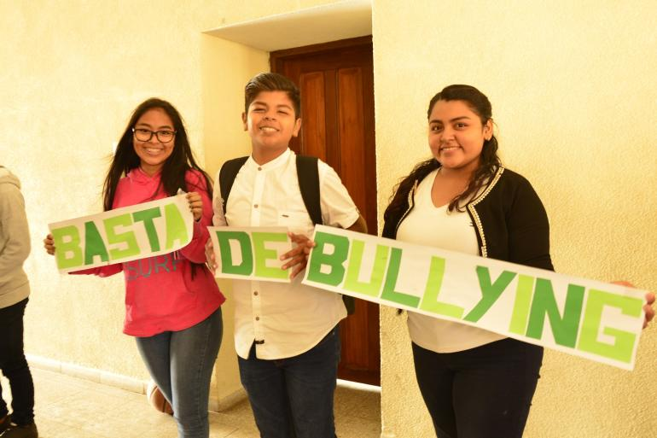

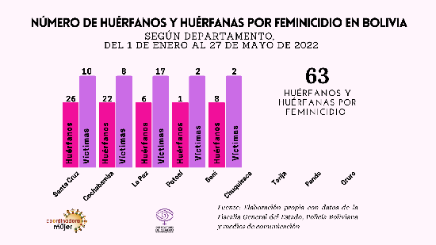
2) Few Effective Education about "Acceptance of Differences", different ways of think, be, live and do.
https://www.unicef.org/bolivia/comunicados-prensa/unicef-y-educo-bolivia-firman-un-acuerdo-para-prevenir-la-violencia-y-promover#:~:text=Los%20casos%20de%20violencia%20que,a%20medida%20que%20van%20creciendo.
http://www.coordinadoradelamujer.org.bo/web/index.php/destacados/306
http://www.coordinadoradelamujer.org.bo/web/index.php/destacados/314
http://www.coordinadoradelamujer.org.bo/web/index.php/destacados/304
http://www.coordinadoradelamujer.org.bo/web/index.php/buscar/all?buscar=violencia
https://gaiapacha.org/contaminacion-atmosferica-en-cochabamba/#:~:text=La%20contaminaci%C3%B3n%20del%20aire%20representa,lo%20recomendado%20por%20la%20OMS.

Slide 18

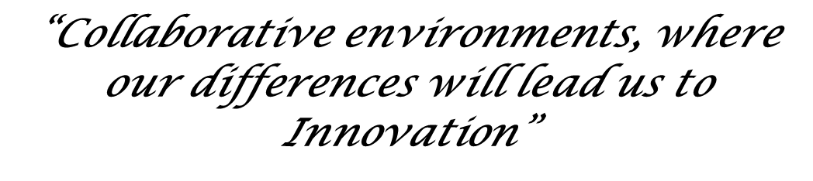
SOCIAL MANTRA

Slide 19


CONTRIBUTIONS TO UN GOALS
MISSION:
VISION:
Link economies excluded from the orange approach with traditional companies, to promote the inclusion, growth and sustainable development of society and companies, through a hybrid space of relationships.
To be the agent of change that generates business links of social impact, at national and international level, through strategic alliances and continuous improvement, between excluded economies and traditional companies.

Slide 20


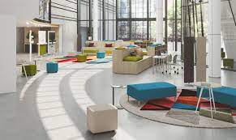

SOCIAL SOLUTION
Generate alliances and Certifications
To create a solid and credible company
SOCIAL MODEL BUSINESS

Slide 21

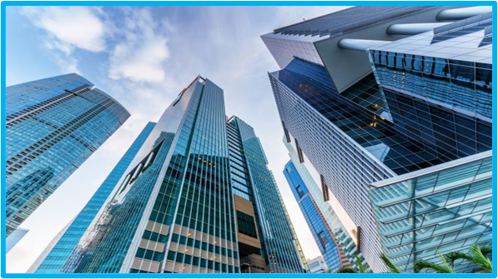
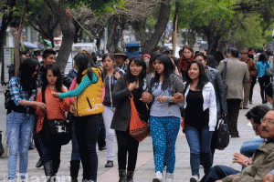
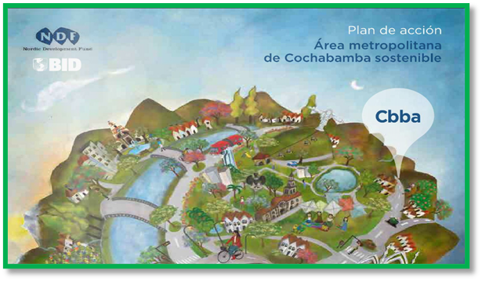
“WE NEED TO HEAL FROM THE ROOT”

Slide 22


BERSE is...
A Little bit of Social Engineering
Social Construction

Slide 23
BERSE's response to social problems is aimed at:
SHORT TERM
To the CRISIS.
LONG TERM
To the VISION based on a historical of crisis.

Slide 24


The principal negative impact that this solution could create is:
Rejection and contingency measures from big companies that feel threatened by this proposal.
Time in which the business idea can be copied…

Slide 25




Preventive measures
Start looking for a solid support.
In our country there are reserved rights for
written projects.
Privileged access to Know How and valuable,
scarce and difficult to imitate TECHNOLOGIES,
focusing on the adoption of a culture of alliances.
Ability to restrict the actions of the competition, through
a fast capacity of innovation.

Slide 26


Coercive measures
- "Everyone can do the same as you, but no one will do it the same." For example, of all the advertisements we see per day, how many do we really say: “wow”? We go ahead, although in a smaller way, then, it is the results of the impact generated that by themselves do something about it.

Slide 27

Complementary Analysis:
Would a true social entrepreneur be capable of plagiarizing an idea in the worst way? No
Would a non-social entrepreneur be interested in carrying out a social entrepreneurship?
Yes, it can be.
However, could this entrepreneur have all the skills required for the actions to be carried out and be really effective?
This is less probably, because soft skills are a strong barrier against plagiarism, and if they don’t have its´, the actions carried out will not have the expected impact.

Slide 28

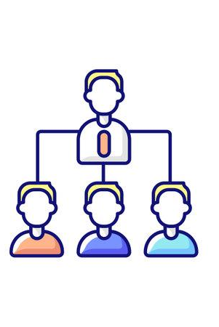

STAKEHOLDER ENGAGEMENT STRATEGY
Orange Companies
Traditional Companies
Population

Slide 29
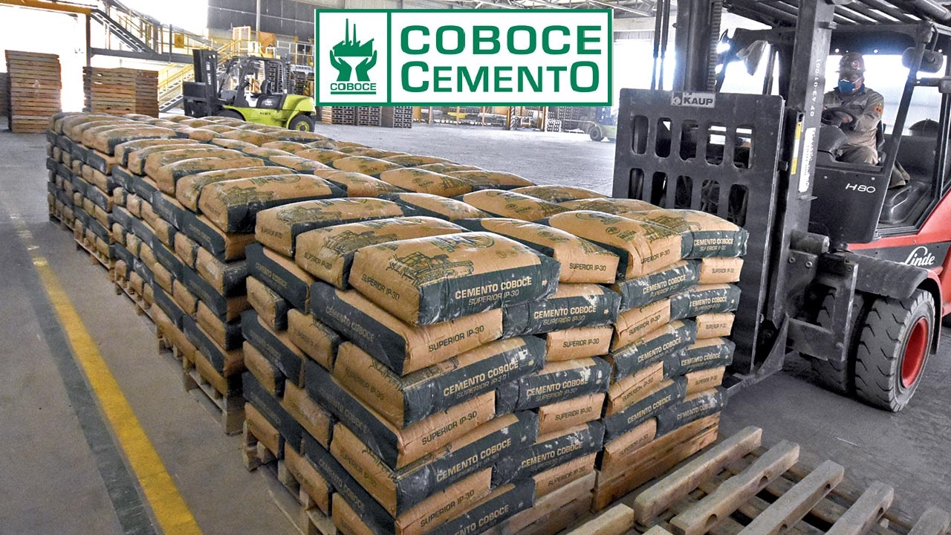
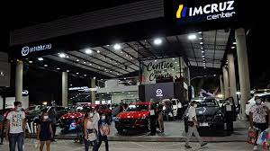
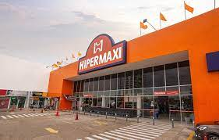
Orange and Traditional Companies
Supporting Reasons
- High need that companies have today about adaptability to the changes.
Contact network between traditional companies, oranges and/or the government.
Simple training oriented to Acceptance of Differences from a business, academic and social perspective.
- The activation and success of an economy has a direct impact on other economies through the value chain and indirectly through the generation of resources to be invested in other economic sectors.
COBOCE
Cement Factory
IMCRUZ
Car Importer
HIPERMAXI Supermarket

Slide 30


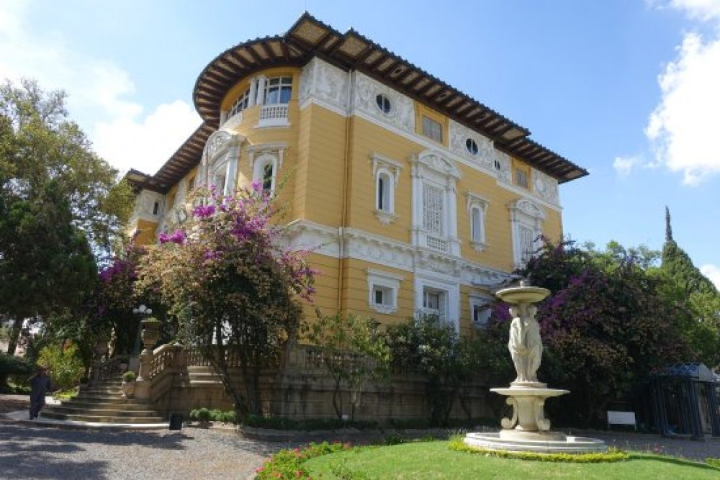
Orange and Traditional Companies
Training in management and technological innovation
An orderly space for the physical and virtual presentation of the products/services.
- Because those who are part of this Company Project are 2 young people with skills (knowledge, skills, attitudes) and participants in both the Orange and Traditional Economies.
This allows us to better understand both sectors, their needs, their way of addressing problems and thus be able to generate a link and analysis of the problems in a more objective manner and closer to the reality of each one of the actors.
VULNERARTE
Cinema Academy
National Union of Poets and Writers
Simón I. Patiño
Cultural Center

Slide 31


Rejection Reasons
Mistrust for being a new Institution.
Distrust because it is not an organization dependent of one of the most representative Federations of Cochabamba
Mistrust because it is not an institution belonging to the government.
- Contribution amount

Slide 32

Population
Supporting Reasons
More sources of employment
Improvement in the family economy
Training on economic, social (acceptance, inclusion) and the UN GOALS
Greater agility when carrying out projects with traditional and orange companies
Decrease in violence, gender violence and citizen insecurity
Better level of social coexistence and quality of life
Reasons for Rejection
Mistrust for being a new institution
Resistance to change
- Stigmas and social paradigms

Slide 33

Necessary support from each stakeholder:
ORANGE AND TRADITIONAL COMPANIES
Monthly subscription FEES or % of comissioon per contract
Responsibility and commitment in relation to delivery times and quality of the work carried out.
Receptivity and open mind to innovation
Trust in the company
Active participation: attendance at training and feedback to the company regarding each of the activities carried out.
Awareness and commitment to the mission, vision and corporate values of the company.
Viral marketing

Slide 34
Population:
Community committed to the mission and vision of the company
Active participation: attendance at training and continous feedback to the company.

Slide 35
The points to reach our stakeholders are:
Needs of each company in products/services depending on the case, for example in Management , MKT, HR.
Entities that represent the population: OTBs, District Representatives, Municipalities.
The different Associations, Federations of Orange and Traditional Companies

Slide 36
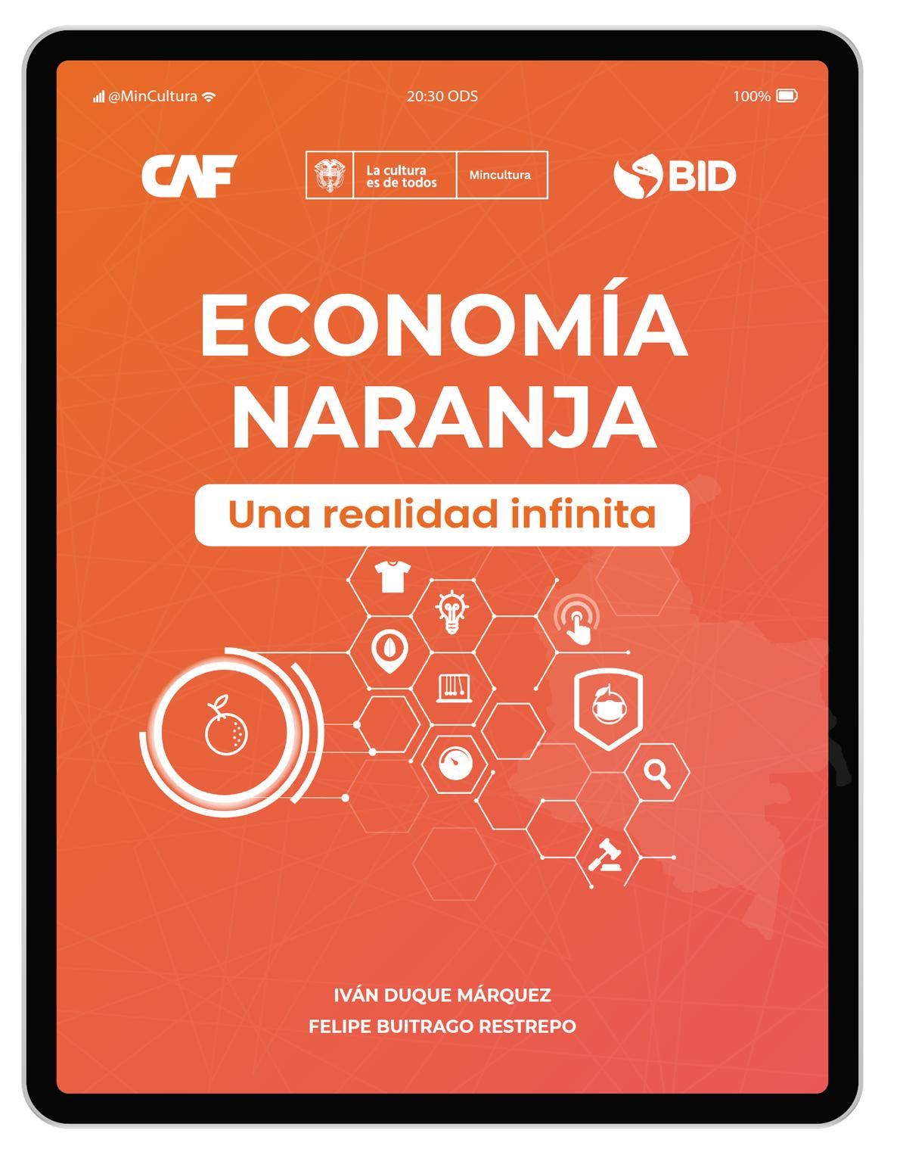
To convince our stakeholders…
Show evidence about the effectiveness of Orange Economy in Latinoamerican Countries:

Slide 37
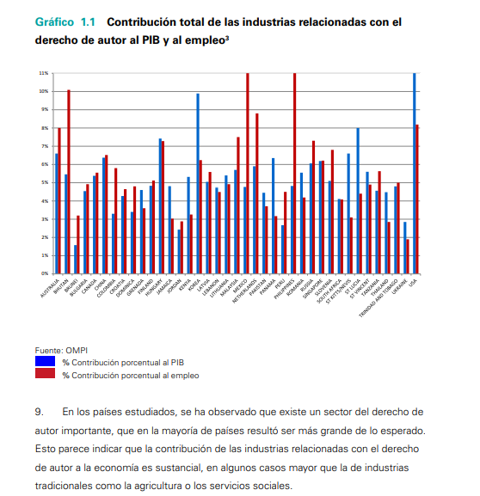
2 - 11 %
GDP
WIPO- WORLD INTELLECTUAL PROPERTY ORGANIZATION

Slide 38
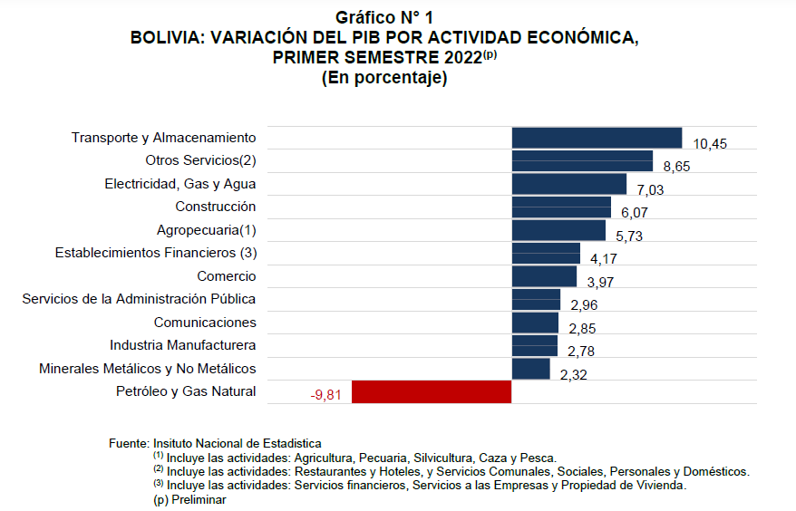
GDP by Economic Activity
INE – NATIONAL INSTITUTE OF STATISTIC (BOLIVIA)

Slide 39
ORANGE ECOSYSTEM IN COCHABAMBA
IPEE - INSTITUTE OF BUSINESS ECONOMIC PROGRESS
From 1060 enterprises:
Gastronomy:
Industrial Products:
Handicrafts and Antiques:
Support media for digital content:
Creative education:
Books, newspapers and magazines:
Fashion - Haute Couture:
From 285 virtual entreprises:
Art and Heritage: A. Visuals
Tourism and Heritage:
Performing Arts and Show:
Ind. Food and beverages:
Ind. Editorial, Audiovisual, Fot.:
37,1 %
11, 2%
10,3 %
3,7 %
5%
5,7 %
7,6%
12,3%
54%
1,8%
13,3 %
9,1%

Slide 40
SOCIAL SUPPORT CAMPAIGN PERFORMANCE
The idea of generating solutions from the linkage of the different actors of the economic system seemed excellent to them
The majority thought it was very good that the orange economy sectors that until now have been careless and little activated are activated, given the cultural, artistic and creative potential that Bolivia has.
Our company is not yet constituted and we have already received a request for our services, including this one, a sample of the animation production talent in Cochabamba – Bolivia.

Slide 41
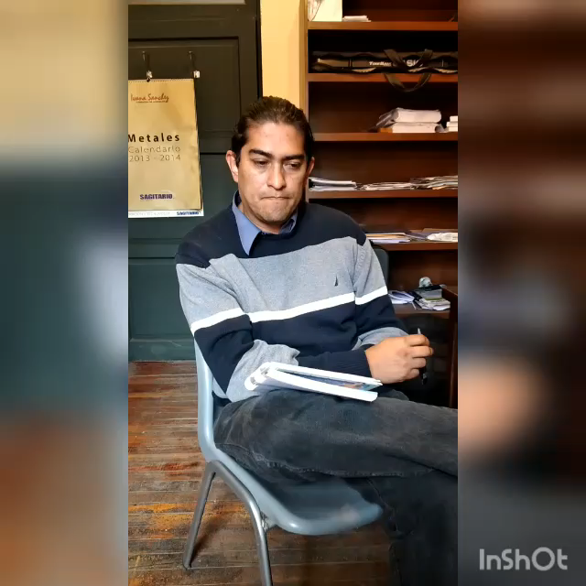
Instituto Eduardo Laredo
Juan Pablo Barrientos
Director Artístico

Slide 42
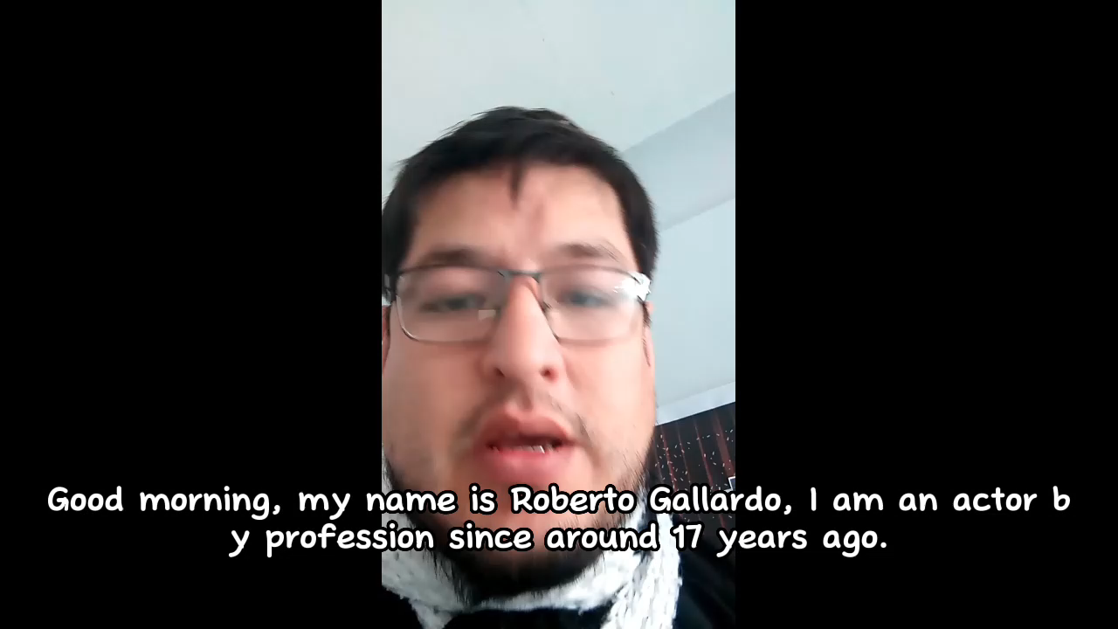
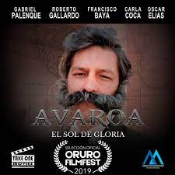
Roberto Gallardo
Actor

Slide 43
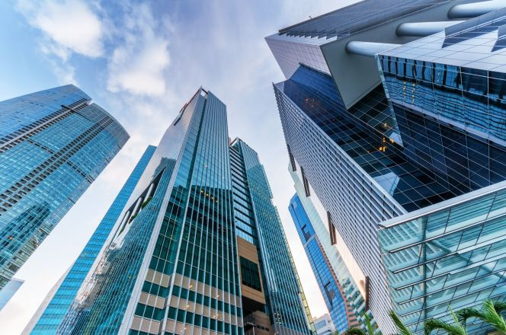


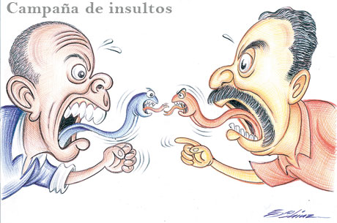



Slide 44
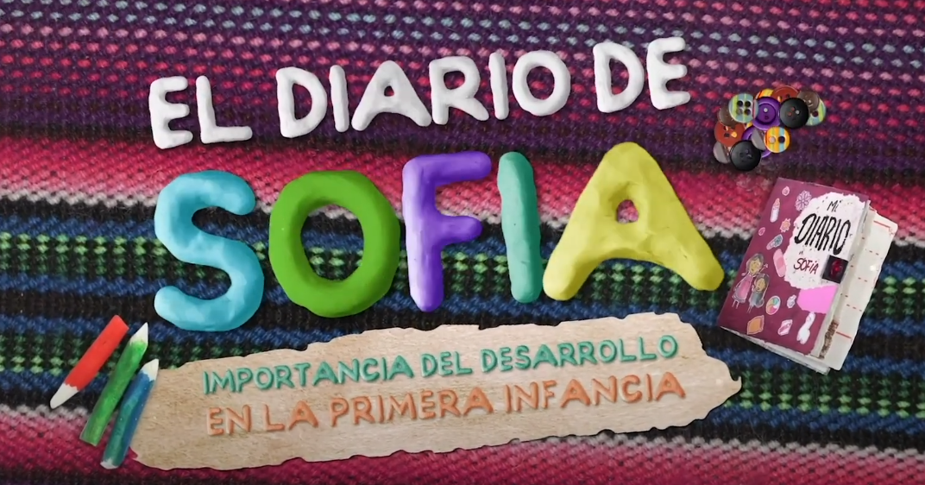

ABOUT IMPROVEMENT STRATEGY...
We were pleasantly surprised that one of the people interviewed did not know about the Orange Economy but was part of it, and he asked us for help to take his project into account: "when you go alone they don't take it very seriously , when it is supported by an institution, the panorama changes and they consider your ideas and projects” (a summary of his words).
The important information we obtained was that companies are interested in the services we offer and in the potential of the idea.

Slide 45

Thanks to Course 1 provided by SBC, we generate:
Written, orderly, more detailed and pertinent information about the
problem and the solution.

Slide 46

New learnings:
It is advisable to start with simple and solid bases and then just develop and expand the business model.
We need to know more about ourselves as a Project, all our potentialities and how to apply them.
Statistics and metrics are very important.
It is not necessary to try to solve all the world's problems at the same time.
Thank You
Coach!!!

Slide 47
The ideal way to improve our social solutions is:
01
03
02
Talk, survey, interview the representatives of ALL our stakeholders
In the final phase of the creation of BERSE, generate the first alliances
Have advice from an expert in Economics and an expert in the Export of Tangibles and Intangibles.

Slide 48
NOVELTY OF THE SOLUTION
Focus on solving the root problems.
The solution has an holistic/systematic focus.
Business social approach (generate profit and contribute to society) aimed at meeting mainly 5 SDGs: 17, 8, 5, and 16.
To be an agent of change: conciliator, integrator and inclusive, generator of alliances, with a strong focus on CREATIVITY, INNOVATION AND DEVELOPMENT.
BERSE is a Bank, which will adopt a complementary color and/or name according to the Economy that requires it, reflecting, as well sustainability and circular economy in the services sector.

Slide 49
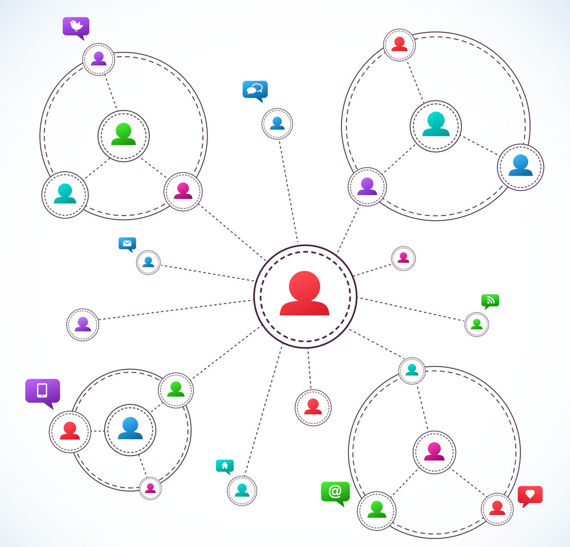
Our solution design is supported by the VALUE CO-CREATION THEORY, which says that one of the KEY STRATEGIES to build value between 2 organizations, 2 initiatives, 2 governments is that there is a NODAL AXIS, where our company comes to be that NODAL AXIS, which is necessary and which still does not exist in our Country.

Slide 50
According to our knowledge and research, we are the first project that will allow the Theory generated by sociological areas about: "Acceptance of Differences", could be not only thought and felt, but also practiced in daily life with greater impact and scope, given that BERSE will be including a significant sector of the population that is generally excluded, to start to work together day after day, with other Traditional Economies.
By BERSE

Slide 51
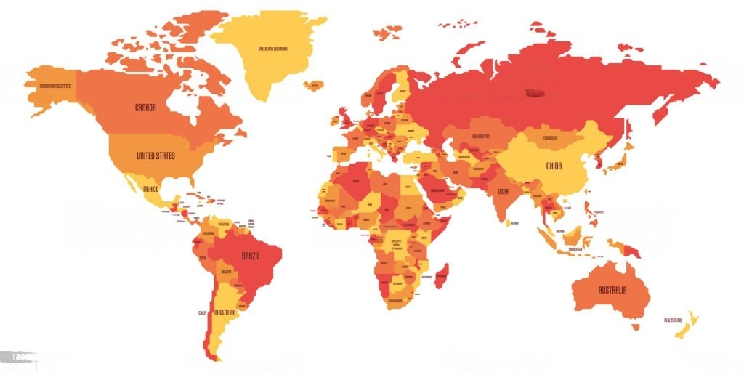

The solution is novel in the different local, regional and global markets.

Slide 52
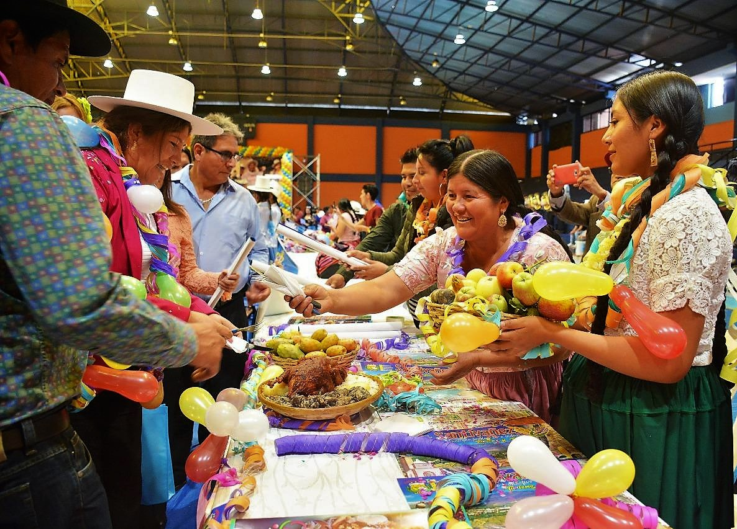
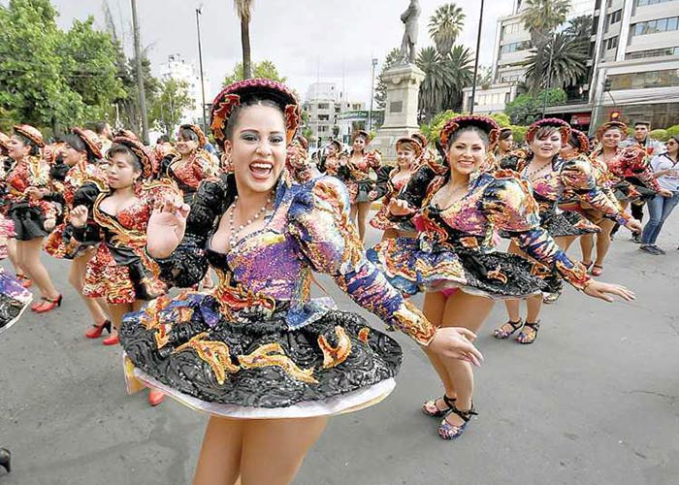
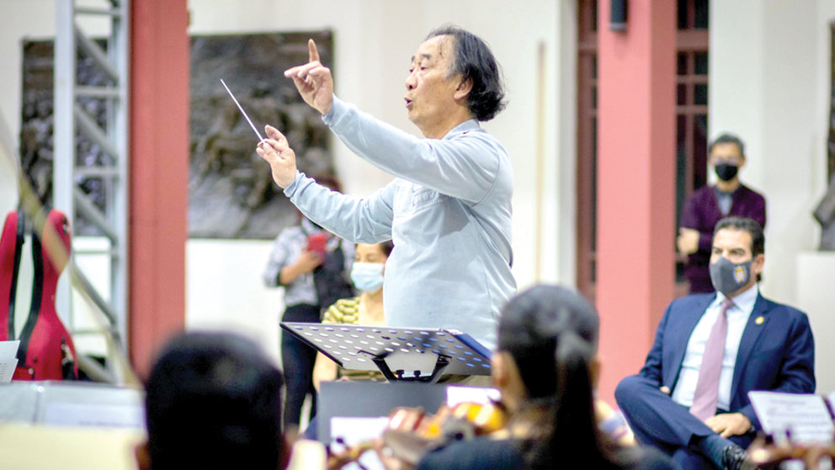
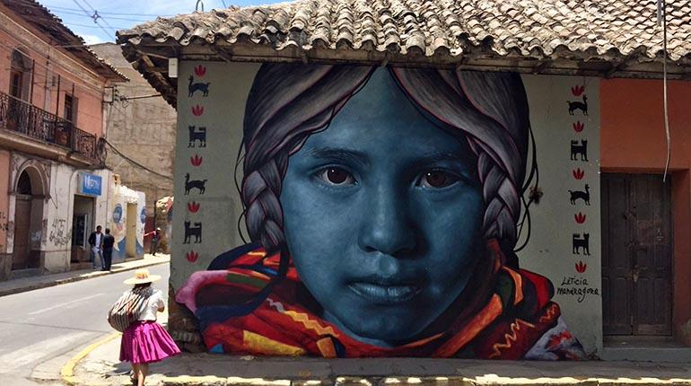
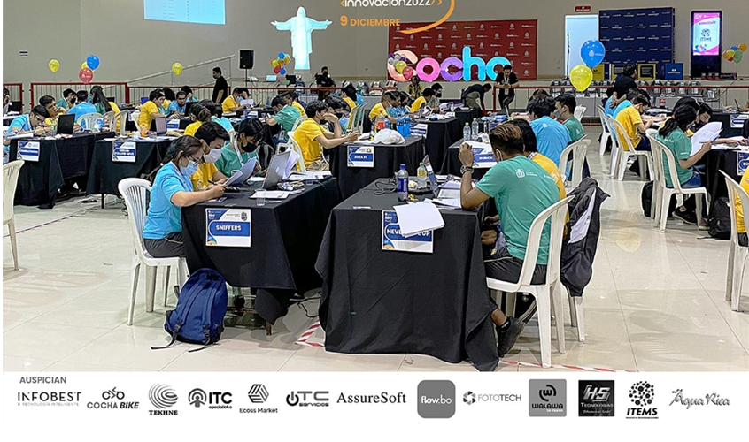


Slide 53
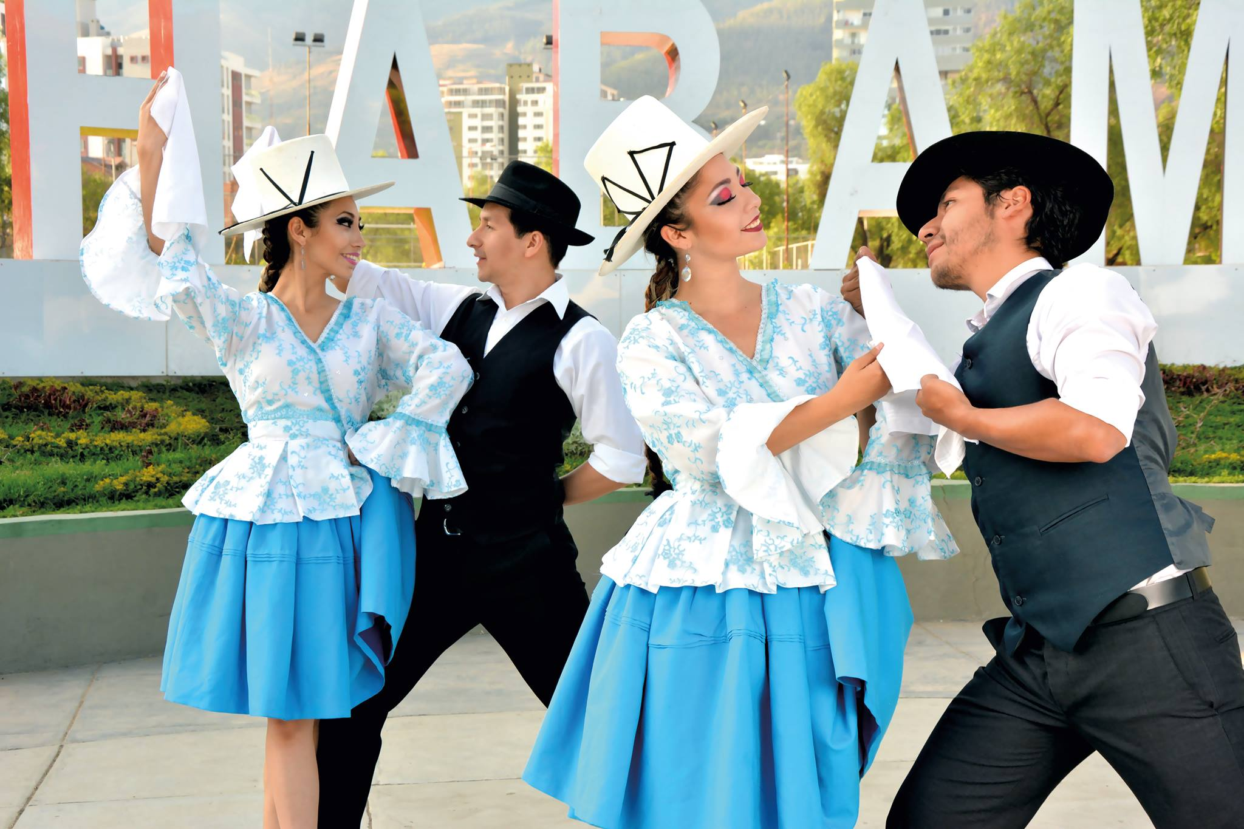
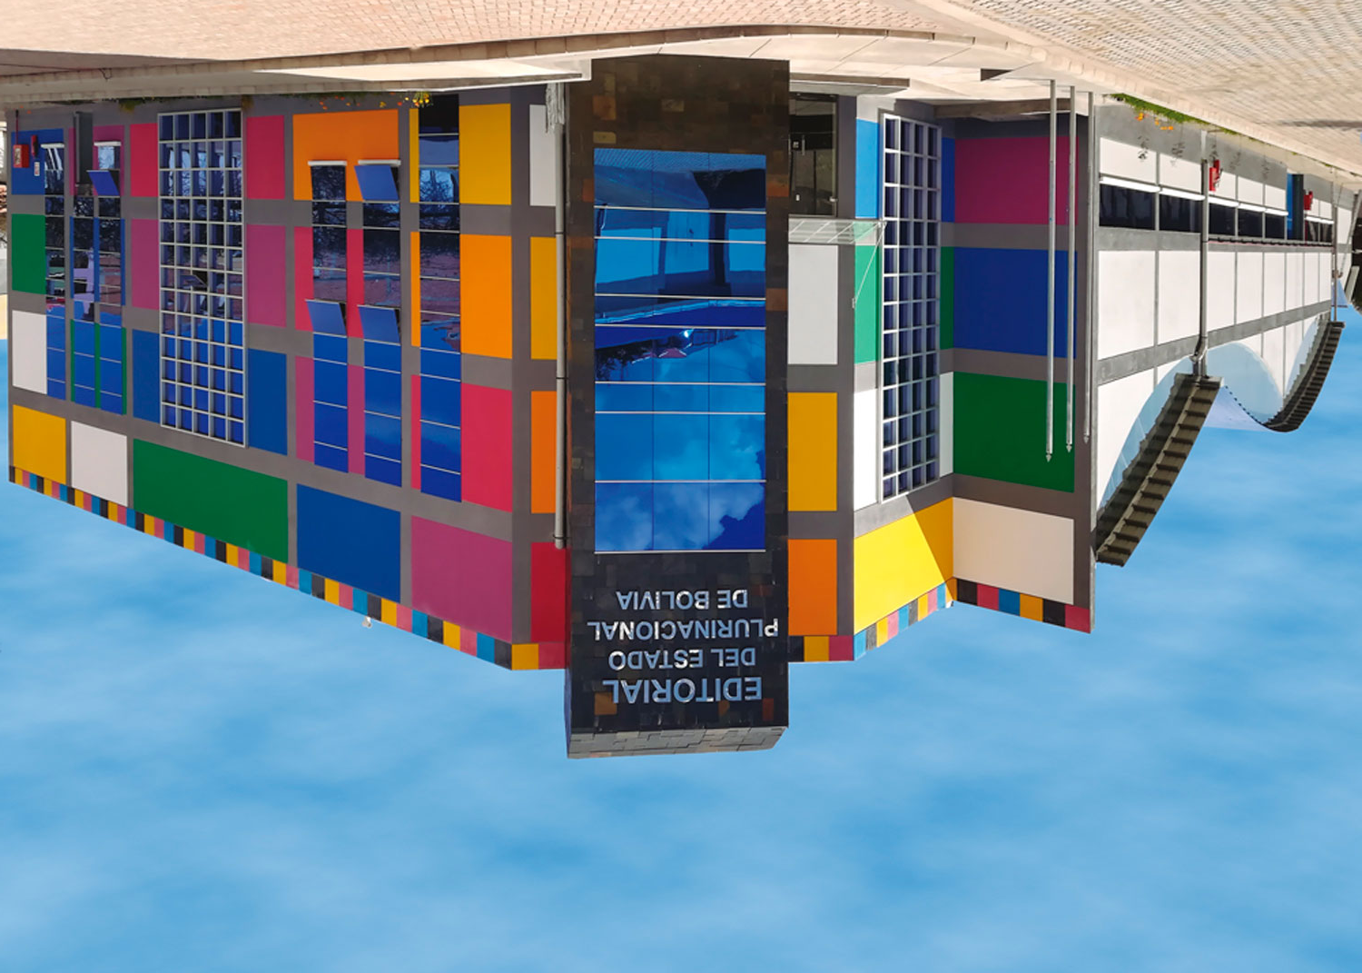
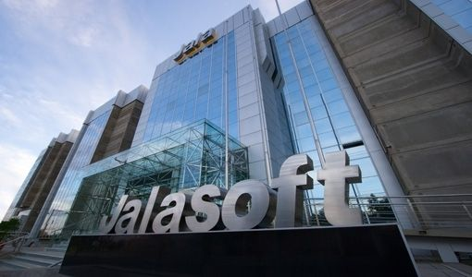
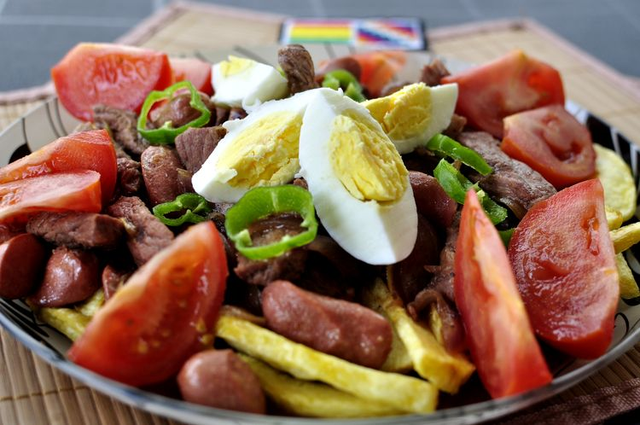
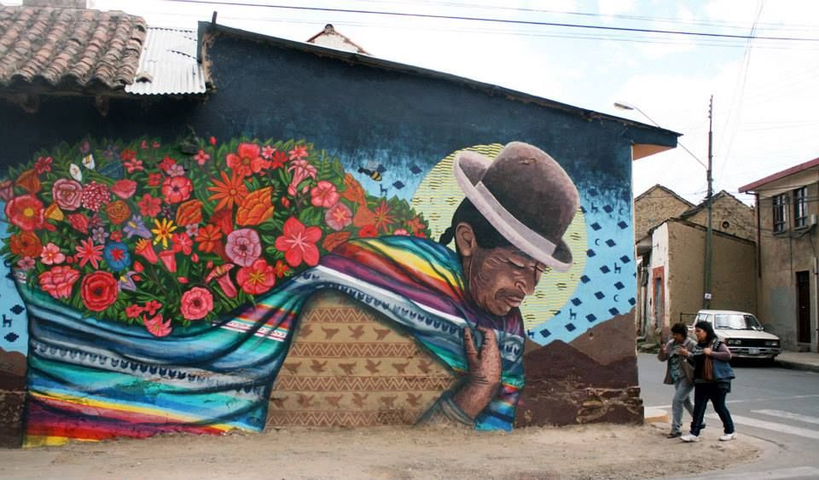
DANCE
EDITORIAL
TECHNOLOGY
GASTRONOMY
ART
MUSIC

Slide 54


Slide 55


Would you like to arrange this bike with us??? Join us ☺!!!
Looking for PARTNERS

Slide 56

Produced by:
With the support of:
HUB Univalle
Thank you!!!

Slide 57
Some evidences about detected symptoms:
Orange Economy
Environmental pollution
Gender Violence
https://activosbolivia.com/censo-de-la-economia-naranja-se-amplia-hacia-la-region-metropolitana-de-cochabamba/
https://www.la-razon.com/economia/2022/12/01/la-economia-naranja-gana-terreno-en-cochabamba/
https://www.opinion.com.bo/articulo/cultura/estudio-gastronomia-mujeres-lideran-economia-creativa-pais/20220331224952861191.html
http://www.coordinadoradelamujer.org.bo/web/index.php/destacados/306
http://www.coordinadoradelamujer.org.bo/web/index.php/destacados/314
http://www.coordinadoradelamujer.org.bo/web/index.php/destacados/304
http://www.coordinadoradelamujer.org.bo/web/index.php/buscar/all?buscar=violencia
https://gaiapacha.org/contaminacion-atmosferica-en-cochabamba/#:~:text=La%20contaminaci%C3%B3n%20del%20aire%20representa,lo%20recomendado%20por%20la%20OMS.

Slide 58
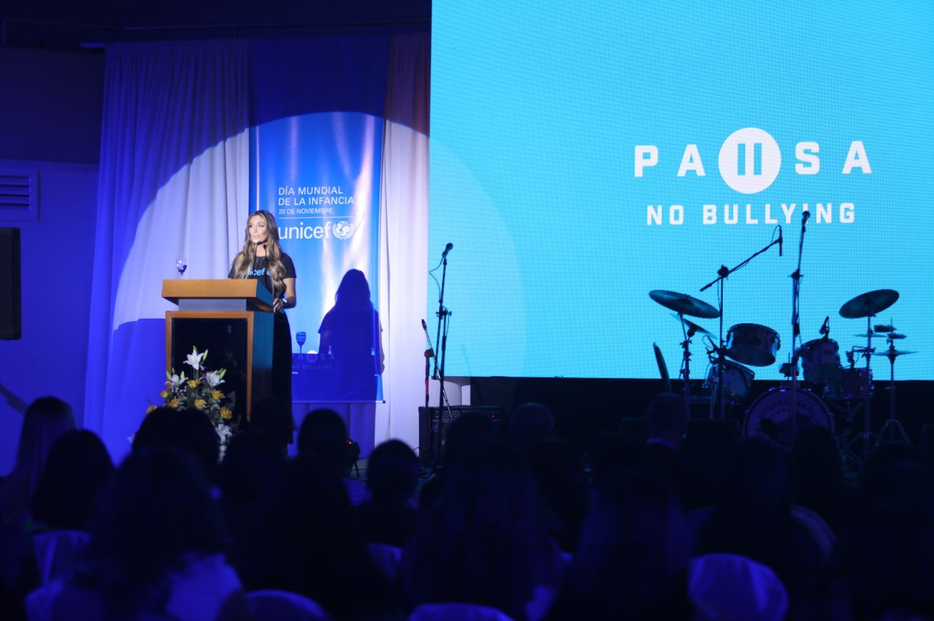
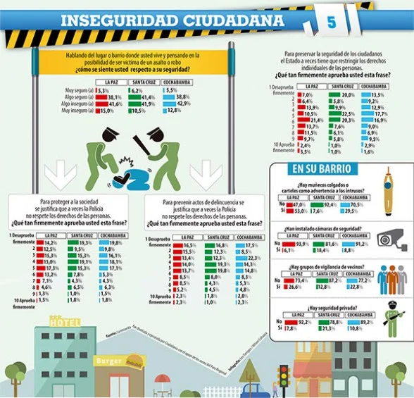
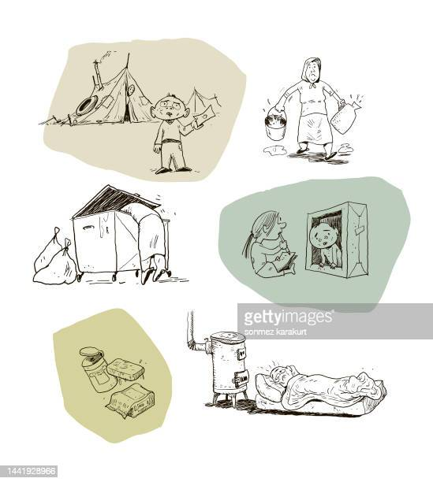
Bullying
Citizen Insecurity
Lines of Poverty and Extreme Poverty
https://www.abi.bo/index.php/noticias/sociedad/30224-unicef-revela-que-14-de-ninos-acosados-callan-gobierno-avanza-en-garantizar-educacion-libre-de-violencia
https://ceresbolivia.org/2015/09/foro-regional-mas-de-la-mitad-siente-inseguridad-ciudadana/
https://www.ine.gob.bo/index.php/encuesta-de-hogares-seguridad/
ile:///C:/Users/DELL/Downloads/01.NOTA%20TECNICA%20LP01_2020.pdf

Slide 59
A3.2. The root cause of our target social issues
¿Why?
Because the orange approach is seen as a recreational and spending activity.
¿Why?
Because cultural and creative industries are not recognized as an economic activity.
¿Why?
Because the contribution of the orange economy to Bolivian PIB is not visible.
¿Why?
Because there is little knowledge about what the Orange Economy is and its benefits.
¿Why?
Because there is no education about the importance of the orange economy in the generation of wealth, jobs and, of course, social impact.

Slide 61
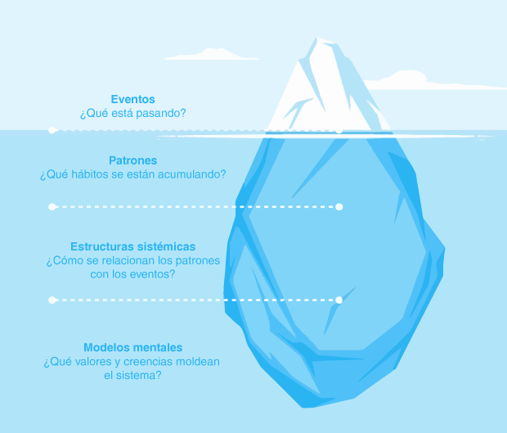
EVENTOS
Limitada aceptación y adaptación al Enfoque Naranja en Empresas Tradicionales.
PATRONES/TENDENCIAS
Resistencia al cambio e innovación en el enfoque empresarial tradicional
ESTRUCTURAS SUBYACENTES
Paradigmas arraigados en las empresas acerca del tiempo y el gasto que incurre el adoptar nuevos enfoques
MODELOS MENTALES
La economía naranja es más un gasto que una inversión.
La economía naranja es un pasatiempo.

Slide 62
Problem 2: Few Effective Education about "Acceptance of Differences", different ways of think, be, live and do.
¿Why?
Porque se socializa al respecto de manera superficial, sólo en teoría, la verdadera educación engloba teoría y aplicabilidad en la vida diaria.
¿Why?
Porque es el patrón con el cual las personas se han acostumbrado a vivir, ya sea de manera consciente o inconsciente.
¿Why?
Porque los modelos educativos, empresariales, sociales, están basados en estudios respecto a cómo es y se desenvuelve la mayoría, pero la mayoría no son todos.
Porque fue la manera más fácil, con optimización de tiempo, recursos económicos y financieros que las personas encontraron para llevar una vida en sociedad relativamente armónica, pero olvidaron la esencia de una vida inclusiva: TODOS, es diferente de: la MAYORÍA.
¿Why?
¿Why?
Porque el conocimiento no estaba tan desarrollado, limitada empatía, visión, y porque los seres humanos, son seres complejos.

Slide 63


Slide 64
EVENTOS
“Poca Educación Efectiva acerca de “Aceptación a las Diferencias”, diferentes formas de pensar, ser, vivir, hacer”.
PATRONES/TENDENCIAS
Seguir el comportamiento que adopta la mayoría Adoptar el comportamiento más fácil y cómodo
ESTRUCTURAS SUBYACENTES
Necesidad de adaptación
Carencia de empatía
MODELOS MENTALES
Ser reconocido, mucho dinero y títulos son lo más importante.
La vida es una competencia donde lo único que importa es que tú ganes.
El fin justifica los medios asumidos como una regla y no como una excepción a la regla en casos de extrema necesidad.

